Slide 1

Hospital ​Teams Panel:
Sharing Approaches that make a Difference

Slide 2
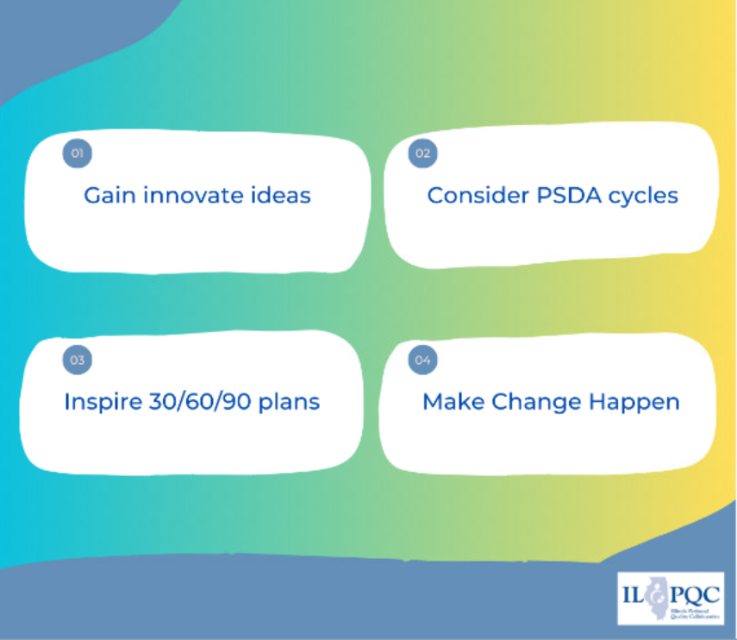

​
Planting Seeds for Change:
Teams Panel
Collaborative Learning
Notes:
I love the growing picture!! That is perfect.
I wonder if to many words and to small for the rest of it? Maybe shorten to:
Gain innovative ideas
Consider PDSA Cycles
Inspire 30/60/90 plans
Make change happen
"Plant a seed for Change"

Slide 3
Birth Equity

Slide 4








Birth Equity Initiative Aim
Birth Equity Key Strategies
Screen all patients for social determinants of health and link to needed services​
Standardize postpartum safety education and schedule early postpartum visit​
Optimize race and ethnicity data collection and review stratified data ​
By December 2023, ≥ 70% of participating hospitals will have implemented all key strategies
Engage patients and community members for quality improvement input ​
Implicit bias & respectful care training for providers, nurses, other staff​
Share respectful care practices and survey patients on their care experience​

Slide 5
BE Teams Panel
Laura Smith, BSN, RNC-OB, C-EFM
  Perinatal Educator, Mercyhealth Javon Bea-Riverside, Rockford, IL
Elena Jenkins, BSN, RN
  Nurse Manager - Labor & Delivery, SSM St. Mary’s Hospital, St. Louis, MO
Notes:
Alana and Aleena to introduce BE team panel

Slide 6

Laura Smith, BSN, RNC-OB, C-EFM
Perinatal Educator
Mercyhealth Javon Bea-Riverside
Rockford, IL

Slide 7

Birth Equity
Laura Smith, OB Educator

Slide 8
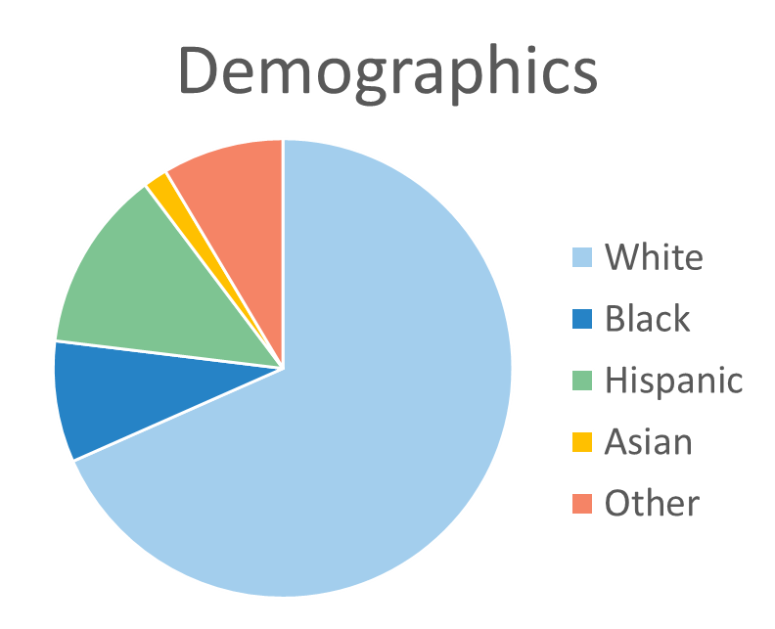
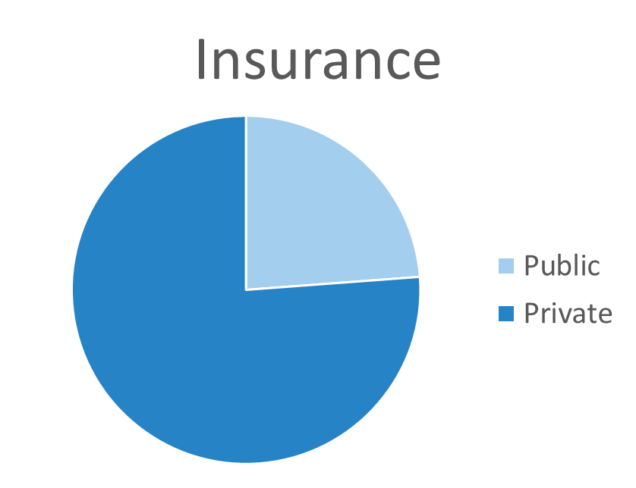
Hospital Demographics
Mercyhealth Javon Bea Hospital is a level 3 Regional Perinatal Center located in Rockford, in Northern IL
Approx. 900 deliveries annually

Slide 9
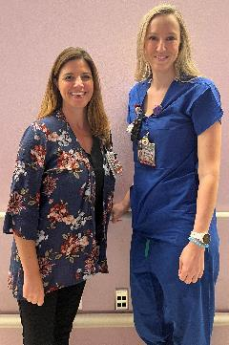
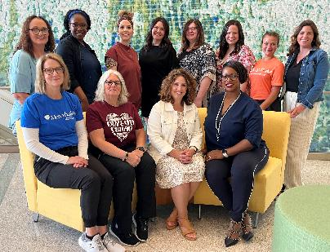
Our BE Journey
BE Team Members:
Team Lead: Laura Smith
Physician Lead: Dr. Macaulay, Chair of OB
Nurse Lead: Jennifer Dicaro
Director of Perinatal Services: Danielle Muskovin
Manager of OB Services: Jen Wessel
Manager of outpatient OB clinics: Jessica Black
Chair of MFM: Dr. Rogers
CNM: Alicia Huntley
Resident Physicians: Dr. Eid & Dr. Shergill
RNs from inpatient and outpatient services
Case Management: Nora Kopping
IT specialist: Vanessa Ortiz
OB Nurse Navigator: Kelly Sprayberry

Slide 10
Our BE Journey
QI Timeline:
Launched in April 2022
1st step – standardize postpartum discharge education to include post-birth warning signs & build reports to stratify data according to race and insurance.
2nd step – build resource mapping tool and staff diversity education
3rd step – build SDOH screening tool and PREM survey
Launched SDOH screening, linkage to resources, and PREM survey in Dec. 2022
Aftershock event in January 2023
Next goal is to host respectful care breakfast in June to engage the community in our QI efforts.
April 2022 BE Project Launch
May 2022 Key Stakeholders Goal Planning
July 2022
Goal Achieved – 100% Discharge education: Post-Birth Warning Signs
July 2022 Launch Diversity Education
December 2022 SDOH screening and PREM survey Go Live
June 2022 Resource mapping tool complete
November 2022 Staff education on SDOH screening & Linkage to Resources
January 2023 Regional Aftershock Viewing Event
January 2023 100% staff & physician completed diversity training
April 2023 Aftershock viewing event with medical students
May 2023 Community outreach- Rockford against Racism
Notes:
Dates --> event format

Slide 11

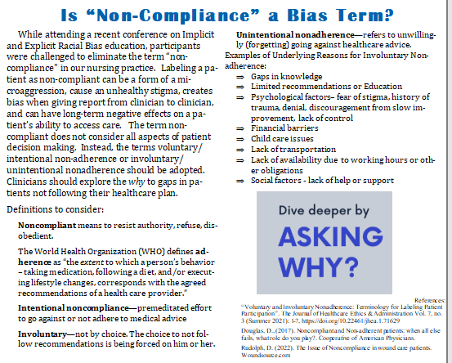
Respectful Care Buy-In
Staff Education – multiple approaches
  Case reviews
  Monthly newsletter
  Staff meetings
  Sharing patient feedback
  Safety huddles
  Survey results

Slide 12




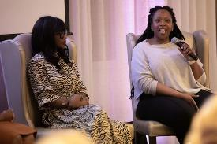
Respectful Care Buy-In
Aftershock Viewing Event

Slide 13

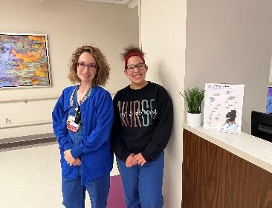
Sharing Respectful Care Practices
Respectful Care Practices Posters
Patient Folders
Nursing Education
Commitments
Nursing Validations
Prenatal classes

Slide 14
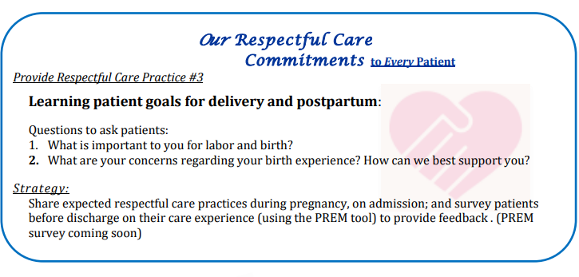
Respectful Care Practices Monthly Education
RCP of the Month
  Strategies presented in our monthly unit newsletter & posted on the unit

Slide 15


BE Apparel to promote RCP

Slide 16
PREM Survey Education: providing respectful care for every patient
Rate how strongly you agree or disagree with the following statements about your care.
I could take part in decisions about my care​
“I want you to feel included in your care.” ​
​
I could ask questions about my care.​
"I want you to feel comfortable asking questions about your care throughout your stay; please feel free to ask any questions as they come up“​
​
My healthcare choices were respected by the healthcare team. ​
"I want to ensure that you feel your choices are respected while we care for you. What things are important to you during your birth experience and hospital stay?”
My healthcare team understood my background, home life, and health history, and communicated well with each other.
"Your care team wants to ensure we understand your background, home life, and health history. This is one way we can provide better care for you and communicate effectively with each other“
I felt pressured by the team into accepting care I did not want or did not understand.
“I want to ensure you understand the plan and agree to proceed.”
When the health care team could not meet my wishes, they explained why. ​
“ I know this goes against what you wanted, but I want to explain why the treatment plan has changed.”
Notes:
*goal is to make respectful care for every patient; we are giving these scripts to nurse/staff to be intentional with our RCPs.
Two columns, two boxes, two separate

Slide 17
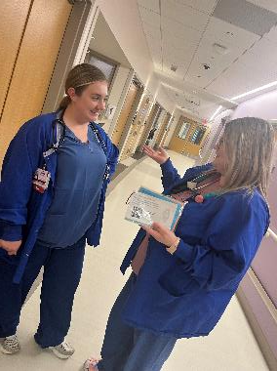
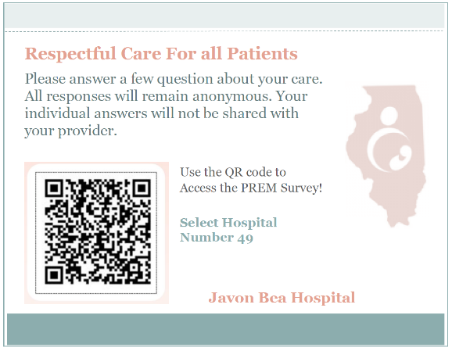
PREM Survey Implementation
Laminated cards
Staff scripting
Discharge checklist

Slide 18


PREM Scripting
PREM Survey Drop-Off
We are working to ensure all of our patients are treated with respect and dignity.
This survey, focused on Respectful Care, is completely anonymous and individual responses will not be shared with the team.
Scan this QR code, select hospital #49 at the top, and answer a few questions to let us know if we exceeded your expectations.
I am going to step-out out of the room to gather your discharge gifts, and allow you a few minutes to complete the questionnaire.

Slide 19
PREM Success

Slide 20
Future Opportunities
Track decline rate, add to documentation
Survey nurses on patient experience with the PREM
Utilize PREM results to drive focus of future respectful care education
Lesson learned of benefit of early implementation
Notes:
*decline rate, instead of refusing -note to Laura

Slide 21

Elena Jenkins, BSN, RN
Nurse Manager-Labor & Delivery
SSM St. Mary’s Hospital- St. Louis, MO

Slide 22



The Birth Equity Journey: Hospital Level
Implementation at
St Mary’s Hospital STL
Elena Jenkins BSN, RN Nurse Manager
Team Lead, Birth Equity Initiative

Slide 23

St Mary’s Hospital St Louis:
2600 Deliveries/year
Level 3 Facility, Administrative Perinatal Center for Southern IL
Antepartum, Labor/Delivery, Postpartum, NICU Units
60% patients identify as Black
30% patients identify as White
66% patients covered by Medicaid
7% meet AIM/CDC SMM criteria
43% patients present with a HTN
Dx
18% patients experience PTD

Slide 24
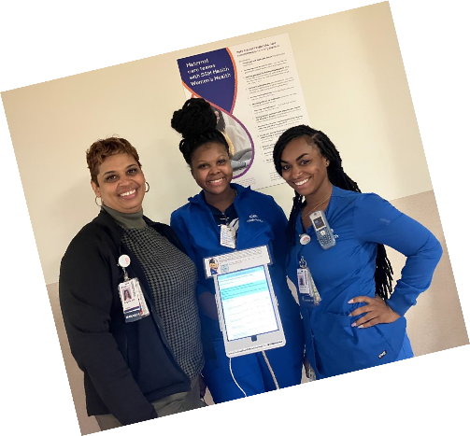
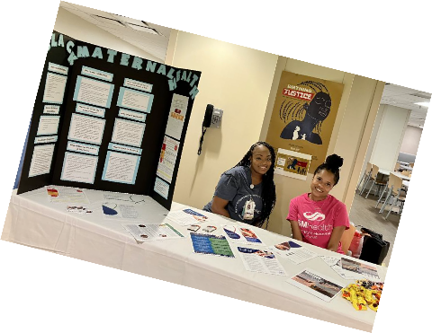
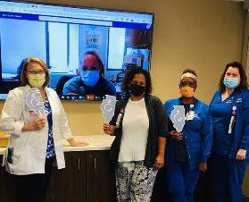
The Birth Equity Team
Members include multidisciplinary staff and management from Nursing, Community Health, SW, and Medicine in collaboration with Administration and system level Patient Experience and DEI leadership

Slide 25
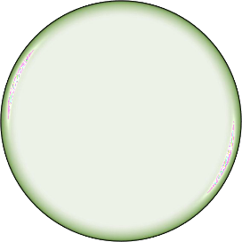
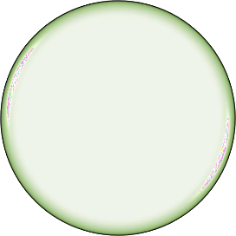
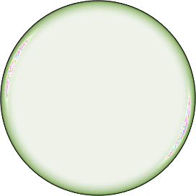
Our Birth Equity Journey
SDoH screening
and resource linkage
Patient & Community engagement
Strategies for active listening

Slide 26

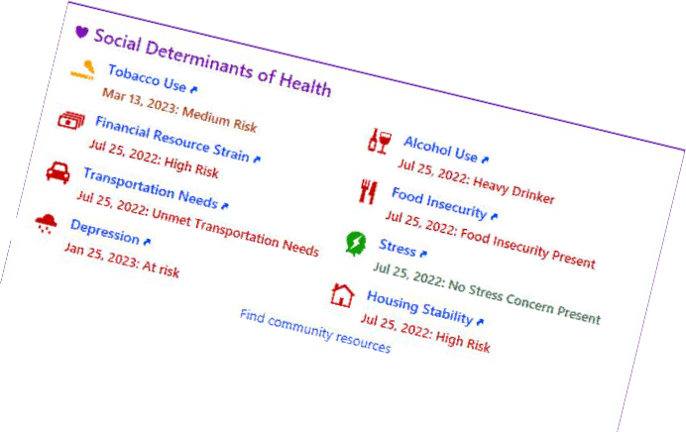
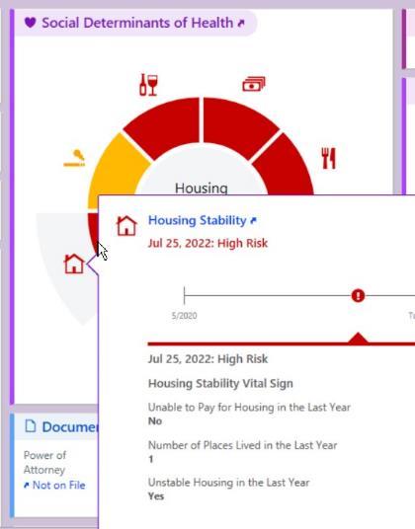


SDOH Screening

Slide 27



Putting the pieces together…
Connection to resources
Community Based
Clinic
Inpatient

Slide 28

Epic based referral to resources: live summer 2023
- Closed loop referrals
Doula Program prenatal enrollment:
Clinics
3 prenatal visits, Labor support, 3 postpartum visits
Navigation of/connections for identified needs

Slide 29
SW Consults with positive screening
Identify high needs patients:
Enroll in home visiting program (reinstating post Covid)
Access to medical/mental health, supportive health education, peer support, material support
Continuity throughout pregnancy and up to two years of infant’s life
Inpatient

Slide 30
Community Based Support
MOMs Groups
  Peer led support groups
  Mental health support
  Material support
  Multiple locations to serve various neighborhoods

Slide 31

Patient & Community Engagement
Growing partnerships with key community organizations
Participation in community events: focus on meeting patients where they are
  Feed the Babies
  MOMs Line Health Fair
  MOMs Tour

Slide 32
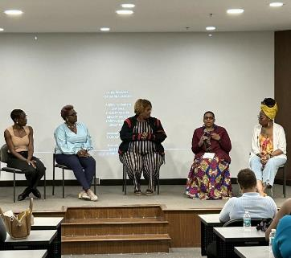
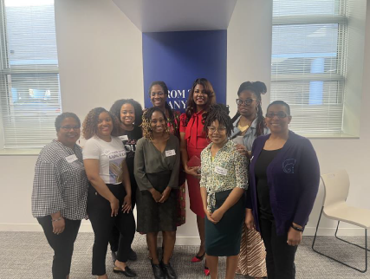
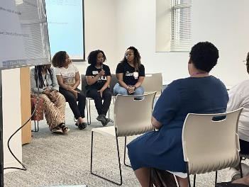
Patient & Community Engagement
Panel and community discussions: engaging feedback and lived experience
Doula Connection
Birthing Justice
11

Slide 33
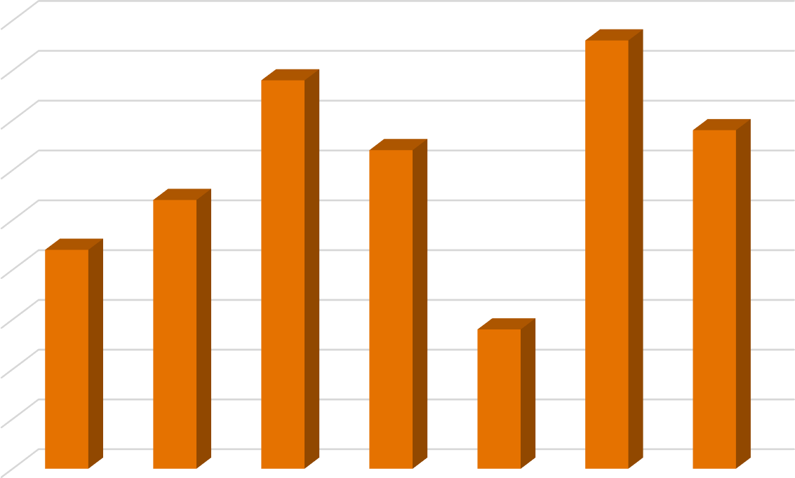
Patient Feedback: Analyzing the PREM Survey
PREM Survey:
Participation
Introduced in June 2022
No results first 4 months
Revamp in October 2022
Significant participation October 2022 - present
90
80
70
60
March 2023 % Completion:
48%
50
40
30
20
10
0
Oct-22
Nov-22
Dec-22
Jan-23
Feb-23
Mar-23
Apr-23
Participation

Slide 34
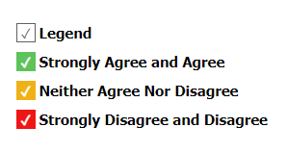
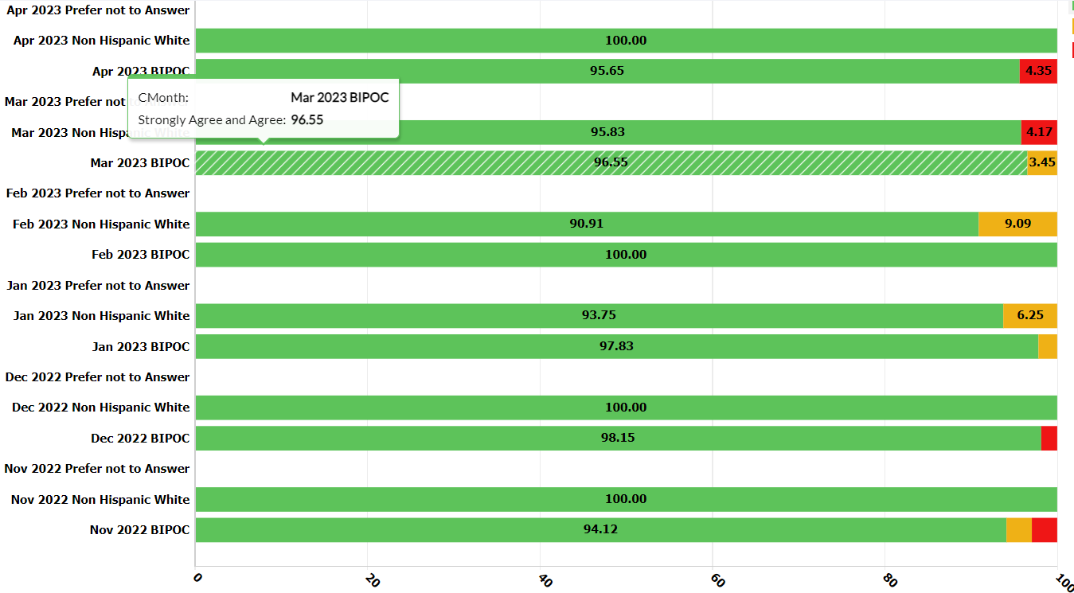
Percent of birthing persons who report they could take part in decisions in their care

Slide 35
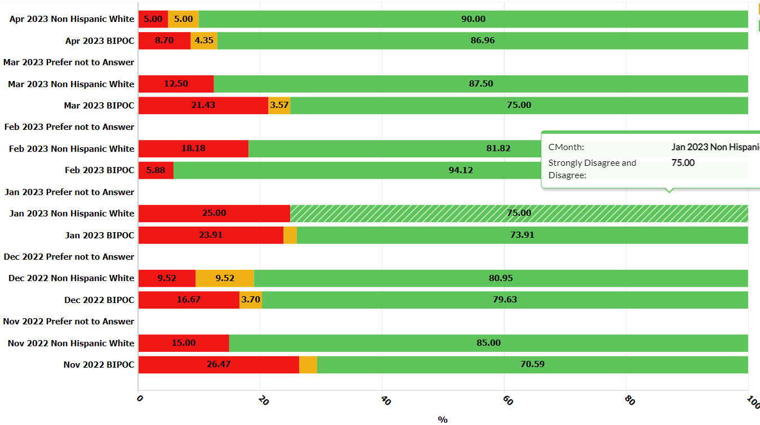
Percent of birthing persons who report felt pressured by the health care team into accepting care I
did not want or did not understand

Slide 36
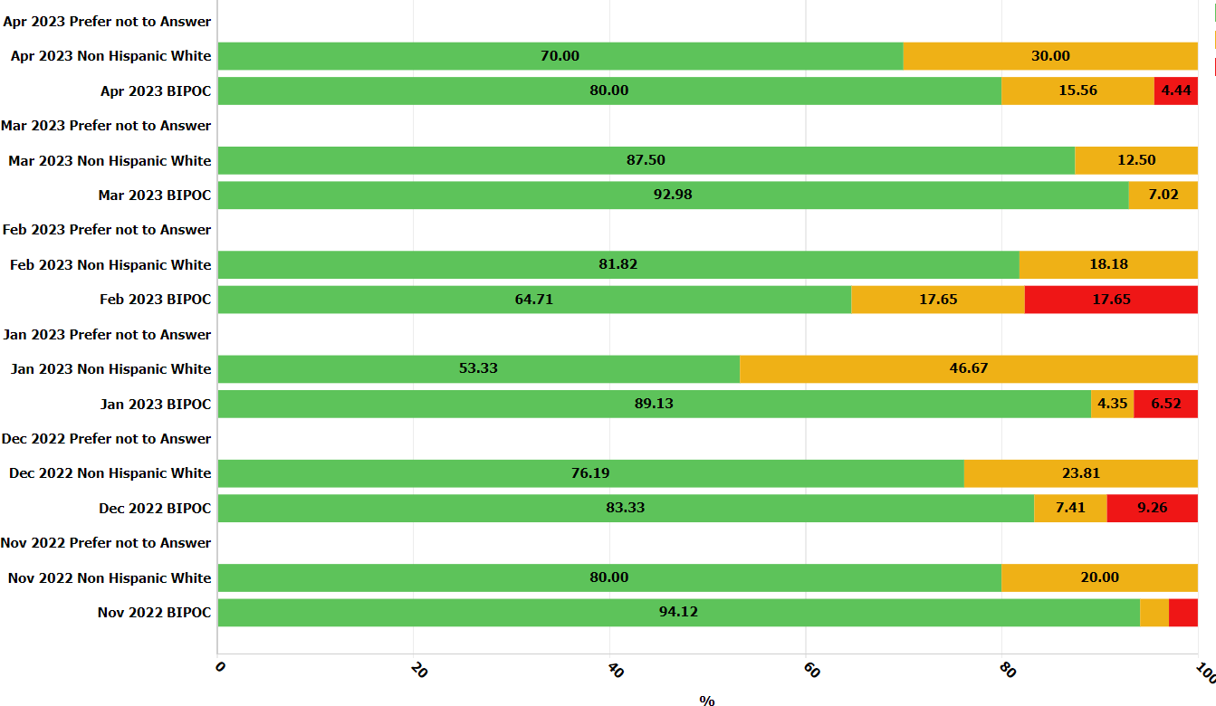
Percent of birthing persons who report when the health care team could not meet my wishes, they explained why
Notes:
*note the red is all in the BIPOC group​

Slide 37
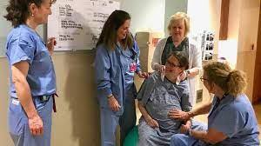
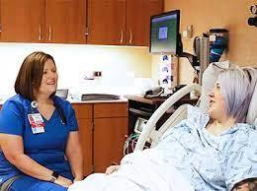
Patient Feedback: Analyzing the PREM Survey
Areas of Opportunity Identified: Communication and Shared Decision Making
Action Strategies:
  Commit to Sit
  Team Discussions

Slide 38

“Equality is leaving the door open for anyone who has the means to approach it; equity is ensuring there is a pathway to that door for those who need
it.”
–Caroline Belden (Writer, ‘The Inclusion
Solution’)

Slide 39

Thank You
Elena Jenkins
Nurse Manager, Labor and Delivery Elena.jenkins@ssmhealth.com

Slide 40
Promoting Vaginal Birth (PVB)

Slide 41
PVB Teams Panel
Abbe Kordik, MD, FACOG
  Executive Medical Director of the Family Birth Center and Chief of Obstetric Quality, University of Chicago Medicine, Chicago, IL
Anna Marzano, BSN, RN, C-EFM, CBC
  Perinatal Services Quality Specialist, University of Chicago Medicine, Chicago IL
Danielle Wittig, BSN, RN
  Perinatal Quality Nurse, FHN Memorial Hospital, Freeport, IL
Keri Schubert, BSN, RNC-MNN
  Perinatal Educator, FHN Memorial Hospital, Freeport, IL
Notes:
Alana and Ellie to introduce PVB team panel

Slide 42
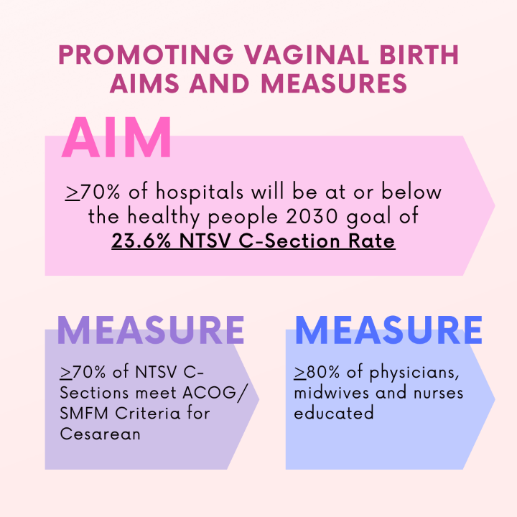
PVB Aims and Measures

Slide 43







PVB Key Strategies for Culture Change
Clinical Team Education and Buy-in
Delivery Decision Huddles and Checklist
Sharing Unblinded Provider-level NTSV C-Section Rates
Educating patients and shared decision making
Fallout Reviews of cases not meeting ACOG/SMFM Criteria
Labor Management Support

Slide 44

Abbe Kordik, MD, FACOG
Executive Medical Director of the Family Birth Center and
Chief of Obstetric Quality
Anna Marzano, BSN, RN, CBC, C-EFM
Perinatal Services Quality Specialist
University of Chicago Medicine, Chicago IL

Slide 45
Promoting Vaginal Birth
Staff Engagement
UChicago Family Birth Center
Anna Marzano, BSN, RN, CBC, C-EFM
Abbe Kordik, MD, FACOG
Notes:
Kordik

Slide 46
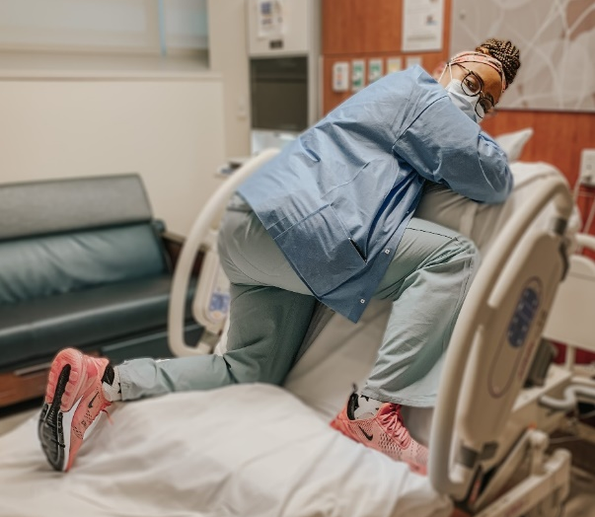
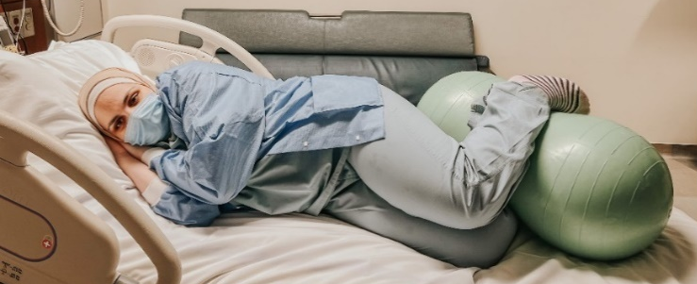
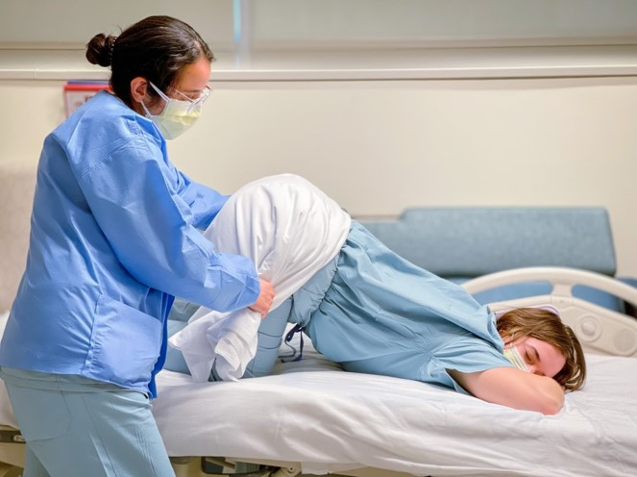
Unit Engagement
Provider Engagement
  Focus at all OB provider meetings
  Physician champions: engaged laborist attendings most frequently on unit
  Resident shadowing program
Nursing Engagement
  Adjusted EMR documentation to prioritize recording labor management techniques
  Encourage Spinning Babies & ILPQC
  Workshops attendance
Unit Based Council Project:
  Created materials featuring our nurses
    Bulletin board refresh
    Share strategies during staff meetings
  QR codes link to “How-to” videos
Notes:
Anna/Kordik

Slide 47
Incorporating Technology
Notes:
Anna

Slide 48
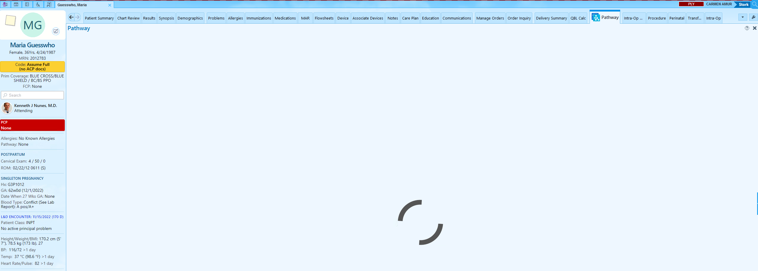
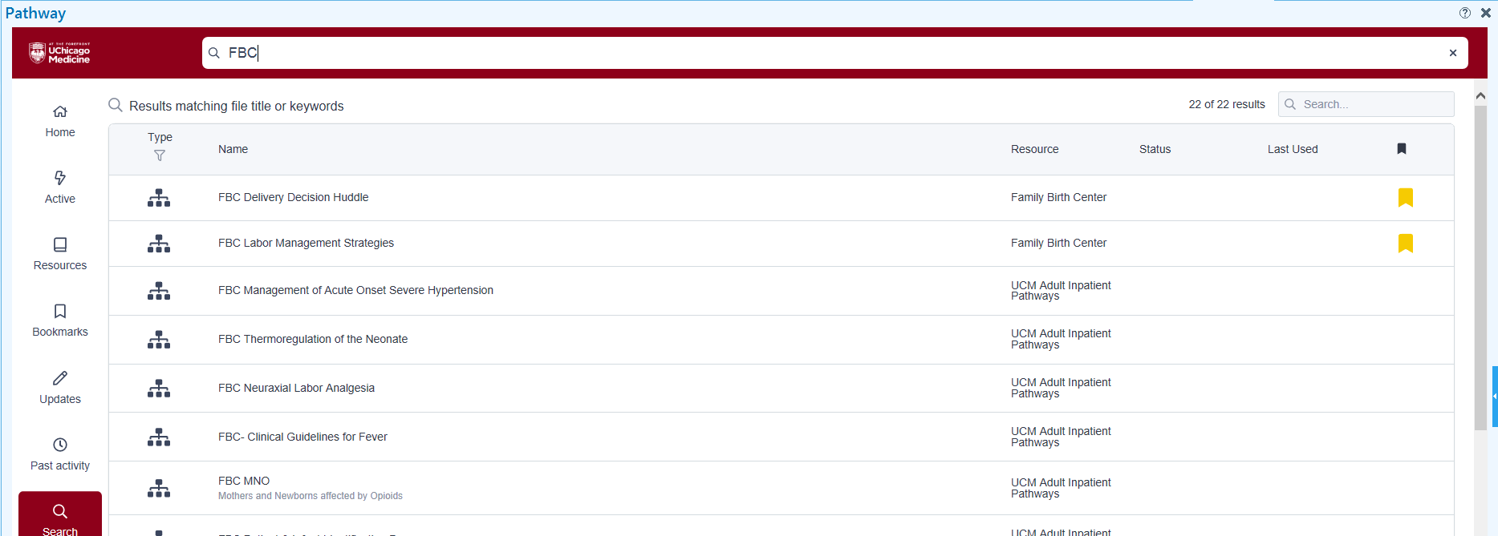
Pathways
Interactive algorithms located within the EMR
  Include links to reference materials, protocols, photos, and guidelines to assist in clinical management
  Accessible at bedside
  Content available to nurses, providers, and patients for real-time education
Notes:
Anna

Slide 49
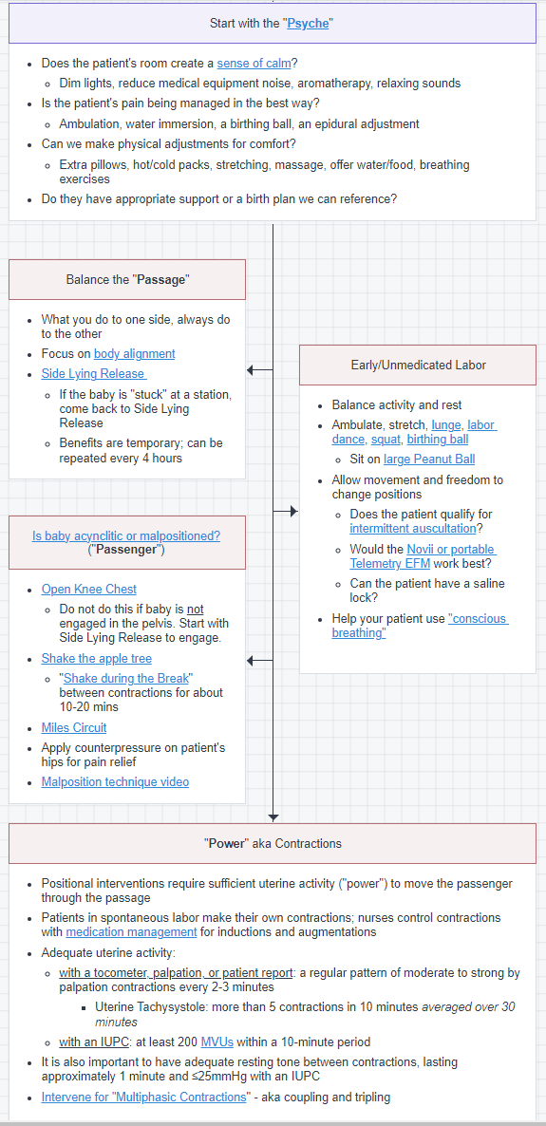
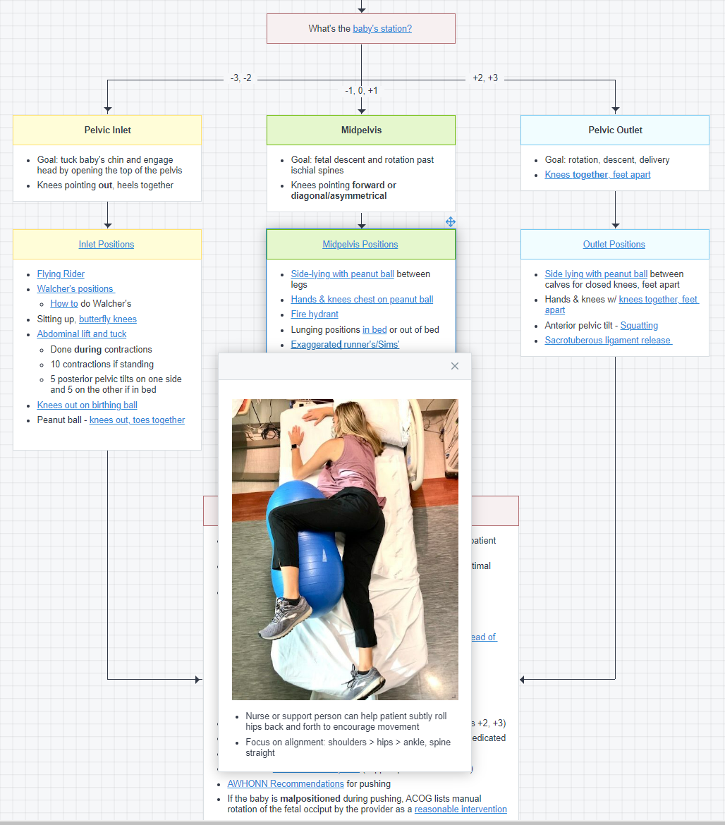
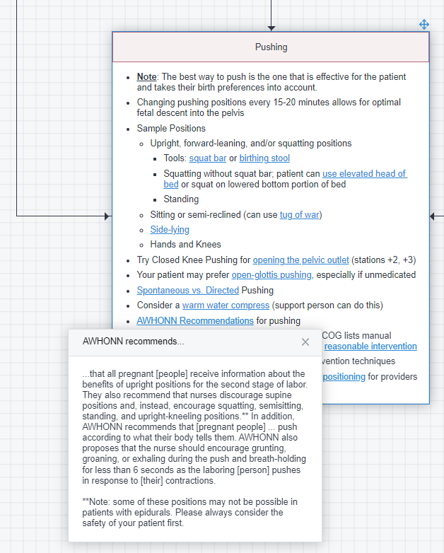
Labor Management Strategies
Evidence-based content created by UCM QI team of providers and nurses
Walks staff and patient through a labor course using the 4Ps of labor
  Psyche, Passage, Passenger, Power
  Labor environment, early unmedicated labor, Pitocin management, positioning techniques in and out of bed, and pushing techniques
Incorporated staff photos and videos to demonstrate positions
Notes:
Anna

Slide 50
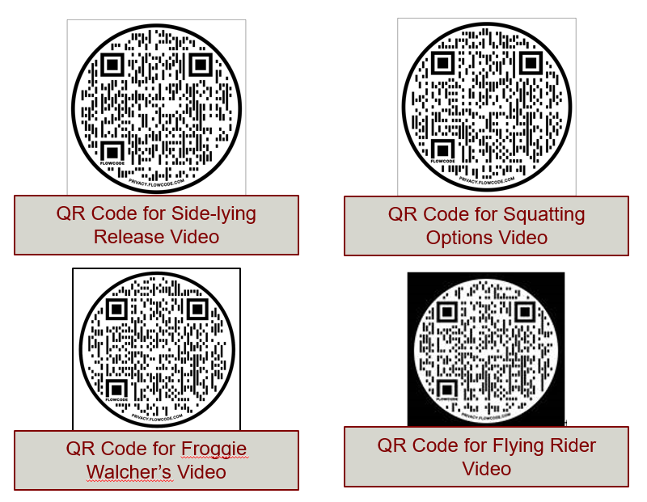
QR Codes
Demonstrate purposeful positioning techniques for staff and patients
  Easy Access via cellphone or tablet
QR Code for Froggie Walcher’s Video
Notes:
Anna

Slide 51
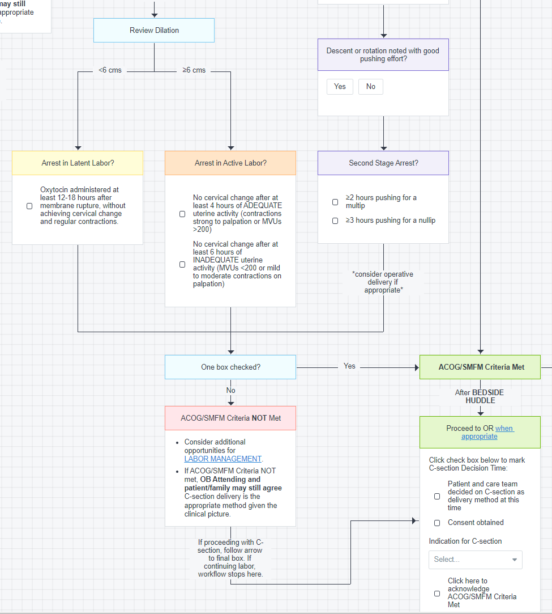
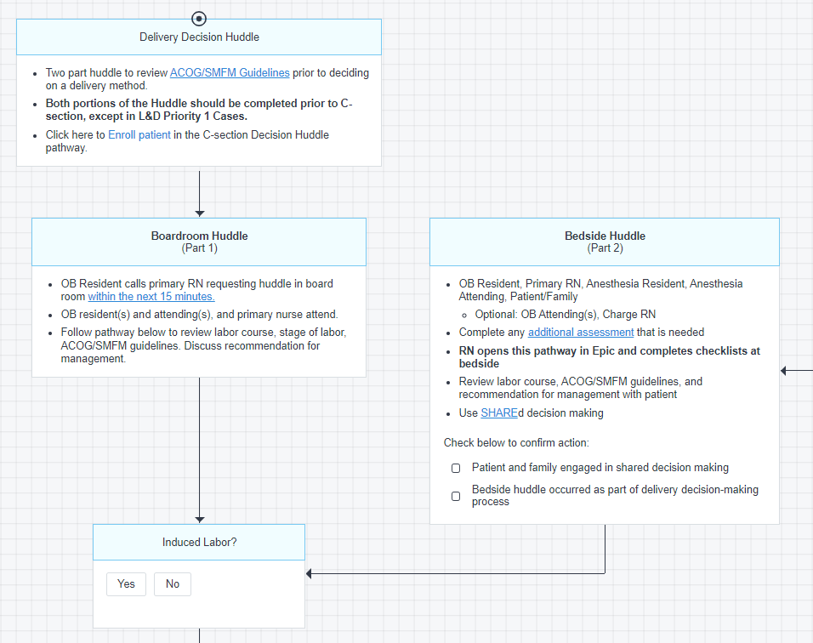
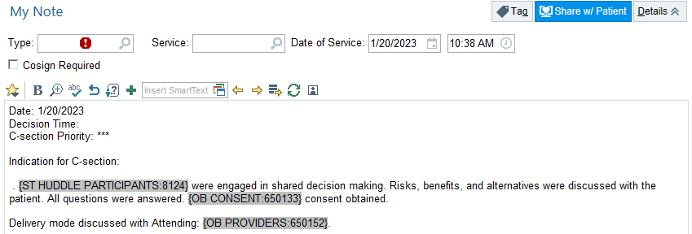
PVB Huddle
2-part huddle completed via Pathway
  Boardroom and bedside
  Incorporates other QI initiatives
    Birth Equity
    Interdisciplinary Communication
  Follows ACOG/SMFM Safe Prevention of the Primary C-section recommendations
    Links to Labor Management Pathway if criteria are not met
Pathway streamlines documentation
  Pathway checkboxes autocomplete provider note
Notes:
Kordik
Full rebrand – Promoting Vaginal Birth Huddle – Part1: Labor Management Huddle in boardroom, Part 2: Consent/Delivery Decision Huddle at bedisde

Slide 52
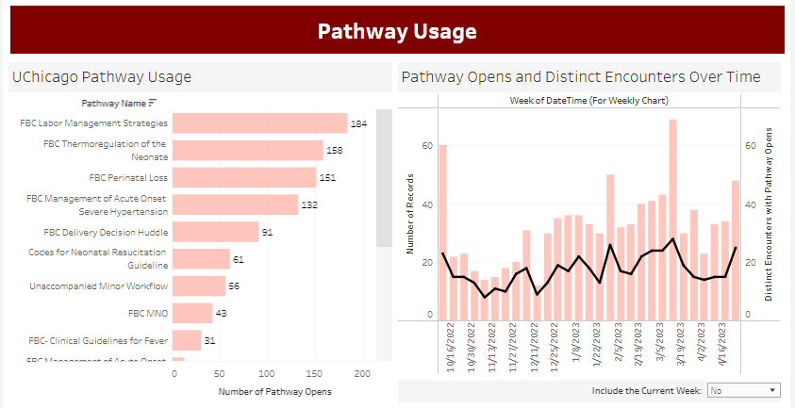
Pathway Usage
Labor Management Strategies most frequently used resource Pathway
Notes:
Kordik

Slide 53
Data Sharing & Usage
Notes:
Kordik

Slide 54
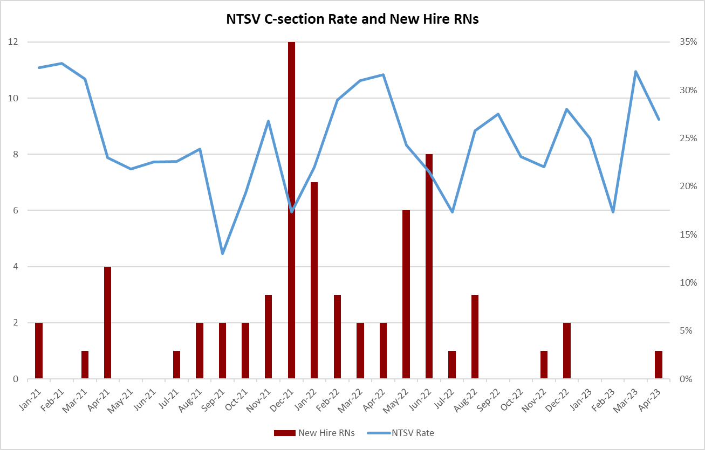
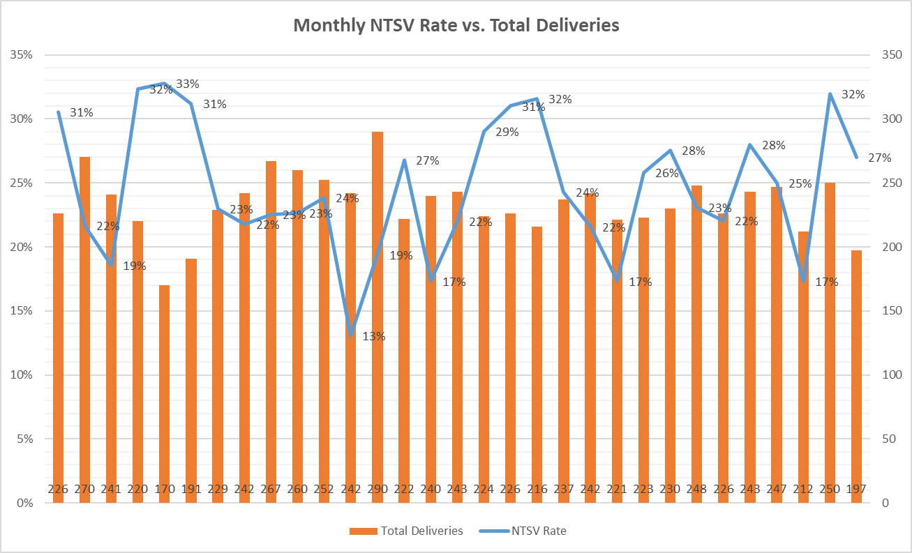
Data Collection, Review, Sharing
Notes:
Anna

Slide 55
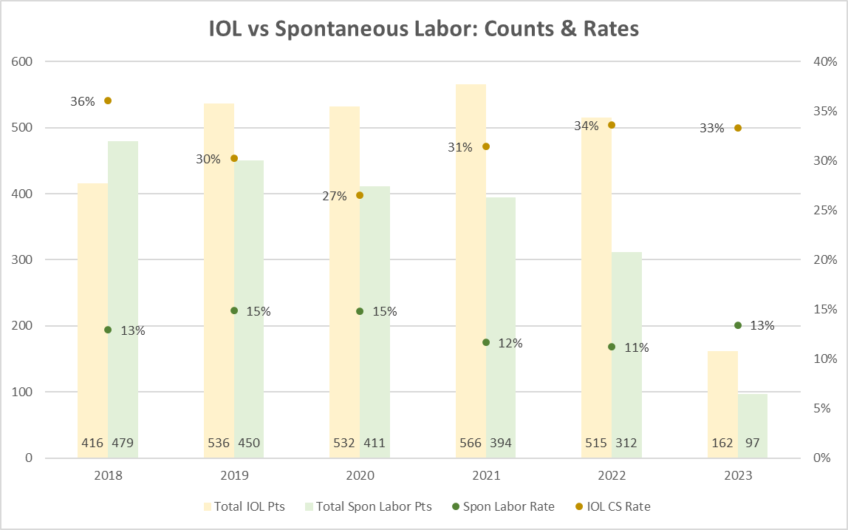
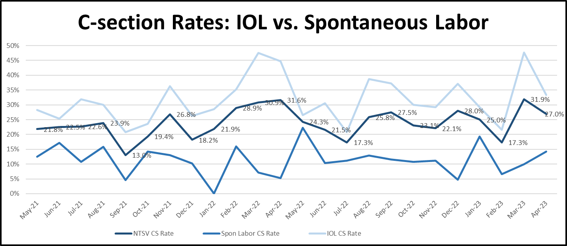
Inductions
Notes:
Anna

Slide 56
Medication Management for IOLs
Focus on Pitocin titration education
  Titration based on MVUs if using IUPC
  Monthly fallout audits include Pitocin reviews for failed IOLs w/ 1:1 coaching
  Coming soon… Provider/nurse partnership to champion education points during team huddles
Adjusting the Pitocin Policy
  Original Policy: Pitocin administration started at 1 mu/min
  Audits revealed nurses like to titrate on even numbers!
  Adjustment of policy and order to begin titration at 2 mu/min
  Live May 2023
Literature review for high dose oxytocin titration
Does your hospital use a high dose or low dose Pitocin regimen?
Notes:
Kordik

Slide 57
Provider Scorecard
Reviews of unit and personal rates
  Mentorship opportunities
Notes:
Kordik

Slide 58
Thank you!
Notes:
Kordik

Slide 59

Danielle Wittig, BSN, RN
Perinatal Quality Nurse
Keri Schubert, BSN, RNC-MNN
Perinatal Educator
FHN Memorial Hospital, Freeport, IL
Notes:
Titles
Map of State, with the town with a star

Slide 60

Promoting Vaginal Birth
FHN Memorial Hospital
Keri Schubert, BSN, RNC-MNN & Danielle Wittig, BSN, RN

Slide 61
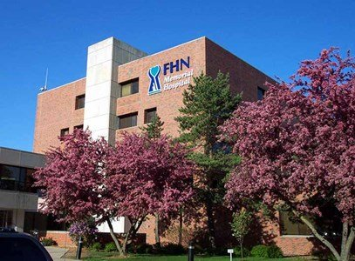
100 Bed Level 2 Rural Hospital, located in Northwestern Illinois
250 Deliveries Per Year
7 LDRP Rooms
2 Triage Rooms
1 OR Suite
1Recovery Room
3 Gyne Rooms

Slide 62
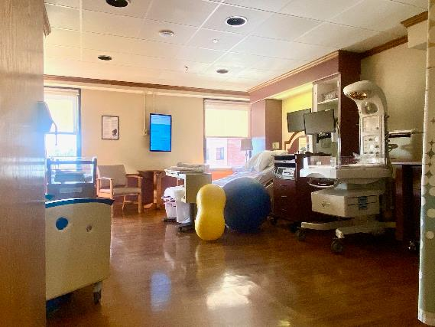
5 In-House Laborist Providers
18 Staff Nurses
2 Patient Care Technicians
1 OB/GYN office
  1 OB/GYN Provider
  2 Women’s Health Nurse Practitioners
Notes:
This is an example of one of our beautiful LDRP rooms. We have peanut balls of numerous sizes and birthing balls for our patients.

Slide 63
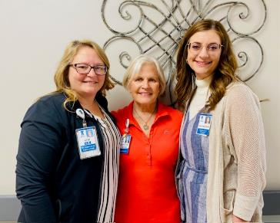

Dr. Karenmarie Meyer-PVB Provider Champion
Danielle Wittig-PVB Team Leader
Keri Schubert- PVB QI Champion
Linn Carter-Leadership Representative
Jordyn Hicks- PVB Nurse Champion
Notes:
Even though we are a small group, we are a mighty group and we get a lot accomplished together.

Slide 64
NTSV Data
2023-29 NTSV patients
Rolling Year- 80 patients
Notes:
We struggle with our small N size. One of the suggestions we have gotten from Ellie and Alana has been to look at a rolling year. Through April 2023, FHN has had 29 NTSV patients with 8 having a primary cesarean section, so our NTSV rate is currently 27.59% which is above goal. It is very easy to get discouraged when seeing this percentage, but when we roll into an entire year, it helps to shift the focus a bit. This brings in 51 more patients so the n size is now 80 patients and brings our percentage to 25%, which is a much more achievable number and closer to the goal of 23.6%.

Slide 65
Struggles
Small N size
High Induction Numbers
Long Length of Stay
Staff Turn Over
Notes:
So you may be wondering why we are here on this panel today, but we at FHN are probably not alone in our struggles. We have implemented all the tips and tricks. We have sent out the Labor Management videos, we have implemented all the structure measures, we have most of our staff attend Spinning Babies, we just enlisted a new nurse champion, we have met with Ellie and Alana, we attend all the webinars, we have an engaged team, but we continue to be above the target. So now we need to look beyond the initiative and do a deeper dive
With auditing the patients, 64% of our NTSV patients are induced. I did not stratify specifically the NTSV patients out, but 90% of our inductions are medically necessary. When we look even deeper we are able to see of those inductions, most of them are for gestational hypertension.
At FHN our average admission Bishop score is 3.96, so primarily these patients are started on a cervical ripening agent of some sort which is appropriate for these Bishop scores, but the patients perception of timeframe of admission to baby is a bit skewed. Our average length of stay for inductions is 3.3 days so patients get upset, they get impatient, they want to throw in the towel. As the graph shows, FHN has a 25% Failed Induction rate and ______ met ACOG/SMFM guidelines.
Finally, as everyone is struggling with staff turnover, reeducating new staff on initiatives, all the processes and standing up for the patient is imperative. The confidence level of the newer nurse in involving the patient in the decision and having a true huddle with the patient and the provider continues to be a struggle.
All these things are important, but at FHN our main focus is how can we impact our induction numbers.

Slide 66

Strategies
Invested Provider Champion
Unblinding Provider Data
ACOG/SMFM Guidelines and C-Section Huddles
Notes:
At FHN we lost our provider champion at the beginning of 2022, so we did hit a lull in implementation, however, we recruited Dr. Meyer to our team and she has worked in other hospitals and has been a great help in sharing the information at the meetings and gives the team a valuable opinion.
Unblinded provider data in a newsletter format that is shared with each provider quarterly by distributing them at their provider meeting. This data remains blinded at the provider meetings when it is shared on a screen which is the format I have shown here, however the report they each receive is unblinded. We shared this for the first time at the last meeting we had with the providers, so now we will be adding the reason the c-section was called.
We were having difficulty with receiving the C-Section Huddle and the ACOG/SMFM checklist, so Keri and Danielle took some time at the staff meeting in February and were able to role play the use of the checklist/huddle forms at the bedside. The goal was to empower staff to initiate and involve the patient in shared decision making. As a result, in March, we received three of the four checklists for c-section patients.

Slide 67

Strategies
Peanut Ball Handout
One on One Meeting
Notes:
Danielle was able to find new resources for utilizing the peanut ball. This was then shared with all staff, laminated and put in every labor room. To enhance their knowledge they’ve already obtained from Spinning Babies
We met with Ellie and Alana for a 1:1 last year to discuss our questions related to our small size and difficulty keeping our rate where we want it to be. As we explained before we show our NTSV as a year to date and as a rolling number to help with our perspective.

Slide 68

Looking to the Future
Working with office on IOL
Educating patients on expectations
Transparency with providers
Notes:
At FHN, we are starting to work with the office providers to ensure patients are managed in the prenatal period with a specific focus on management of our hypertensive patients. The goal is to get patients as close to their due date with the hope to decrease prolonged induction of labor.
With the help of our shared governance committee, we are also working on implementing standardized education for all induction of labor patients starting in the office. This will help be more transparent with the patient on expectations when coming into the hospital. Our prenatal class educators are educating on our promoting vaginal birth initiative as well as talking about the process of induction of labor.
Finally, the PVB team will continue with transparency with each laborist provider on their NTSV rates as well as indication for each c-section performed. Each provider’s rate is given to them at the provider meeting that takes place every other month.

Slide 69
ILPQC is here to Support your Team Achieve QI Excellence!
Visit ILPQC's Support & Resource Table Today!
Birth Equity
Promoting Vaginal Birth
Arrange 1:1 QI Support Call with ILPQC
ILPQC-Sponsored AWHONN Respectful Maternity Care Implementation Toolkit
Attend monthly BE webinars
  3rd Monday of the month at 12:00pm
Arrange 1:1 QI Support Call with ILPQC
ILPQC-Sponsored PQI Intermittent Auscultation Simulation-Based Education
Attend monthly PVB webinars
  4th Monday of the month at 12:30pm
  Small group coaching and break outs
Attend upcoming BE QI Summer Series
  Respectful Care Breakfasts: 6/22
  Patient Partner on your QI team: 7/20
  Linking Patients to Community Resources: 8/24
Notes:
*Focus on 1:1 Support calls, come visit and sign up today at ILPQC QI table! CAN YOU MAKE THE BLUE A BIT BRIGHTER< SEEMS A LITTLE DULL?
Promote Summer Servies
Focus on Acheiving QI Excellence

Slide 70

Questions

