Slide 1
Celebration of a Successful BASIC Initiative

Slide 2
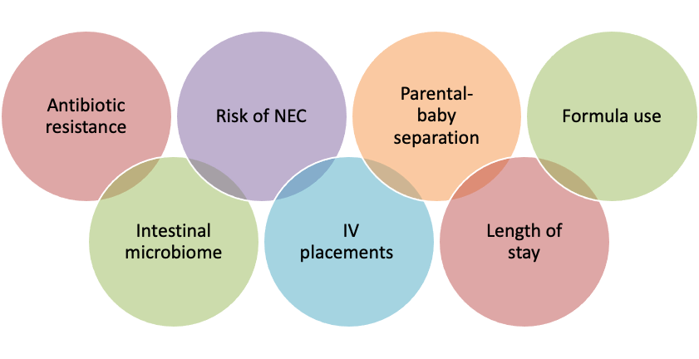
Why Antibiotic Stewardship?
Notes:
As we all know, antibiotics are essential in fighting infections in newborns; but wide variations in antibiotic prescribing for suspected or proven early onset sepsis exist and can lead to unnecessary or prolonged antibiotic exposure resulting in short- and long-term adverse outcomes or impacts such as antibiotic resistance, increased risk of NEC, parental baby separation, increased formula use, impaired development of the intestinal microbiome, unnecessary IV placement, and increased length of stay.
Antibiotic stewardship can improve antibiotic use through coordinated efforts to decrease variation and foster the appropriate use of antibiotics.

Slide 3
BASIC
ILPQC developed a statewide quality improvement initiative, the Babies Antibiotic Stewardship Improvement Collaborative - BASIC.
The vision of BASIC was for ILPQC hospitals, regardless of perinatal level or previous experience with implementing newborn antibiotic initiatives, to implement best practices to decrease antibiotic exposure in the first 72 hours of life for babies born in Illinois.

Slide 4
BASIC Statewide Aims
Decrease by 20%, or an absolute rate of 4%, the number of newborns born at ≥35 weeks who receive antibiotics
Decrease by 20% the number of newborns born at ≥35 weeks with a negative blood culture who receive antibiotics for longer than 36 hours
The Right Antibiotic for the Right Baby for the Right Length of Time

Slide 5
BASIC Key Driver Diagram
Notes:
A workgroup of clinical experts reviewed national guidelines and evidence-based practices, including the clinical report from the American Academy of Pediatrics, Management of Neonates Born at ≥35 0/7 Weeks’ Gestation With Suspected or Proven Early-Onset Bacterial Sepsis. The workgroup developed a key driver diagram and built a BASIC toolkit, a dynamic document of best practices and resources for the implementation of local hospital clinical culture change.

Slide 6
BASIC Primary Drivers
Driver 1: Quality Improvement Infrastructure and Antibiotic Data Monitoring and Transparency
Driver 2: Timely and Appropriate Initiation of Antibiotics
Driver 3: Appropriate Administration and De-escalation of Antibiotics
Driver 4: Equitable Care Delivery
Notes:
This team also created the key drivers for the BASIC initiative:

Slide 7
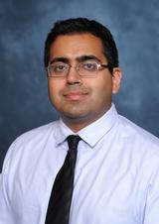
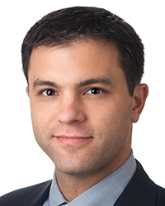
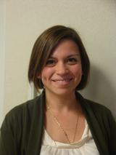
Thank you to the BASIC Clinical Leads for your expertise and support
Sameer Patel, MD, MPH
Gustave Falciglia, MD
Kenny delBarco Kronforst, MD, MPH, MS
Patrick Lyons, MD

Slide 8
BASIC Timeline
BASIC Launch and QI Leadership Training
Race and Ethnicity Data Utilization
BASIC Data Dashboard and Stratification of Data by Race and Ethnicity
Data Narratives and Visualizations
ILPQC voted on BASIC
EMR Integration
2020
January 2021
July 2021
December 2021
March 2022
January 2023
Fall 2019
December 2020
April 2021
August 2021
February 2022
August 2022
Planned BASIC
EOS Assessment Rollout
Parent Education Materials and Antibiotic Timeouts - 36 hour rule out
Automatic Stop Times - 36 hour rule out
Community Pediatrician Engagement
Transition to Sustainability
Notes:
Our BASIC Initiative timeline is shown here. The initiative included 20 monthly collaborative learning webinars with national expert speakers and team sharing. Webinar topics were determined by reviewing collaborative data, understanding ILPQC team needs, and using Plan-Do-Study-Act methodology to work toward individual and collaborative goals. You also participated in semi-annual meetings where we learned from national experts and each other.

Slide 9
Key Speakers across BASIC
2019 Annual Conference: Sameer Patel, MD, MPH:
Antimicrobial Stewardship in the NICU
2020 Face-to-Face: Martin McCaffrey, MD, CAPT USN (Ret) PQCNC-
Neonatal Antibiotic Stewardship: the North Carolina Story
2020 Annual Conference: Dmitry Dukhovny, MD, MPH-
Antibiotic Stewardship for the Newborn Population
April 2021: Patrick Lyons MD-
Using EMR for Data & Clinical Support
2021 Face-to-Face: JB Cantey, MD, MPH-
Antimicrobial Stewardship In the Nursery- It can be done!
September 2021: Sagori Mukhopadhyay, MD, MMSc-
Evidence behind the AAP EOS Preterm Policy
2021 Annual Conference: Karen Puopolo, MD, PhD-
Antibiotic Stewardship: Beyond the Sepsis Calculator

Slide 10
BASIC Hospital Teams
The Right Antibiotic for the Right Baby for the Right Length of Time
Notes:
Working together we got the right antibiotic to the right baby for the right length of time.

Slide 11
Right Antibiotics: Standardized Dosing Guidelines
Stay current with AAP antibiotic dosing recommendations
Educate healthcare team on AAP guidelines to establish best practices
Utilize ILPQC BASIC Toolkit for resources
Communicate updates to clinical teams
(email, daily huddles, boards, etc.)

Slide 12
Right Babies: Standardized EOS Risk Assessment Protocols
Standardize use of NEOSC as part of workflow
Educate on use of the NEOSC to ensure consistency
Determine best integration method for your hospital
Develop systematic process for documentation of EOS risk

Slide 13
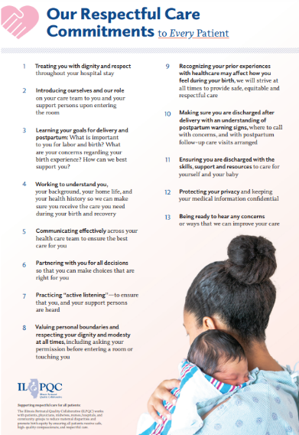
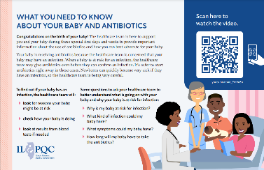
Right Babies: Standardized Parent/Family Education
Standardized workflow providing education to every parent/family every time
Equitable, respectful care practices for neonatal patients and their families

Slide 14
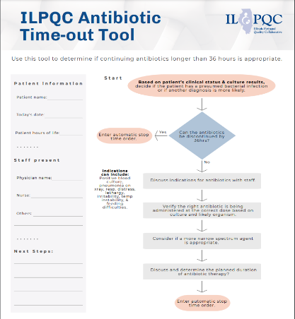
Right Amount of Time: Antibiotic Time Out Process
Process for every baby, every time
Brief antibiotic length/plan discussion
Use ILPQC Time Out tool or similar process
Standardized antibiotic timeout workflow

Slide 15
Built a Foundation for BASIC and Future Initiatives: A Partnership with Health Information Technology & the Electronic Medical Record
BASIC Teams developed relationships with their HIT / EMR teams for data collection, reporting optimization, and clinical decision support
These relationships and strategies will be used in future Neonatal QI initiatives

Slide 16
Collected data by race, ethnicity, and insurance status
BASIC teams implemented strategies for:
Collecting self-reported birthing patient race, ethnicity, and insurance data
Stratifying initiative data by race, ethnicity, and insurance status
Developing plans to address disparities
These strategies will be used in future Neonatal QI initiatives

Slide 17
Thank you to the participating BASIC Hospital Teams
AdventHealth Adventist Medical Center - Bolingbrook
AdventHealth Glen Oaks Hospital
AdventHealth Hinsdale
Advocate Aurora Sherman Hospital
Advocate Children's Hospital- Park Ridge
Advocate Children's- Oak Lawn
Advocate Christ Medical Center
Advocate Condell Medical Center
Advocate Good Samaritan Hospital
Advocate Good Shepherd Hospital
Advocate Illinois Masonic Medical Center
Advocate Lutheran General Hospital
Advocate Trinity Hospital
Alton Memorial Hospital
Anderson Hospital
Ann & Robert H. Lurie Children's Hospital of Chicago
Ascension Alexian Brothers
Ascension Health St. Joseph Hospital - Chicago
Ascension Mercy
Ascension Resurrection
Notes:
Nearly 80 hospital teams made BASIC a success.

Slide 18
Thank you to the participating BASIC Hospital Teams
Ascension Saint Alexius
Ascension Saint Mary- Chicago
Ascension Saint Mary- Kankakee
Barnes-Jewish Hospital
Blessing Hospital
Carle BroMenn Medical Center
Carle Foundation Hospital
Children's Hospital of Illinois- Peoria, OSF
Edward Hospital
Elmhurst Memorial Hospital
FHN Memorial Hospital
Franciscan Health Olympia Fields
Highland Park Hospital
HSHS St. Anthony's Memorial Hospital - Effingham
HSHS St. Elizabeth's Hospital
HSHS St. John's Hospital
Humboldt Park Health
Katherine Shaw Bethea (KSB) Hospital
Loyola University Medical Center
MacNeal Hospital

Slide 19
Thank you to the participating BASIC Hospital Teams
NorthShore University Health System - Evanston Hospital
Northwest Community Hospital
Northwestern Memorial Hospital
OSF Heart of Mary Medical Center
OSF Little Company of Mary Hospital
OSF St. Anthony Medical Center- Rockford
OSF St. Francis Medical Center
Palos Community Hospital
Riverside Medical Center
Memorial Hospital East
Memorial Hospital of Carbondale
Memorial Medical Center
Mercyhealth Javon Bea Hospital
Morris Hospital and Health Care Centers
Mount Sinai
NM Central DuPage Hospital
NM Delnor Hospital
NM Huntley Hospital
NM Lake Forest Hospital

Slide 20
Thank you to the participating BASIC Hospital Teams
Rush University Medical Center
Rush-Copley Medical Center
Sarah Bush Lincoln
Silver Cross Hospital
SSM Cardinal Glennon Children's Hospital
SSM Health Good Samaritan
SSM St. Mary's Hospital - St.Louis
St. Anthony Hospital
St. Joseph Hospital - Breese
St. Louis Children's Hospital
Stroger Hospital of Cook County
Swedish American Hospital
Swedish Hospital
UnityPoint Health Methodist Medical Center
UnityPoint Health Trinity
University of Chicago Medical Center
University of Illinois Hospital & Health Sciences System (UIC)
West Suburban Medical Center

Slide 21
Thank you ILPQC Hospital teams!
All ILPQC BASIC Hospital Team Talk Presenters, QI Panels, and Breakout Session Facilitators!

Slide 22
Achieving BASIC Together: Two Years of Outstanding Hospital QI Work
Notes:
Thank you for all your hardwork. Let’s look at what we have accomplished together.

Slide 23
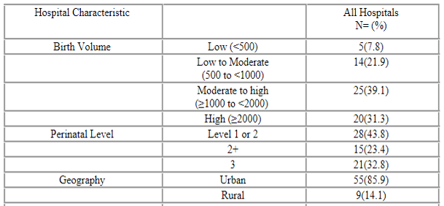
Who we are:
BASIC Hospital Team Characteristics
Notes:
71% Illinois birthing hospitals created multi-disciplinary BASIC QI teams. These hospitals represented a diverse mix of birth volume, perinatal level, geography, and patient demographics.

Slide 24
Making Systems Changes Happen: BASIC Structure Measures
90% standardized ≥35 EOS Risk Assessment
79% standardized <35 EOS Risk Assessment
80% standardized healthcare team education
83% standardized family education
93% standardized dosing guidelines
85% standardized antibiotic time outs
92% standardized antibiotic automatic stop orders
Notes:
Your teams focused on hospital strategies that would lead to a decrease in antibiotic use in the first 72 hours of life. BASIC strategies included educating providers on best practices, respectfully educating families about EOS and antibiotic use, coordinating with information technology partners to develop reporting systems and integrate risk assessment tools into the Electronic Medical Record, standardizing dosing guidelines and developing order sets, implementing processes to discuss antibiotic duration, and implementing antibiotic stop order processes.

Slide 25
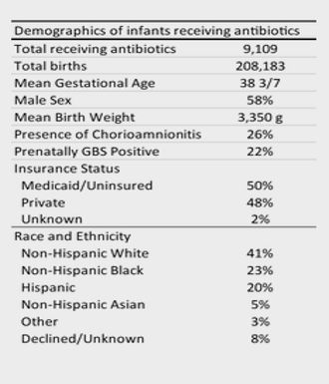
Who we took care of:
Newborn Demographics
Notes:
During the active phase, we collected data on 208,183 babies of which 9109 received antibiotics. Of note, 26% of birthing patients had a diagnosis of chorioamnionitis and 22% were GBS positive. Insurance status was equally distributed. Race and ethnicity data are shown in the table.

Slide 26
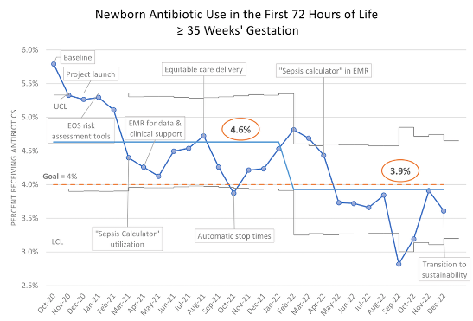
Newborns Receiving Antibiotics
Notes:
Antibiotic prescribing rates in ILPQC hospitals decreased from 5.7%, at baseline to a mean of 3.9% by December 2022, meeting our goal of below 4%.

Slide 27
36 Hour Rule Out
Notes:
The number of newborns who received antibiotics for less than 36 hours increased from 47% at baseline to a mean of 63.6% by December 2022. An increase of 26%, exceeding our aim of 20%.

Slide 28
Antibiotic Timeouts
Notes:
The use of antibiotic timeouts increased from 69 to 88%.

Slide 29
Automatic Stop Times
Notes:
Automatic stop times were entered into the electronic medical record for 93% of ILPQC babies receiving antibiotics, an increase from 51% at baseline.

Slide 30
Family Education
Notes:
Lastly, the percent of families receiving education about early onset sepsis, antibiotics, and a treatment plan increased from 57% from baseline to 79%.

Slide 31
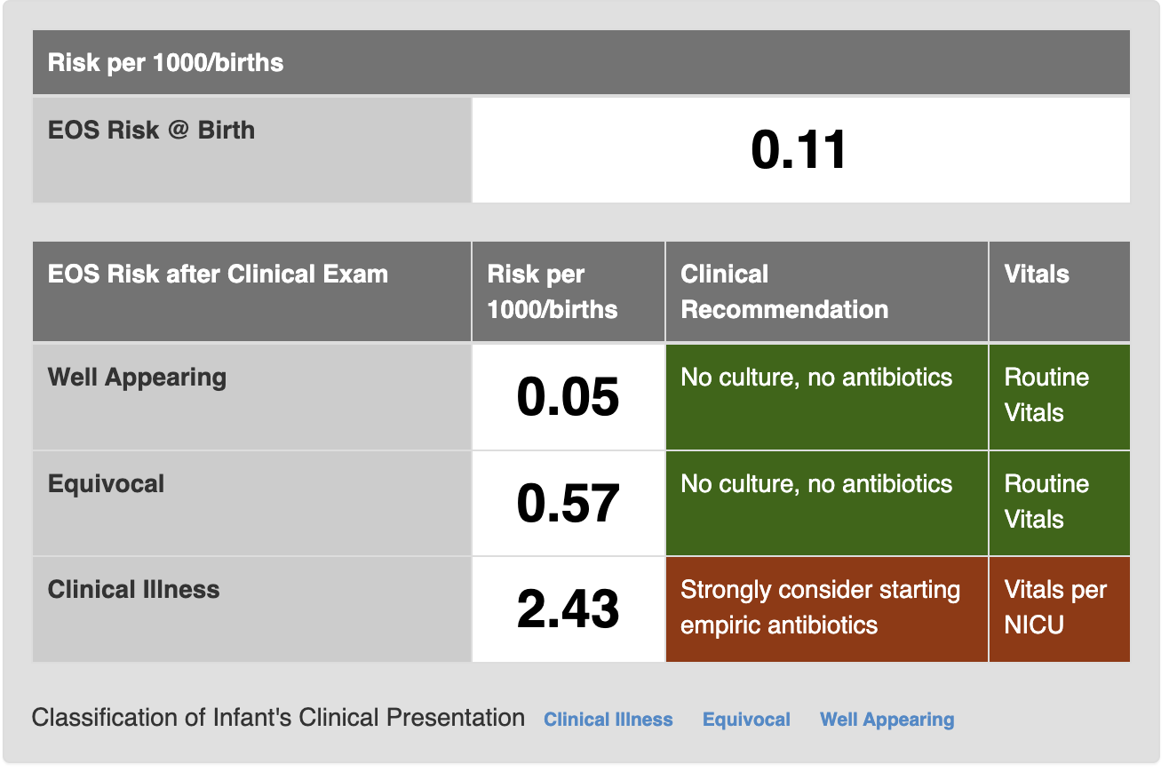
Case Presentation from an ILPQC Hospital
35 1/7 weeks
2000 g
Highest maternal antepartum temperature 98 F
ROM 12 hours
GBS Unknown
Broad spectrum antibiotics > 4 hours before delivery
Respiratory distress requiring CPAP that continued beyond the delivery room

Slide 32
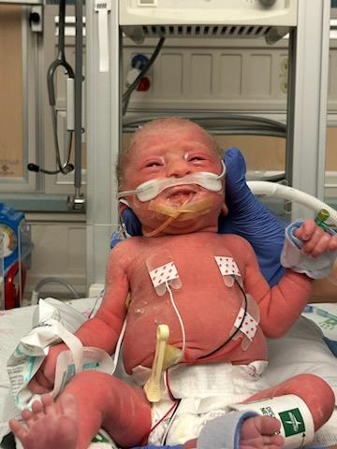
BASIC in Action
EOS protocol run by clinical team
Blood culture drawn
Ampicillin and gentamicin started
Antibiotic course discussed by clinical team on rounds
36-hour stop time entered in the medical record
Antibiotics stopped with negative blood culture at 36 hrs!

Slide 33
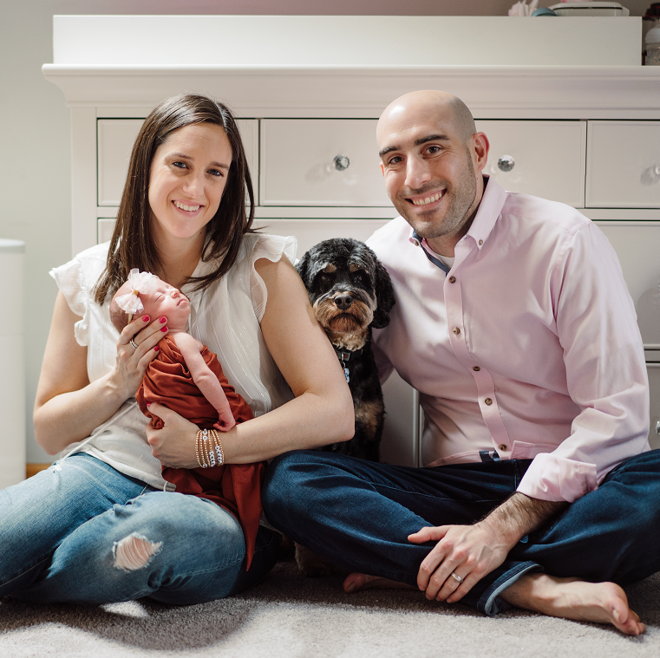
Introducing: Avery Shelley Weiss
Birthday: 4/10/2023
Born 12:03 am
5 weeks early
4 lbs. 6 oz.
17 inches

Slide 34
BASIC Success!!
The collaborative structure of ILPQC supported you, a diverse group of hospital teams, to learn successful strategies, and work together to achieve individual and collective BASIC aims.
Through our statewide quality improvement initiative, newborn antibiotic use was decreased your Illinois hospitals.
Notes:
This should be the end before susustainability.

Slide 35
What’s Next for BASIC: Sustainability
Work with your hospital team to complete your BASIC Sustainability Plan and submit it to ILPQC and your network administrator by June 30, 2023
Continue monitoring your achievements for changes
Take notes from the Storyboard Session to bring strategies back to your team to implement

Slide 36
Upcoming ILPQC Webinars
Event | Day/Time
BASIC Sustainability Webinar | Monday August 21st, at 2:00pm

Slide 37
BASIC QI Award Recognition

Slide 38
Award Instructions
If your hospital team receives a QI Excellence Award for BASIC , when you name is called, please come to the table to the left of the stage to receive your QI Excellence Award and then walk across the main stage to be recognized.
Please connect with Dan if you have any questions regarding your award status.

Slide 39
BASIC QI EXCELLENCE AWARD CRITERIA
All 6 key structure measures in place
All process and outcome measures achieved

Slide 40
Celebrating 2022 Annual Conference BASIC QI Excellence Award Winners
Advocate Aurora Sherman Hospital
Advocate Children's Hospital- Oak Lawn
Advocate Condell Medical Center
Advocate Good Samaritan Hospital
Advocate Illinois Masonic Medical Center
Advocate Lutheran General & Advocate Children's Hospital- Park Ridge
Ascension Alexian Brothers
Ascension Resurrection
Edward Hospital
Elmhurst Memorial Hospital
FHN Memorial Hospital
HSHS St. John's Hospital
Loyola University Medical Center
MacNeal Hospital
Memorial Hospital East
NM Lake Forest Hospital
NorthShore University HealthSystem Evanston
Northwest Community Healthcare
Northwestern Memorial Hospital
OSF Little Company Mary Medical Center
OSF St. Francis Medical Center
Riverside Medical Center
Rush University Medical Center
Silver Cross Hospital

Slide 41
BASIC QI Excellence Award Winners
Blessing Hospital
HSHS St. Joseph's Hospital Breese
OSF St. Anthony Medical Center
NM Delnor
Palos Hospital
AdventHealth Bolingbrook
AdventHealth Hinsdale
Ascension St. Alexius Medical Center
Notes:
HSHS St. Joseph's Hospital Breese
OSF St. Anthony Medical Center
NM Delnor Hospital
Palos Hospital
AdventHealth Bolingbrook Hospital
AdventHealth Hinsdale
Ascension St. Alexius Medical Center

Slide 43
Thanks to our Funders
CME Provider:
Supporters:
Notes:
Team, let's us this slide for sponsors

