Slide 1
State Quality Collaborative Leaders Panel:
National Perspectives on Improving Perinatal Care
State Quality Collaborative Leaders

Slide 2

State Quality Collaborative Leaders Panel
Kylie Hibshman, LCSW, PMH-C
  Director of Integrated Behavioral Health and Continuum of Care
  Colorado Perinatal Care Quality Collaborative (CPCQC)
Brenda Barker, M Ed, MBA
  Executive Director
  Tennessee Initiative for Perinatal Quality Care (TIPQC)
Sydnie Carraher DNP, APRN-NP, NNP-BC
  Program Administrator
  Nebraska Perinatal Quality Improvement Collaborative (NPQIC)

Slide 3

Colorado Perinatal Care Quality Collaborative
Integrated Perinatal Behavioral Health Initiatives in Colorado
KYLIE HIBSHMAN, LCSW, PMH-C
Notes:
Good afternoon. It is an honor to speak to you today about how Colorado is improving the care for pregnant and birthing people who experience substance use during the perinatal period.
My name is Elena and I work as the program manager for the Colorado AIM: Substance Use Disorder learning collaborative at the Colorado Perinatal Care Quality Collaborative.

Slide 4

About CPCQC
COLORADO PERINATAL CARE QUALITY COLLABORATIVE
  Legislatively authorized to implement Colorado MMRC recommendations for clinical quality improvement
  Designated by CDC as state’s Perinatal Quality Collaborative (PQC)
  CO agency for Alliance for Innovation on Maternal Health (AIM)
  QI programs in L&Ds, NICUs, and communities
  Backbone of Colorado Maternal Mental Health Collaborative
  Convene maternal health stakeholders across clinical, public health, community, and policy sectors

Slide 5

New CO MMRC Report, 2016-2020
One-third of all pregnancy-associated deaths in CO are due to unintentional overdose
Mental health or substance use was a contributor to 1 in 2 CO pregnancy-related deaths. Of deaths not attributable to suicide or overdose, mental health or substance use affected 1 in 5.
9 out of 10 of all maternal deaths in CO were preventable, meaning there was an opportunity to avoid these deaths through reasonable intervention at the patient, provider, facility, system, or community level.
100% of maternal deaths due in CO to accidental overdose were (and are) preventable.
CDPHE Maternal Mortality Review Committee, 2016-2020

Slide 6
Programs
CHoSEN (substance-exposed newborns)
CO AIM: SUD (perinatal substance use)
MOMs+ (perinatal substance use - MOUD)
IMPACT BH (integrated behavioral health)
SOAR (primary Cesarean reduction)
FIRST (lived experience integration)

Slide 7
LIVED EXPERIENCE
FIRST
Lived experience is at the heart of our quality improvement work.
Partners:
Hard Beauty
Tough as a Mother
  Speaking engagements
  Panels
  Breakout groups
  Curriculum oversight
  Stigma and Bias trainings
Notes:
The most important thing however, that we have found through implementation is the lived experience is crucial for buy in of the healthcare industry as well as to ensure that patients are treated thoughtfully and with respect. CPCQC has now integrated lived experience expertise into all our quality improvement programs through our FIRST program. FIRSt brings together a cohort of experts with varying background to provide insight and guidance to the maternal health projects. This program ensures that our programs are both implementing clinical best practices but also patient experience to best meet patients where they are at.

Slide 8


TWO PROGRAMS, ONE GOAL: PREVENT MATERNAL OVERDOSE
Integrated, CPCQC-led
  QI approach
  Data collection
  Learning & evaluation
  Staff education
Shared commitment to reducing stigma and integrating lived experience
CO AIM: SUD
Universal Screening,
SBIRT, QI
Perinatal SUD Care 101
AIM Patient Safety Bundle
Naloxone
MOMS+
Perinatal SUD Care 201: OUD
Specialty OUD consulting within CO AIM: SUD framework
MOUD
Notes:
As I was saying, this learning collaborative started in 2020 with 8 hospitals. Today, we have 19 hospitals participating which makes up 31% of Colorado L&D units. 3 of these hospitals are in Montana and joined as a part of a hospital system in the rocky mountain region.
The participating hospitals in Colorado account for 52% of all births in the state and these hospital account for 5 out of the 7 state designated regions.

Slide 9
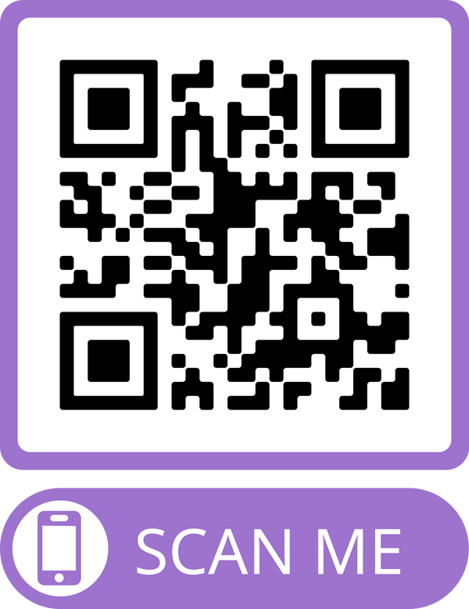
Combined Programs - CO AIM: SUD & MOMs+
Hospitals:
20 L&D units
L&D Units:
39% of Colorado L&D units
Birth Volume
53% of Colorado births
Regional Distribution:
In 7 out of 7 RAEs
Public Cohort Data Dashboards (and private, hospital-specific dashboards):
Notes:
As I was saying, this learning collaborative started in 2020 with 8 hospitals. Today, we have 19 hospitals participating which makes up 31% of Colorado L&D units. 3 of these hospitals are in Montana and joined as a part of a hospital system in the rocky mountain region.
The participating hospitals in Colorado account for 52% of all births in the state and these hospital account for 5 out of the 7 state designated regions.

Slide 10
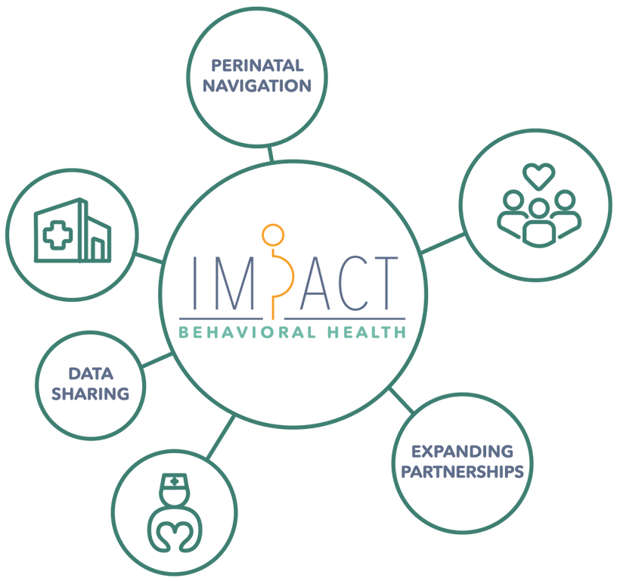

IMPACT BH
Improve Perinatal Access, Coordination, and Treatment
Pilot project bringing together
  hospitals
  primary healthcare services
  community-based organizations
as active collaborators and partners in providing wrap-around support and care navigation to pregnant and postpartum people and their families.
Notes:
The most important thing however, that we have found through implementation is the lived experience is crucial for buy in of the healthcare industry as well as to ensure that patients are treated thoughtfully and with respect. CPCQC has now integrated lived experience expertise into all our quality improvement programs through our FIRST program. FIRSt brings together a cohort of experts with varying background to provide insight and guidance to the maternal health projects. This program ensures that our programs are both implementing clinical best practices but also patient experience to best meet patients where they are at.

Slide 11




IMPACT BH
Working Across the Continuum of Care
COMMUNITY-LED FAMILY SUPPORT
Promotora (community health worker) and Alma (peer support) program; cash assistance
INCREASED MENTAL HEALTH SUPPORT
Multi-lingual wellness checks and provider leasing model in rural communities across Colorado
ADVANCING OUD CARE IN HOSPITALS
Grounded in peer support, stigma reduction, and community connections

Slide 12
Colorado Maternal Mental Health Collaborative
CPCQC is the backbone organization of the Colorado Maternal Mental Health Collaborative, working across the state to improve perinatal mental health outcomes
Community, state, and organizational leaders across Colorado
Commitment to lived experience
Resources, learning sessions, and community engagement across the continuum of care
Policy + Financing Workgroup

Slide 13
Thank You!
KYLIE HIBSHMAN, LCSW, PMH-C
khibshman@cpcqc.org

Slide 14



Brenda Barker,
MEd, MBA
Executive Director
TIPQC
ILPQC Panel
November 2, 2023

Slide 15

QI Projects
Infant Projects
2009-2010, NICU Hypothermia
2009-2013, NICU Human Milk, 2009-2013
2010-2012, NICU CLABSI Reduction
2011-2012, Undetected Critical Congenital Heart Disease
2012-2013, NCABSI Multi-State Collaborative
2012-2015, Family Involvement Teams
2012-2013, NICU Follow-Up Network
2012-2015, NICU Golden Hour
2012-2015, NICU NAS 1.0 & 2.0
2014-2016, NICU HAI 2.0
2015-2016, NICU NAS Multi-State Collaborative
2016-2018, iNICQ Antibiotic Stewardship
2016-2018, Nutrition: Improving Nutrition and Growth in Very Low Birth Weight Infants
2018-2019, Tennessee Antibiotic Stewardship
2018-2019, Optimizing Care of the 35-36 Week Infant in the Newborn Nursery
2019-20 OEN Wave 1
2020-21 Safe Sleep
2020, iNICQ Transitions of Care
2022- Tennessee’s Tiniest Babies (TTB)
Maternal Projects
2009-2015, Reduction of Early Elective Deliveries
2010-2011, Breastfeeding Promotion: Prenatal
2013-2014, Breastfeeding Promotion: Delivery & Postpartum, Wave 1
2013-2014, Antenatal Steroids
2014-2016, Breastfeeding Promotion: Delivery & Postpartum, Wave 2
2016-2018, Obstetric Hemorrhage
2018-2019, Immediate Postpartum Long-Acting Reversible Contraception
2019-20 OUD Wave 1
2020-22 Severe Maternal HTN
2022- Promotion of Vaginal Delivery
2023- Cardiac Conditions in OB Care
Joint Projects
2019-2021, Opioid Use Disorder: Optimizing Obstetric & Neonatal Care (Joint Maternal and Infant Project)
2022- 23 Optimal Cord Clamping
2023- Best For All

Slide 16
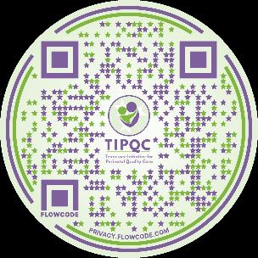

Safe to Sleep 2020-21
Notes:
In 2020, 25% of all infant deaths in TN were due to unsafe sleep.
Sleep related deaths in infants are frequently preventable.
State QI projects are effective in increasing safe sleep compliance.
Social media and public service announcements may increase parent awareness of safe sleep.
State perinatal quality collaboratives can partner with the State Department of Health, local hospitals, and providers, to increase awareness, educate parents, and model safe sleep.

Slide 17
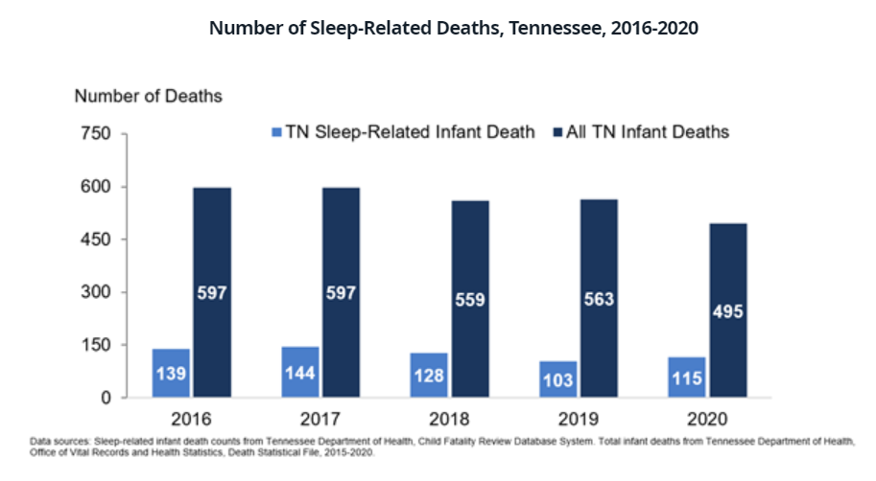

Slide 18

Sleep-Related Infant Deaths, 2015-2019
Data source: Tennessee Department of Health, Child Fatality Review; Office of Vital Records and Statistics.
Notes:
In turn, the audits disaggregated by mother’s race / ethnicity were not combined across the hospitals – any signal of improvement would be misleading. With that said, the hospitals’ monthly data reports (that were generated and provided to them by TIPQC) included run charts of their audit compliance broken down by mother’s race /ethnicity and audit location. Race is not a proxy measure for other social determinants of health. This project did not have significant findings within the different racial groups.

Slide 19
Contributing Factors in Sleep-Related Infant Deaths, 2019
*Includes comforter, blanket, pillow, bumper pads, toys, plastic bags and other.
Data source: Tennessee Department of Health, Child Fatality Review.

Slide 20
Hospital Safe Sleep Work
Continue to model safe sleep
Have consistent safe sleep crib audits
Submit crib audits for BEST award
Use teachable moments to educate families on safe sleep
Ask families where they plan to place their baby to sleep once they go home.
Do they have a safe sleep space?
  Can they get one?
  Provide them with a portable crib or connect them with the health department.
Notes:
(1) develop and implement safe sleep policies in compliance with AAP recommendations; (2) provide safe sleep education to staff and family; and (3) complete monthly safe sleep audits.

Slide 21



Safe to Sleep 2020-21
13/12 Teams
3,136 Audits
Improvements

Slide 22
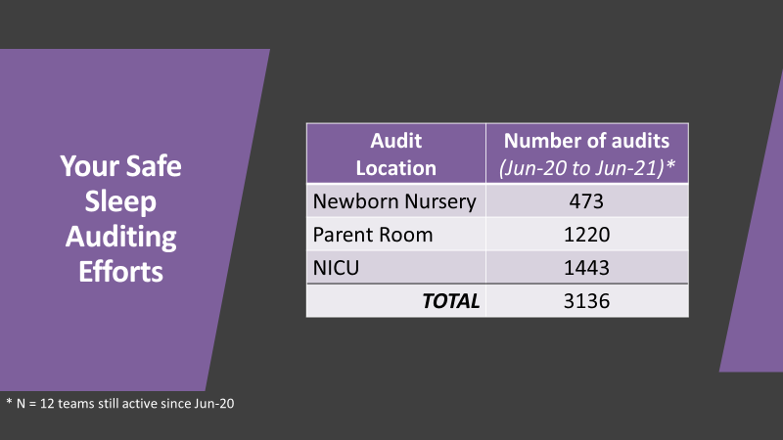

Slide 23

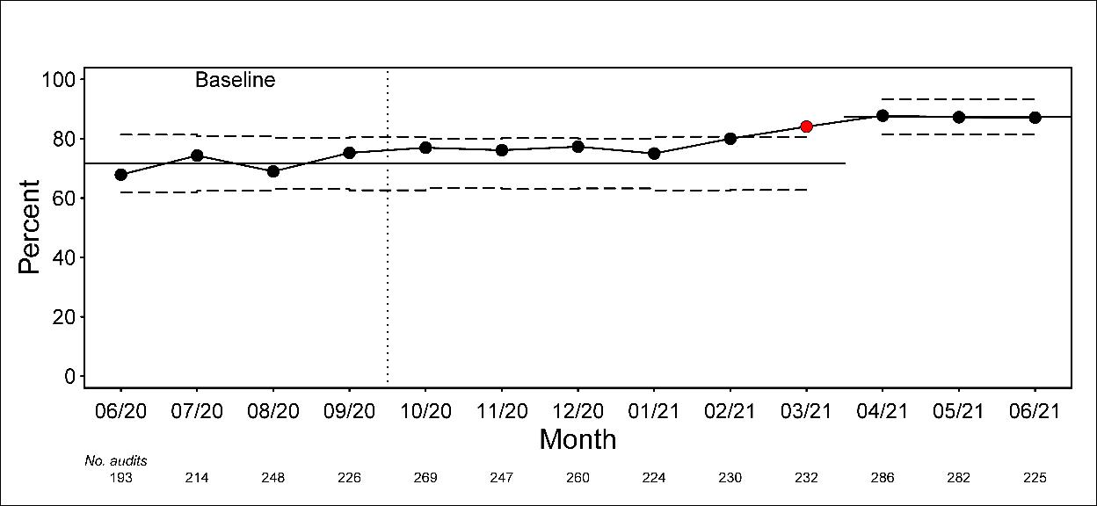
Percent of audits compliant with Safe Sleep recommendations
% compliance improved from 71.6% to 87.4% - a 22% relative increase

Slide 24
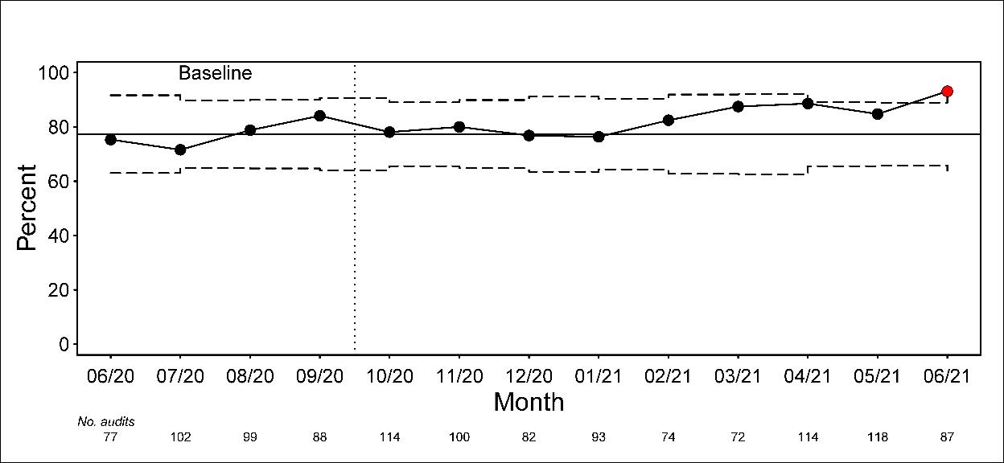
% audits compliant: Our Parent Rooms
Signal of special cause variation
% compliance ↑ from 77.3% to >90.0% - a >16% relative increase

Slide 25
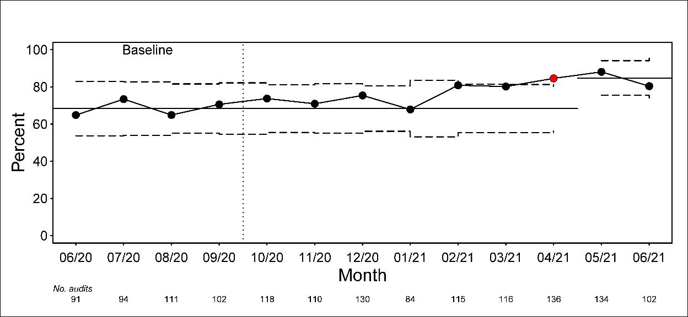
% audits compliant: Our NICUs
Signal of special cause variation
% compliance ↑ from 68.3% to 84.7% - a 24% relative increase

Slide 26
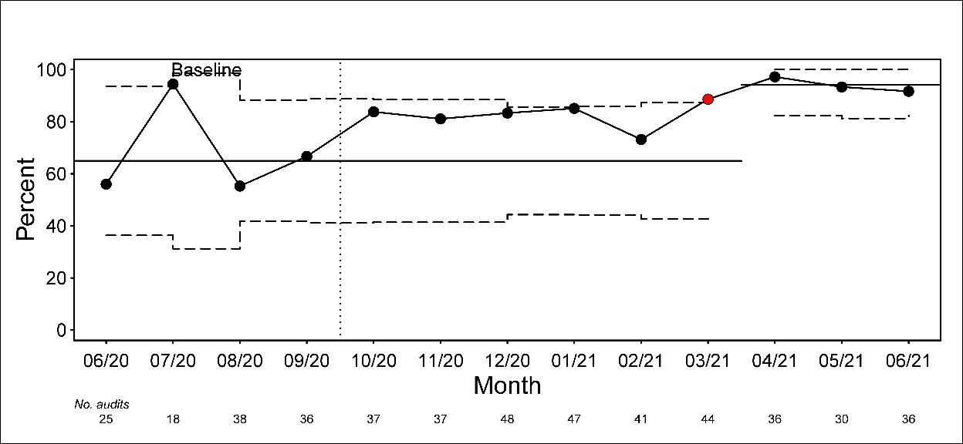
% audits compliant: Our Newborn Nurseries
Signal of special cause variation
% compliance ↑ from 65.0% to 94.1% - a 45% relative increase

Slide 27
Reasons safe sleep was not compliant
Reason | N (%)
Additional objects in crib | 678 (29%)
Head of bed elevated | 510 (22%)
Unsafe bedding | 446 (19%)
Positioning devices being used | 342 (14%)
Infant not supine | 271 (11%)
Infant unattended while asleep not in crib | 63 ( 3%)
Bed sharing while adult asleep | 52 ( 2%)
TOTAL | 2367

Slide 28
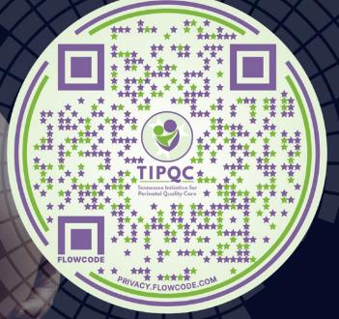
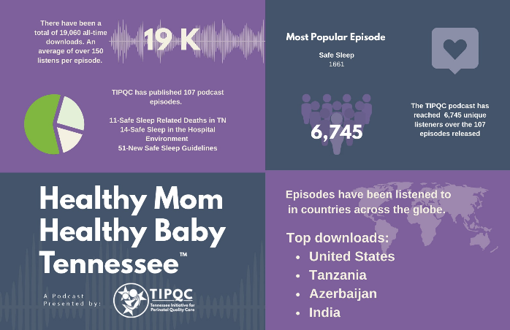
As of 10-13-23
Notes:
Will try to update.

Slide 29
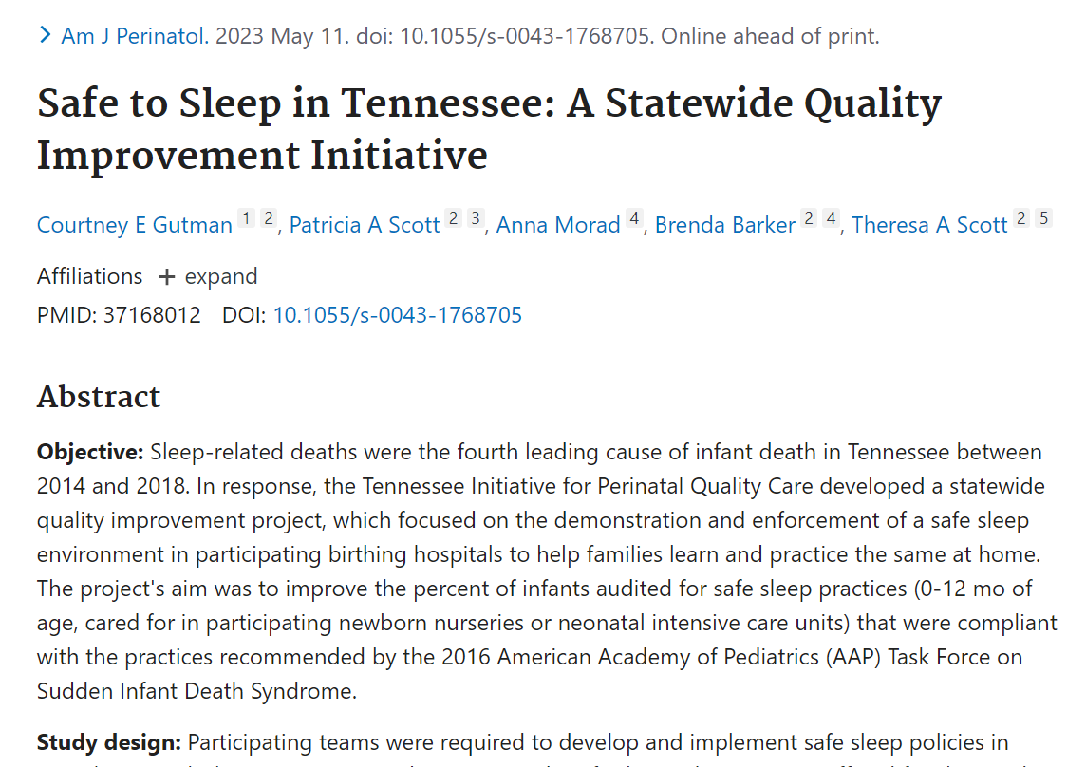

Slide 30

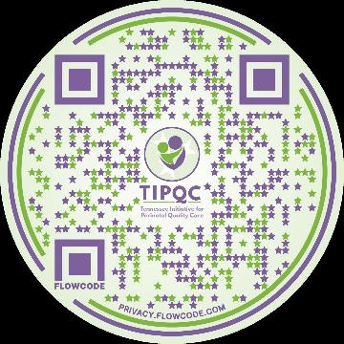
Patient & Family Engagement
Notes:
I found a total of 20,957 studies about involving patients in the design, delivery, or evaluation of health care
According to the Institute for Healthcare Improvement’s Seven Leadership Leverage Points for Organization- Level Improvement in Health Care (Second Edition) , “We have observed that in a growing number of instances where truly stunning levels of improvement have been achieved, organizations have asked patients and their families to be directly involved in the process. And those organizations’ leaders often site this change—putting patients in a position of real power and influence, using their wisdom and experience to redesign and improve care systems—as being the single most powerful transformational change in their history. Clearly this is a leverage point where a small change can make a huge difference.”

Slide 31
Every project needs a reason
Notes:
Be the change you want to see in the world

Slide 32
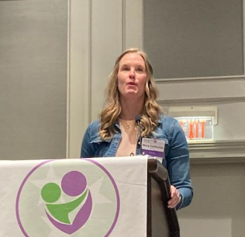

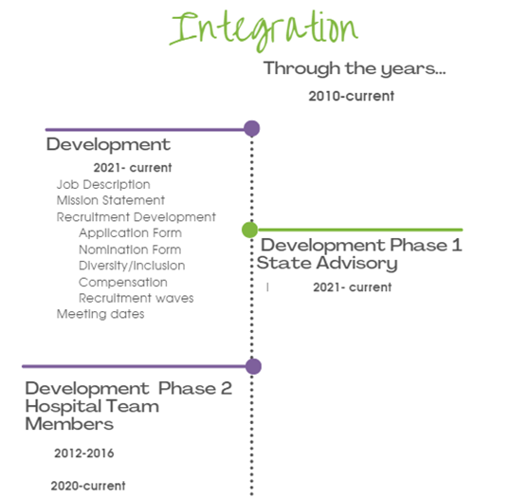
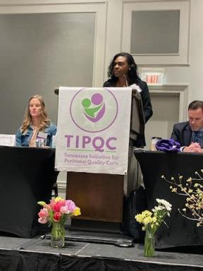

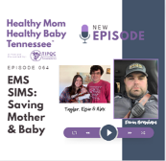


Notes:
Even borrowed some of their Patients & families!

Slide 33

Keys to Success
1. Belief that Patient & Families are essential!
2. Prep Work
3. Family Selection & Training as Advisors
4. Culture Shift: Integration & Imbed
Notes:
Ideas, Will Execution

Slide 34



Inter-Institutional Quality Improvement Project
Keys For Success
Active Participation
Improve Outcomes
Test Changes
Achieve
Statewide
Aim
Improve Processes
Patient/Family Partner
Implement Structures

Slide 35
“We have observed that in a growing number of instances where truly stunning levels of improvement have been achieved, organizations have asked patients and their families to be directly involved in the process. And those organizations’ leaders often site this change—putting patients in a position of real power and influence, using their wisdom and experience to redesign and improve care systems—as being the single most powerful transformational change in their history.”
Institute for Healthcare Improvement’s Seven Leadership Leverage Points for Organization- Level Improvement in Health Care (Second Edition)

Slide 36




















Partners

Slide 37

Quality Collaboratives: Perspectives on Improving Perinatal Care
Sydnie Carraher, DNP, APRN-NP, NNP-BC
Program Administrator, NPQIC
November 2nd, 2023

Slide 38








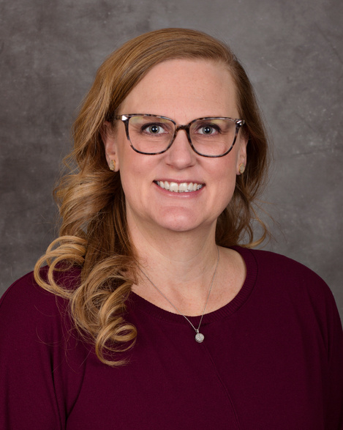


MEET OUR
Team
DR. ANN ANDERSON BERRY
DR. ROBERT BONEBRAKE
SYDNIE CARRAHER
KARA FOSTER
CHELSEY KENNEDY
MD, PhD, FAAP
MD, FACOG
DNP, NNP-BC
MPH
DNP, WHNP-BC, IBCLC
Co-Medical Director
Neonatal
Co-Medical Director
Maternal
Program Administrator
Project
Coordinator
Project
Coordinator
@NPQIC.ORG

Slide 39
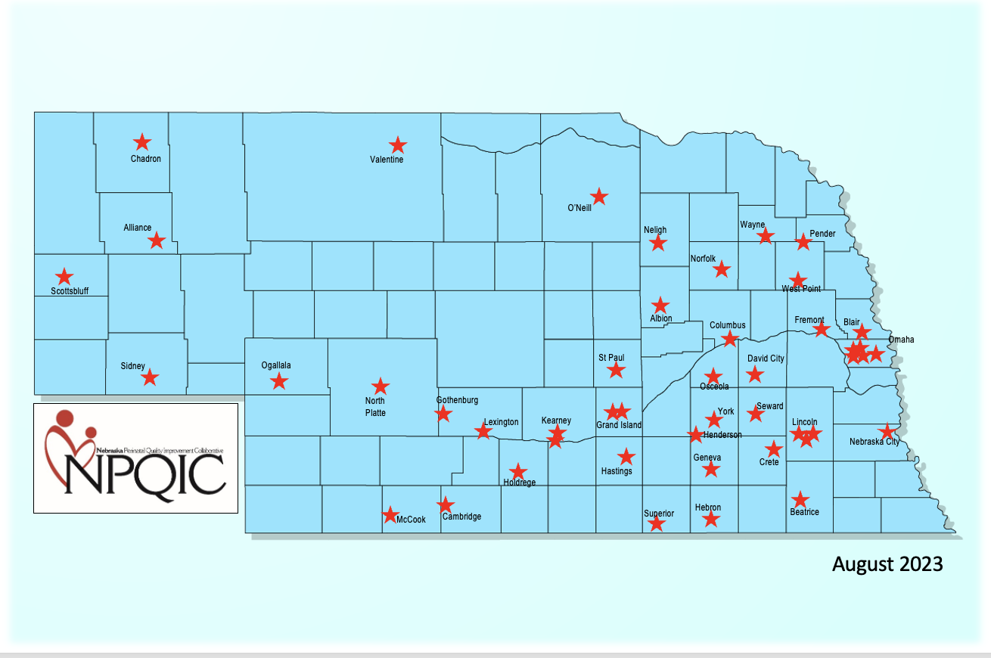
Nebraska Birthing Facilities
Total of 47
  29 critical access
  17 non-critical access
  1 birth center
23,000-25,000 annual births
Hospital births range from 7-5,046 birth/year
All members of PQC
Notes:
Will drop to 46 at the end of the year. 28 CAH.

Slide 40


Improvement Initiatives
Perinatal Mental Health
Culturally Matched Doula Support

Slide 41


AIM: Perinatal Family Mental Health Initiative
Launched Fall 2020
Three-year statewide depression screening project
Funded by the Pritzker Foundation through a sub-award from First Five Nebraska
By July of 2023, parents from all areas of Nebraska will consistently be screened and subsequently treated for perinatal depression.
Goals:
  Establish perinatal depression screening as the standard of care in all clinics, hospitals, and NICU’s caring for obstetric and pediatric patients.
  Identify state-wide treatment referral systems
Notes:
In 2020, the NPQIC received funding from the Pritzker Children’s Initiative and First Five Nebraska for a 3 year statewide depression screening and referral project. Funding ended in June 2023. Will continue to work on perinatal mental health.
The goal of the Perinatal Family Mental Health Initiative is to establish perinatal depression screening as the standard of care for all clinics, hospitals and NICU’s caring for obstetric and pediatric patients and to identify state-wide treatment referral systems.
We are also monitoring the availability and saturation of resources, especially those that provide care regardless of insurance status and ability.
LB 905, introduced by Senator Lynne Walz (District 15).
NPQIC and FFN- provided data from this project and testified on behalf of this bill.
This bill recommends mental health screenings for mothers during and after pregnancy and tasks the Board of Medicine with crafting policies with providers around maternal depression screenings.

Slide 42
Minimum Screening Timeline
Mothers
  At least once prenatally
  During birth hospitalization
  At comprehensive postpartum visit
  At baby's 1, 2, 4, and 6 month well child visits
Fathers or Non-Delivering Partner
  At least once within the first 6 months of birth
NICU parents
  At 7-14 and 30 days postpartum and then every 30 days thereafter
(ACOG, 2018; ACOG, 2023; Earls et al., 2019; Hynan et al., 2013; Murthy et al., 2021; Siu et al., 2016; Walsh et al., 2019)
Notes:
Timing of screening should be performed according to ACOG and AAP recommendations for mothers and current evidence-based recommendations for fathers.​
Based on their recommendations the following minimum screening timeline was identified.​
Although there is no formal recommendation, screening mothers during the birth hospitalization and NICU parents is also highly encouraged.​

Slide 43
Steering Committee and Toolkit Development
Introduction of Toolkit and Learning Session # 1
Ongoing Recruitment
Education and Dissemination
Dec 2020
April 2021
June 2021
2023
09.05.XX
Feb 2021
May 2021
July 2022
Preliminary Surveys and Recruitment of Pilot Sites
Implementation of Screening, Small Tests of Change, and Monthly Coaching Calls
LB 905, NE Statute 38.204.01
Notes:
Steering Committee Convened in Dec, 2020 to:
Review recommendations for screening
Identify screening tool
Discuss how to provide education
Explore referral network options
Representation on Committee:
Behavioral health specialists (Eastern and Western part of the state)
FP, Pedi, Neo, CNM and OB
Preliminary survey’s were sent to obtain baseline data on screening practices. (Feb 2021)
Survey sent to 53 birthing facilities(52/53) and 15 NICU’s
Outpatient Provider and Clinic Contacts identified (155) 58%

Slide 44
Notes:
Results of baseline surveys Feb 2021
As you can see there are significant gaps and work to be done!

Slide 45
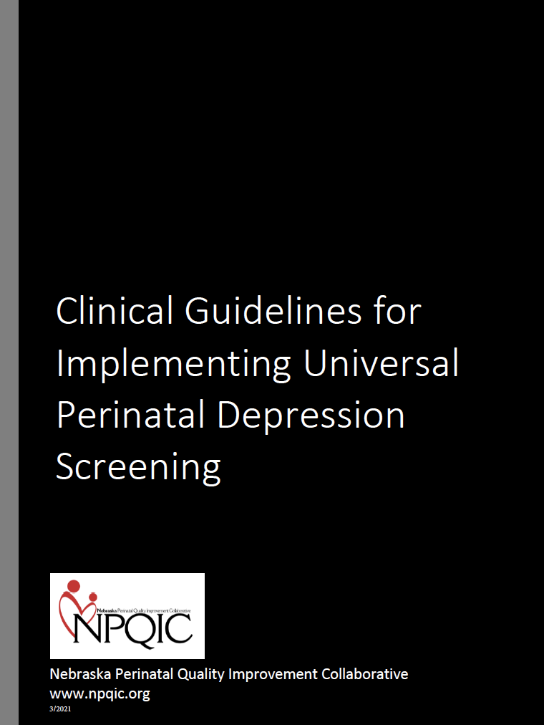
Toolkit
Why Screen for Perinatal Depression
Who and When to Screen
Which Screening Tool to Use
  Edinburgh Postnatal Depression Scale (EPDS)
  Patient Health Questionnaire-9 (PHQ-9)
  Generalized Anxiety Disorder Screener (GAD-7)
Sample Screening Algorithm for EPDS and PHQ-9
Sample Action Crisis Plan
Key Clinical Considerations
Perinatal Mental Health Resources
Medication Therapy and Lactation
Lactation Resources
Resources for Families
Patient Handouts and Education
Appendix A-G:
  Summary of Mood and Anxiety Disorders
  EPDS, PHQ-9, and GAD-7 Tools (English/Spanish) and Scoring Instructions
  Sample Scripts for Screening and Referral
  Local Resources Template
  Behavioral Health System of Care Regions
Notes:
Based on a review of the current literature and recommendations from the steering committee a toolkit was created to guide implementation of PDS.
Included in the toolkit are recommendations for who and when to screen, which tool to use with links, a sample action crisis plan, key clinical considerations, a list of perinatal mental health resources, resources for families including patient handouts and education.
The next couple of slides highlight some of the items included in the toolkit… some of which were adapted or used in permission from several other entities including the DC Collaborative for Mental Health in Pediatric Care, MN Dept of Health, Kansas MCH Program, and MA Child Psychiatric Access Program for Moms. ​

Slide 46
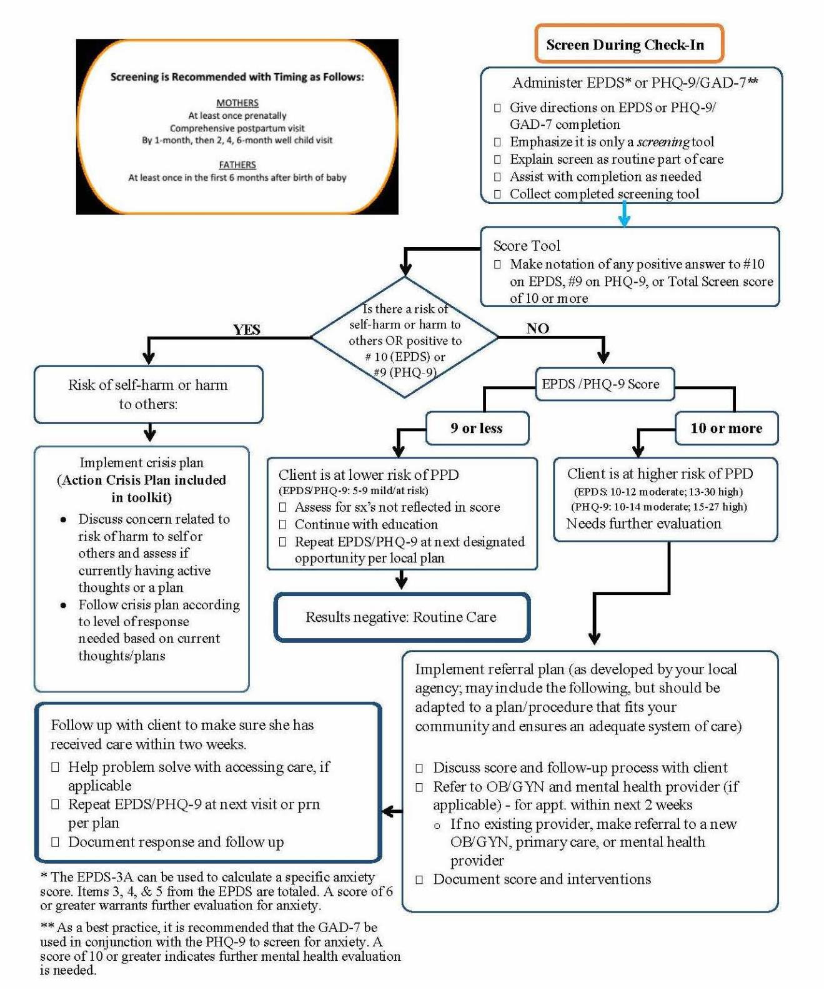
Sample Workflow

Slide 47
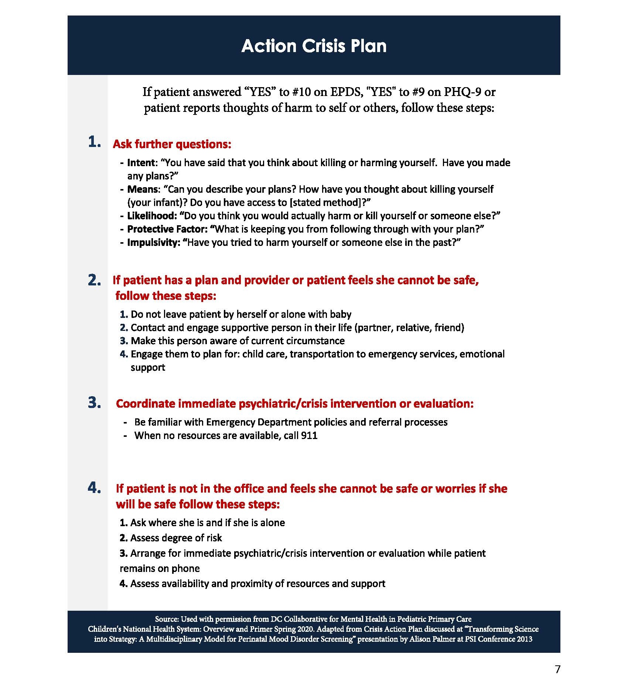
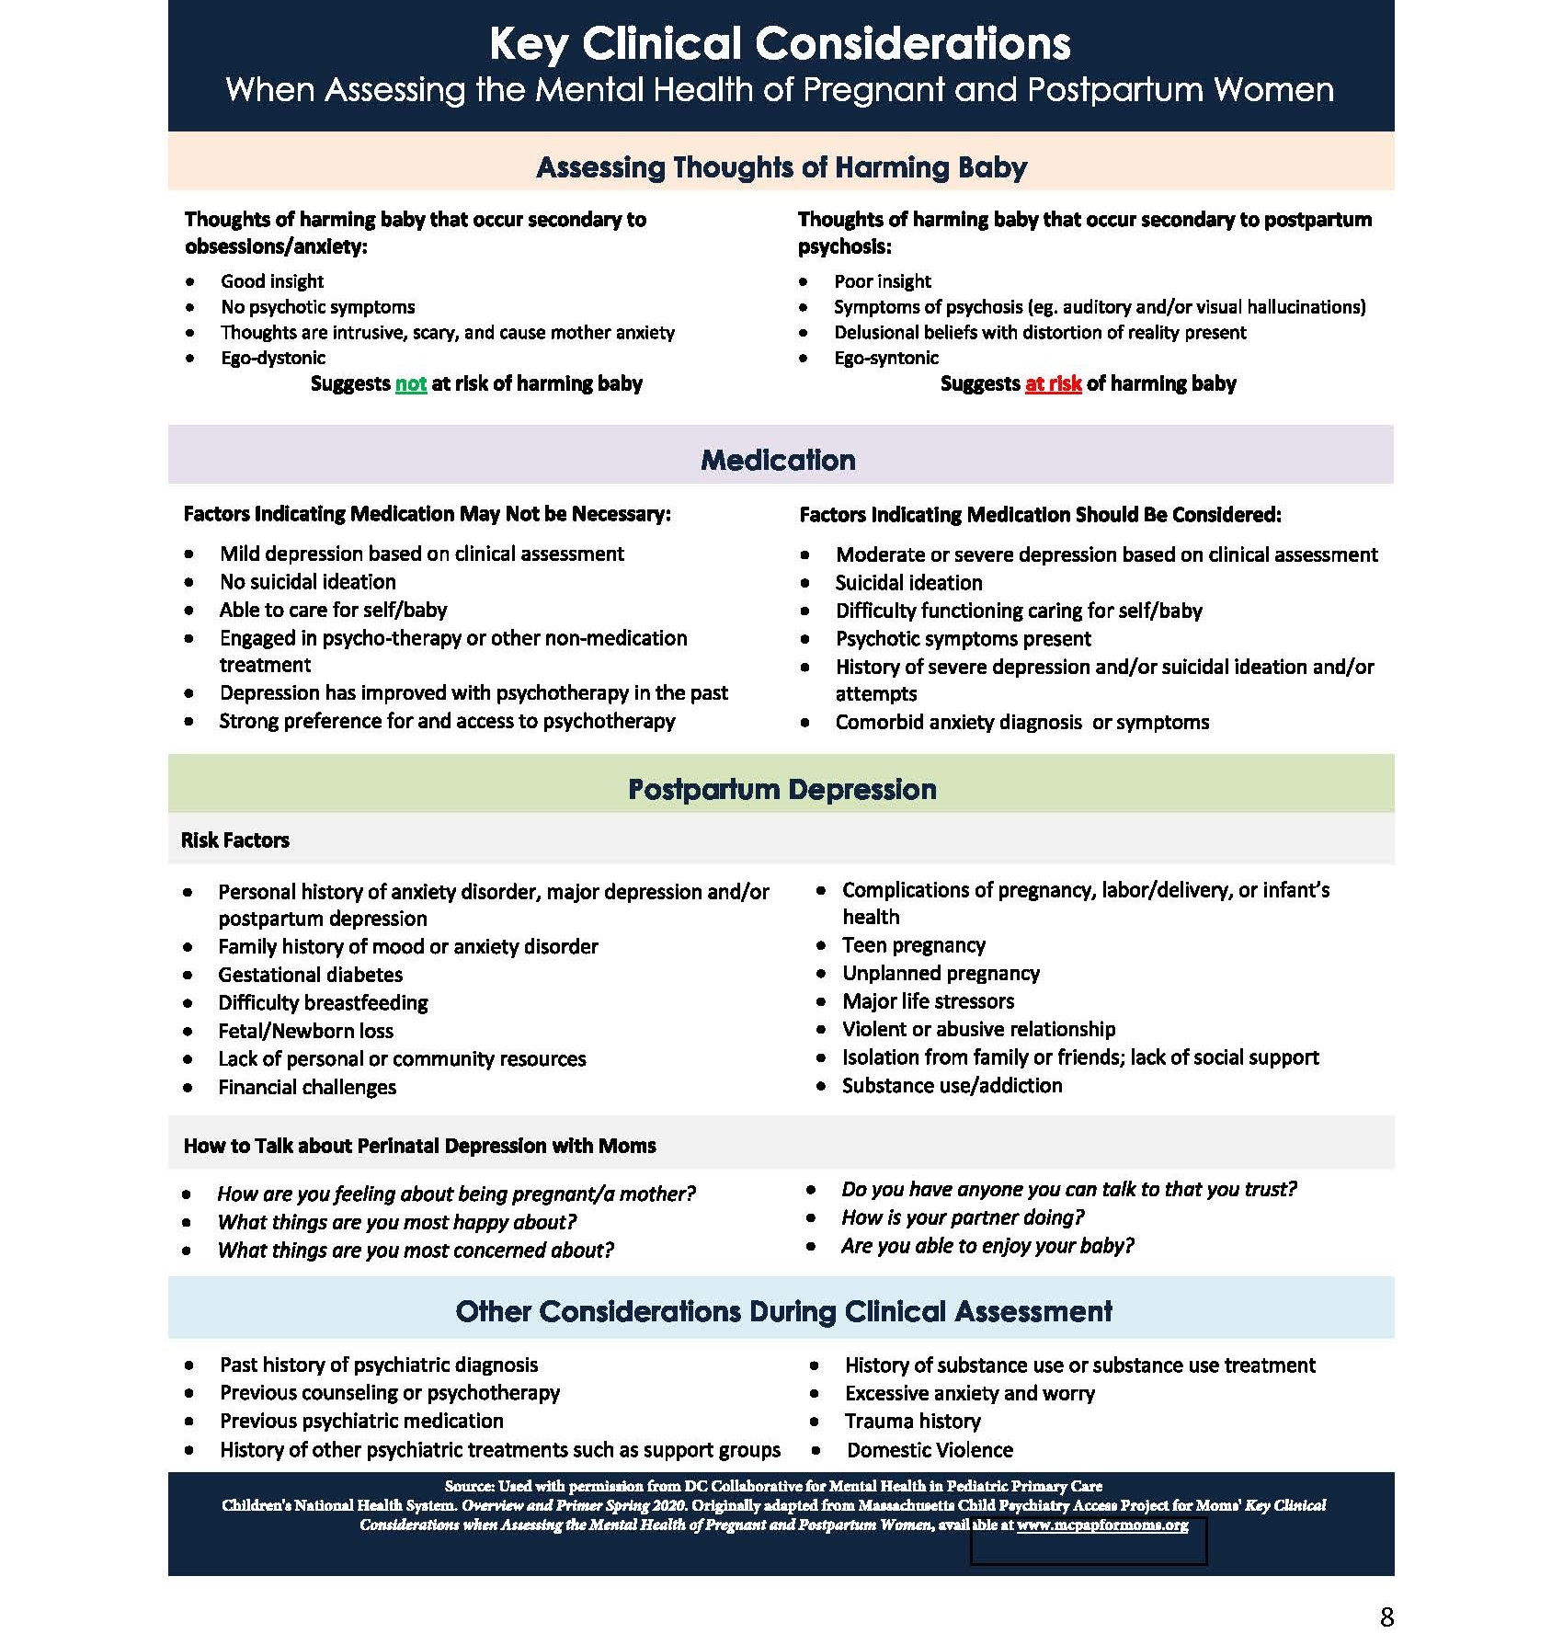
Notes:
Used with permission of DC Collaborative for Mental Health in Pediatric Primary Care

Slide 48
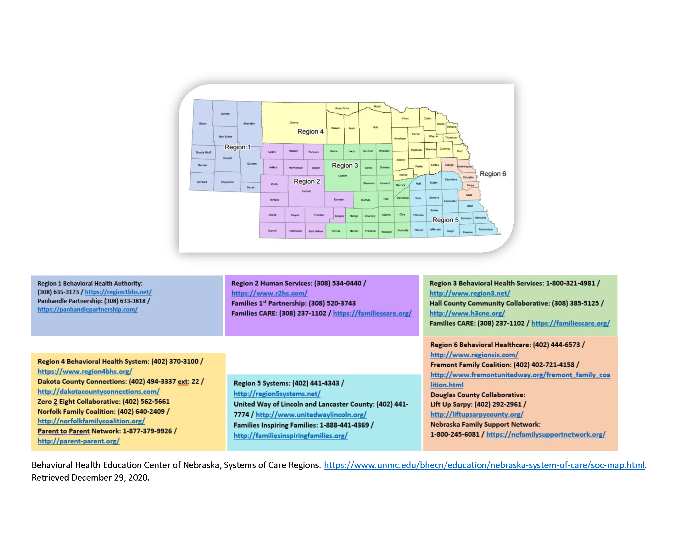
Nebraska Network of Care
Notes:
Google search for private therapists…

Slide 49
Perinatal Mental Health Metrics
Number of hospitals, clinics, and NICU’s screening​
  Screening intervals​
Perinatal Depression Referrals​
  Wait time until first appointment​
Notes:
Initiative Metrics

Slide 50
Sharing Our Progress- Clinics

Slide 51
Notes:
CHI Health will be implementing screening at 43 family medicine clinics which will impact future rates.

Slide 52
Sharing Our Progress- Hospital Discharge
30 out of 47
Notes:
Increase of ~40 %, 30/47

Slide 53
Sharing Our Progress- NICU
12 out of 15
7 out of 15
Notes:
Baseline
15 NICU’s in Nebraska
10 screening mothers
2 screening fathers
Current
12 screening mothers
7 screening fathers

Slide 54
Perinatal Mental Health Referrals
Average wait time 14-21 days ​
Increase in social work and behavioral health referrals as a result of increased screening practices.​

Slide 55
Challenges
Expanding QI initiatives into outpatient clinics ​
COVID-19​
Provider “Buy-In”​
  HIPPA/Legal Concerns​
Pilot Sites:​
  Workflow​
  Documentation in medical record​
Expanding QI initiatives into outpatient clinics ​
COVID-19​
Provider “Buy-In”​
  HIPPA/Legal Concerns​
Pilot Sites:​
  Workflow​
  Documentation in medical record​
Notes:
So what are the challenges of implementing a statewide perinatal depression screening initiative??
Historically NPQIC’s work has been in the hospital setting- moving into outpatient clinics has been challenging. Awareness of who we are and what we do….getting contacts etc. ​
COVID 19- The increased workload and stress of the Covid-19 pandemic have left many healthcare facilities and providers exhausted. We continue to find it challenging to get clinics and providers to engage in new projects. ​
We are hopeful that with the introduction of legislation, increasing awareness of maternal mental health, and slowing of the pandemic that this will improve​
Provider “Buy-In”​
HIPPA/Legal Concerns when moms/dads are not patients in the clinic, ​
AAP Policy Statement 2019- specifically addresses this- Well-being of mother linked to infant. Screening performed for benefit of dyad. PCP focus on dyad and facilitating referral, not providing treatment​
COPIC(Medical Liability Insurance)- continuation of mother’s care and not a HIPPA violation​
Pilot Sites:​
Workflow challenges​
How to document in the MR​

Slide 56
Successes
Demystification​
Identifying at-risk mothers and fathers ​
Ensuring treatment and follow-up​
Providing support to Nebraska families impacted by perinatal mental health disorders​
Providing education to healthcare providers, staff, and key stakeholders
Legislation​
  NE Statute 38.204.01, effective July 21st, 2022​
Provided input to AIM on revisions of the Perinatal Mental Health Bundle
Notes:
Despite these challenges, we’ve also had a lot of success!
Demystification- We are talking about it!! ​
Perinatal depression is common, the mother is not at fault or a bad mother, perinatal depression is treatable! ​
Healthy mother is critical to health of the baby!​
We are identifying at risk mothers and fathers and ensuring that they are getting the necessary treatment and follow-up.​
Providing support to NE families impacted by perinatal mental health disorders​
Legislative success: ​
LB 905, introduced by Senator Lynne Walz (District 15). ​
NPQIC and FFN- provided data from this project and testified on behalf of this bill. ​
The bill recommends mental health screenings for mothers during and after pregnancy and tasks the Board of Medicine and Board of Nursing with crafting policies with providers around maternal depression screenings. ​
Unanimously advanced from the Health and Human Services Committee. ​
Passed on final reading by legislature and approved by the Governor on April 18th​
Statute went into effect on July 21st. ​
​

Slide 57
Culturally Matched Doula Support Initiative
Doula Passage Program
Rooted Doula Care & Support Program

Slide 58
Culturally Matched Doula Support Initiative
Supports the integration of culturally matched doula support for high-risk populations, starting with Black birthing people
Collaborating with I Be Black Girl (IBBG) to build the infrastructure to train doulas and educate the healthcare community on their implementation into the healthcare team
  Establish doula-friendly practices and policies
Survey data from healthcare workers and front-line staff to assess knowledge, attitudes, and past experiences with doulas
Focus groups with Black doulas
Notes:
CDC Grant Update Y1 Focus on reducing disparities and equitable health care practices

Slide 59
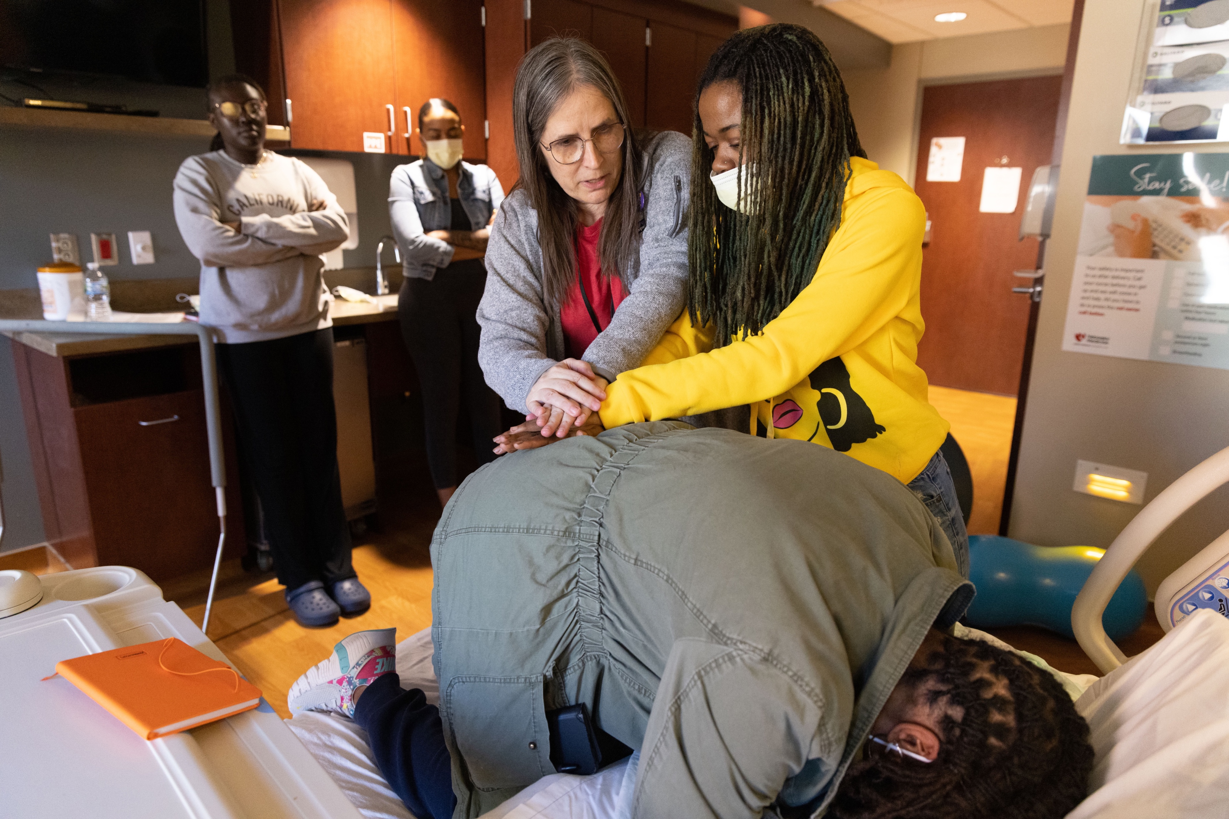
Doula Passage Program
Launched on March 11th, 2023
An intentional learning environment designed to provide education and support to community-based Black doulas
Intent of Program:
  Build a network of community-based Black doulas equipped to serve Black women and people with the capacity for pregnancy through their birth journey.
Ten-week program
  Custom curriculum
  Includes 1-year of peer support and mentorship
39 students graduated in June
Photo courtesy of I Be Black Girl
Notes:
The custom curriculum was designed by and is being delivered by Black women.
Topics: Maternal health landscape, Business training, maternal health/nutrition, trauma informed care, conflict management, power and choice, birth and postpartum support, CPR, lactation
Overwhelming response... 12, 30 then 40 with over 100 applicants. Applied, 2 rounds of interviews. Receive a stipend.
Thirty-nine students graduated from the program in June and are now able to serve birthing people within their community
Recruitment for second cohort is underway

Slide 60
Doula Passage Program
Goals:
  Create a shared learning platform for Black doulas in Nebraska
  Provide peer support and mentorship for Black doulas
  Create model(s) that allows Nebraska to recognize and reimburse doula services
  Create a standard of care and build expectations for the relationship between pregnant and birthing people and their doula (s)
  Role model a structure that can ripple and help better serve other birthing populations of color

Slide 61
UHC: Rooted Doula Care and Support Program
Doula pilot project for BIPOC birthing people in Douglas and Sarpy County
Funded by Medicaid MCO, United HealthCare Prevention Pathways Program
Partnership with IBBG, a Mothers Love, and Nebraska Medicine to provide doula support for high-risk birthing people at no cost
NPQIC and United Health Care will collect data on outcomes for those participating in the pilot
Pilot launched in June of 2023
Provide rigor and definition for doula practices to help inform future policy or coverage considerations
Notes:
Enroll 30 women- cohorts of 10
Up to 8 prenatal visits, unlimited contact, L/D support, f/u 6 months.
Outcomes we will track:
(a)CSxn rates (c) Epidural rates (d) Gestational Age at delivery (e) Birth weight (f) Maternal morbidity/mortality rates (g) NICU admission (h) Breastfeeding at 6 months (i) HEDIS PPC measures (prenatal visit and postpartum visit) (j) Satisfaction survey (k) Early notification of pregnancy (l) Visit compliance (m) Smoking cessation (n) Depression screening
This program is open to: • Black pregnant people up to 20 weeks pregnant • Live in Douglas and Sarpy Counties (NE) • Have NE Medicaid coverage through United Healthcare • Will give birth at Nebraska Medicine

Slide 62
Our Progress
Qualitative Data
  Surveys
  Focus Groups Black Doulas
Cohort #2 Doula Passage Program
Birth Equity Initiative
  Creation of doula-friendly policies
  Implementing respectful and equitable care practices
  Collaboration with patients and community members
  Implicit bias training for care teams
Notes:
Education of healthcare teams and sharing our work with patients, community and others.

Slide 63

www.npqic.org

Slide 64
Thank You!

Slide 65

State Quality Collaborative Leaders Panel Q&A

