Slide 1
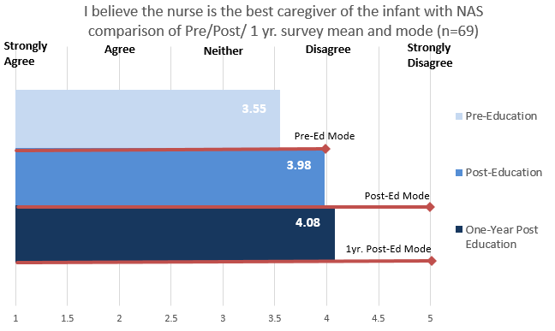
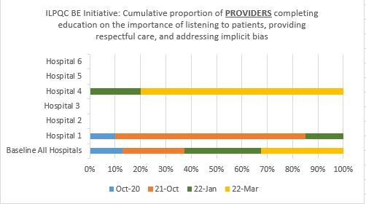
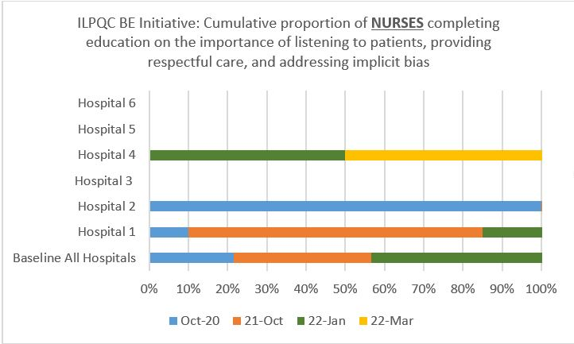
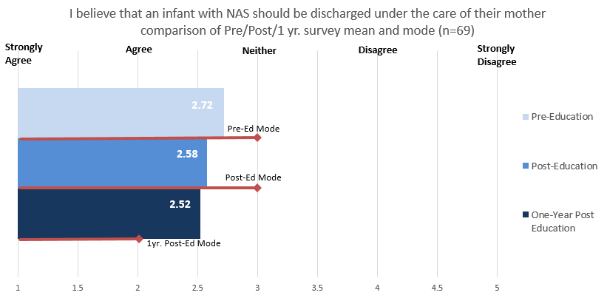
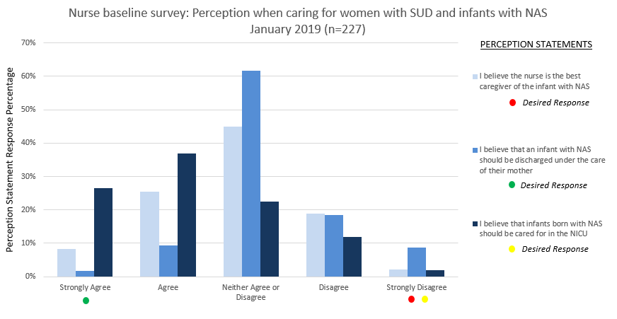
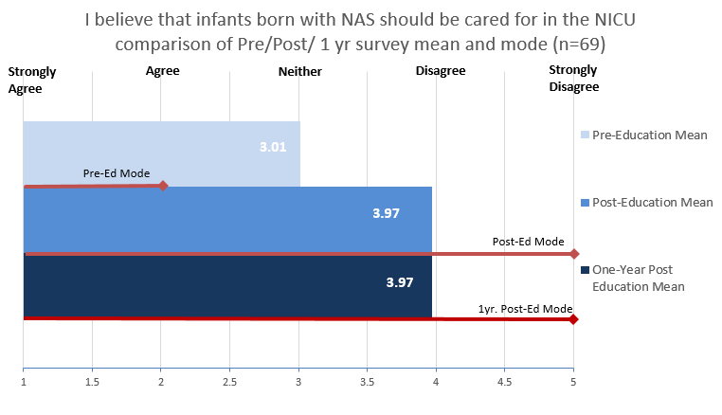
Implementing Standardized Education to Identify and Reduce Nurse Stigma and Bias
Toward Mothers with Substance Use Disorder (SUD) and Improve Birth Equity
Roma Allen, DNP, MSN ed., RNC- OB, Lisa Festle, MSN, RNC-NIC, APRN/CNS
Administrative Perinatal Center (APC), Loyola University Medical Center (LUMC)
ILPQC 2022
Perinatal Network Storyboard
LUMC Perinatal Network Overview
Post Implementation Survey
ILPQC Birth Equity
The Loyola University Medical Campus is located in Maywood, a western suburb approximately 13 miles from the Chicago loop. LUMC receives consults, referrals, and transports from its network hospitals and throughout Cook, Will and DuPage counties. The LUMC Perinatal Network has more than 10,000 births annually.
214 nurses from the perinatal network participated in the training modules
Nurses that completed the pre-education provider perception survey repeated the survey immediately following program completion
One year later, those nurses were invited to participate in the same survey
69 (32%) completed the one year survey, providing a comparison of pre-education, immediate post-education, and one year post-education to measure sustained changes in nurse attitude
To help improve Illinois maternal morbidity and mortality rates, ILPQC initiated a new project in June, 2021, Birth Equity, to address disparities in maternal health, social determinants of health factors, and implicit bias.
One major component of this initiative concentrates specifically on educating providers, nurses, and staff on the importance of listening to patients, providing respectful care and addressing implicit bias.
Prior to the start of the Birth Equity project, all Illinois birthing hospitals were asked to share completed education by healthcare workers on implicit bias.
In March, 2022, 50% of Loyola APC network hospitals had implicit bias education completed by 100% of both providers and nurses.
The LUMC Perinatal Network
Loyola University Medical Center Ascension St. Alexius Ascension Alexian Brothers
Ascension Resurrection Morris Hospital MacNeal Hospital
Non-Birthing Hospitals:
Community First Hospital Loretto Hospital Gottlieb Hospital
Sustained Change
In 2018, the Illinois Perinatal Quality Collaborative (ILQPC) launched a state-wide project to address Mothers and Newborns Affected by Opioids (MNO). At this time, the Loyola APC initiated a standardized Vermont Oxford Network (VON) bias training program for its network nurses. Program modules focus on increasing awareness of a nurse's own bias that affects their interactions when providing care to women with SUD and infants born with Neonatal Abstinence Syndrome (NAS).
Project AIM
Loyola APC Network nurses participating in a perinatal education program to reduce bias will have the tools to identify and change their own perceptions and attitudes, creating a trusting nurse patient relationship to improve care of mothers with SUD and for infants with NAS.
Nurses from five network birthing hospitals with varying levels of care and demographics will participate in the VON bias training program.
Pre-, post-, and one year post-training surveys will measure immediate and lasting changes in nurse attitude.
Improved over 1yr.
Continuing Education & Training
Literature supports the need for reinforcement of bias training and continued education to maintain an improved culture of caring for women with SUD and is essential to sustain change:
Negative attitudes by healthcare workers towards women with SUD can threaten their therapeutic relationship and prevent women from seeking prenatal care and disclosing substance use
Evidence demonstrates nurses educated in SUD can decrease the disparity during pregnancy by advocating for change, endorsing language appropriate communication, and applying training to improve the equity of care
Ongoing staff education and learning opportunities (including continuing nursing education credit) on SUD, stigma, bias and discrimination, and trauma-informed care should be offered in all maternity care settings
Baseline Survey Results
227 nurses from five birthing hospitals voluntarily participated in an anonymous survey to measure their perceptions and attitudes toward mothers with SUD and caring for infants with NAS.
Three statements from overarching themes of the literature review were selected as survey questions to determine opportunities for change.
Sustained Change
Next Steps
Encourage SUD education for all nurses (i.e. annual review, orientation)
Utilize universal SUD screening tool to recognize women with SUD and design appropriate, individualized plan of care
APC to provide trauma-informed care education (introduction given at APC Network Nurse Council meeting for network leadership, 3/2021)
Participation by network hospitals to utilize resources from the ILPQC MNO project
Introduce birth equity questions at network hospital maternal morbidity and mortality case reviews to recognize identification and intervention opportunities for women with SUD
Encourage network hospitals to create a multidisciplinary birth equity committee that will champion change
Implementation
Outcomes
Date | Step
1/2019 | Obtain baseline perception survey and evaluate opportunity for improvement
5/2019 | Initiate the project with an informative session for network hospital nurses titled, It Starts with Us: Decreasing Stigma Related to Substance Use Disorder Presentation: Stigma and Bias Experienced by Women with SUD Keynote Speaker, Testimony: Woman with SUD; treatment in the healthcare system and beyond Group discussion
6/2019 | Each hospital has a designated champion (that will encourage staff participation and endorse and model program concepts by applying to their practice); a minimum of five core team members will be assigned to complete all (18) learning modules.
7/2019 Thru 11/2021 | *VON education modules assigned to all champion and core team members Feedback obtained from champions and core team members: Ease of access and use of online training program Evaluation and applicability of new knowledge to practice Selection of eight essential modules for all nurses to complete when assigned
8/2019 thru 8/2021 | Eight education modules assigned to all network nurses Pre- and post-surveys to measure nurse attitude toward maternal patients with SUD Steps to work on in conjunction with staff completing VON education modules: Pledge to use the correct language with each other and when speaking to patients Evaluate written material for correct terminology Implement prenatal and intrapartum SUD universal screening Create/Revise standards that address the unique needs of women with SUD Create collaborative care plan with mother During quarterly APC facilitated network hospital meetings, an open forum was used to discuss challenges with the education program, staff buy-in, and lessons learned. Education modules were available for two years for enrollment and as resource materials
Results indicate participation in a bias training program has an immediate and lasting effect on nurses’ perceptions and attitudes of maternal SUD and caring for infants with NAS, evidenced by pre-, post-, and one year post- education survey.
The implementation plan included action steps that were initiated by network hospitals that could have contributed to positive survey responses.
Sustaining positive change and decreasing bias and stigma requires ongoing education, reinforcement of training, and organization accountability to culture change by supporting destigmatizing practice.
Challenges
Acknowledgement
Inclusion criteria limited to nurses that have continued employment one-year post education resulting in loss of participants and need to educate new hires
Not all nurses completed the pre and post perception survey and were then excluded from the one year survey because sustained change would be unmeasurable
Education was limited to nursing, creating an opportunity to strengthen a changing
culture by all healthcare providers participating in bias training
The standardized education was available for a limited time
Thank you to participating Loyola University Medical Center Network hospital leadership and nurses with your engagement and collaboration in implementing the VON training program to reduce stigma and bias.
Loyola University Medical Center
Ascension Alexian Brothers
Ascension Resurrection
Ascension Saint Alexius
Morris Hospital

Slide 2
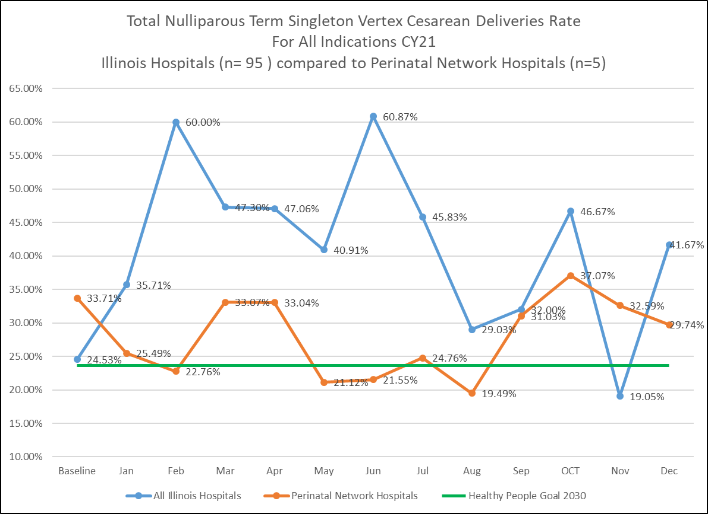
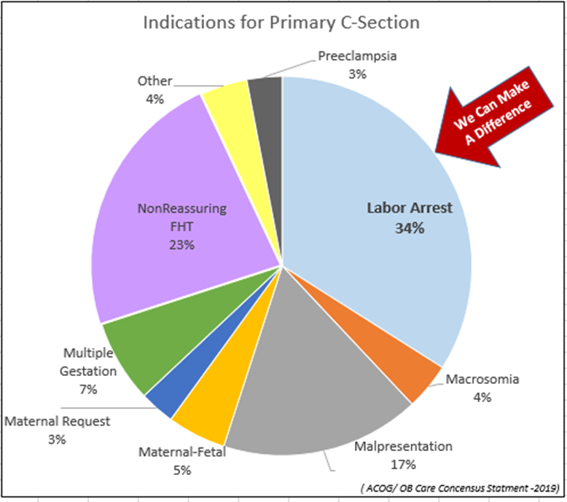
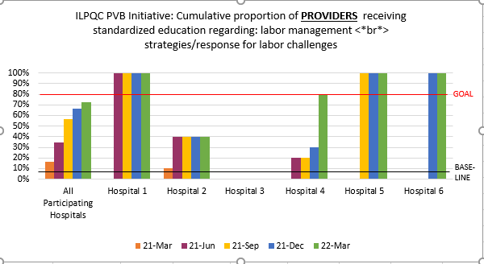
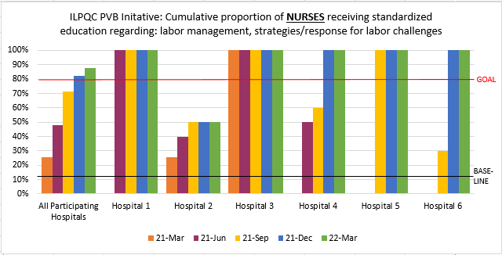
Promoting Vaginal Deliveries through Labor Support Education for Perinatal Nurses
Stephanie Loiacono BSN, MS, RNC-OB, CBC and Roma Allen DNP, MSN ED., RNC-OB
Administrative Perinatal Center (APC), Loyola University Medical Center (LUMC)
ILPQC 2022
Perinatal Network Storyboard
LUMC Perinatal Network Overview
Method /Timeline
The Loyola University Medical Campus is located in Maywood, a western suburb approximately 13 miles from the Chicago loop. LUMC receives consults, referrals, and transports from network hospitals and throughout Cook, Will and DuPage counties.
December 2019 to June 2020-
APC outreach educators; with network hospital educators, collaborated to create an online educational module highlighting the significance of and techniques for labor support that promotes vaginal birth. This included a video demonstrating multiple birth positions.
November 2020-
All hospitals labor nurses participated in the education via their online education platform.
.
January 2021-
99% of network nurses completed the online education.
June 2021 and January 2022
Network hospital labor nurses were offered an APC endorsed labor support full day workshop. The interactive, hands on workshop focuses on techniques to improve fetal position and descent through knowledge of the effects of maternal positions, along with impact of uterine ligaments and pelvic muscles. Solutions for long and/or posterior labors, and labor dystocia are addressed.
Ongoing-
Network hospitals will report practice changes related to endorsing labor support techniques through nurse council feedback and nurse surveys.
ILPQC
APC rates are less!
The LUMC Perinatal Network
Loyola University Medical Center Ascension St. Alexius Ascension Alexian Brothers
Ascension Resurrection Morris Hospital MacNeal Hospital
Non-Birthing Hospitals
Community First Hospital Loretto Hospital Gottlieb Hospital
The LUMC Perinatal Network has more than 10,000 births annually
Introduction/Background
The Healthy People 2030 Obstetric objective is reduction of nulliparous, term, singleton, vertex (NTSV) cesarean sections to 23.6% (www.healthypeople.gov). Labor progress complications is the highest indication for a primary cesarean. Evidence shows a woman who receives continuous labor support is less likely to have a cesarean delivery. Implementation of labor support strategies requires specific knowledge and skills of labor nurses. Effective labor support techniques minimize labor arrest and dystocia, thereby decreasing cesarean sections (ACOG Obstetric Care Consensus No.1, 2014).
Conclusion
Results
Educational programs aimed at improving nurses knowledge of labor support in the APC network hospitals have likely contributed to decreasing the network hospitals NTSV cesarean section rates.
Surveyed nurses report satisfaction with both educational programs, stating that improving their knowledge and application of labor support techniques has contributed to decreasing NTSV cesarean sections.
Protocols and guidelines for induction and labor progress, as well as provider and patient education supporting culture change can also contribute to lowering NTSV cesarean rates
Recommendations
Continue offering labor support education, literature suggests it may decrease NTSV cesarean section rates.
New and experienced nurses can utilize the available online education to increase knowledge and/or review
Hands on labor support workshops should be prioritized as a necessary educational need and be included in quality improvement plans to support practice change.
Survey suggestions include: “more hands on classes on labor support, include physicians in education, culture change for more patience providing more time for labor progress”.
Next Steps
3/8/2022 Perinatal nurse council members have agreed to continue education through collaboration on design and implementation of a second phase focusing on “Second Stage of Labor Support Techniques”.
The Illinois Perinatal Quality Collaborative (ILQPC) has responded to high cesarean section rates with the initiative of Promoting Vaginal Birth (PVB). All LUMC network hospitals are participating in the ILPQC PVB initiative; actively working to decrease their NTSV cesarean section rates
Results
1/4/2021: 99% of network nurses completed the online labor support education
1/24/2022: 23% of network nurses participated in labor support workshops
Perinatal hospitals NTSV cesarean section rates are less than the average of other Illinois hospital rates for 2021 (see graph)
Nurse Survey results 4/2022:
Prior to this initiative over 80% of respondents had not had any other education on labor support techniques
100% of respondents stated both the virtual education and hands on education were very or extremely helpful in providing labor support
Over 70% of respondents feel their gained knowledge has helped decrease their institution's Cesarean Section rate related to labor dystocia and/or labor arrest
Over 90% of respondents desire to learn more about second stage labor support.
We Can Make
A Difference
We Can Make
A Difference
Project Identification
Challenges
The Loyola Administrative Perinatal Center (APC) is designated by The Illinois Department of Public Health (IDPH) to provide resources; including education, to its network hospitals that improve maternal outcomes. The APC network nurse council recognized the need for labor support nurse education through group discussion and sharing bedside observations. This practical need was identified as a component of the ILPQC PVB Initiative and Healthy People Obstetric goal to decrease cesarean section rates. Therefore, a shared nurse council decision was made to create a network wide initiative aimed at nurse education specific to learning labor support techniques.
Cultural change that allows for more time in labor and increased labor support interventions is difficult to achieve, and measure.
Normalized deviance promotes regression to old practices.
Traditional hierarchy by roles impair shared decision making.
Survey results and literature identify physician resistance to change.
Acknowledgement
Project AIM
We would like to thank Theresa Salgado for co-chairing this project with us and all of the Loyola APC network hospitals’ educators for collaborating on this important education initiative:
Peggy Farrell, Ascension Alexian Brothers
Kara Calhoun, Ascension Resurrection
Tori Hansen, Allison Henke-Schotke, Kellie Smith; Ascension Saint Alexius
Julie Dervishoski Loyola University Medical Center
Karen Richardson, MacNeal Hospital
Julie Kerr, Morris Hospital
Thank you to all of the nurses and staff in the LUMC APC network for their dedication to quality & patient safety!
Network hospital nurses will understand the significance of labor support and apply learned principles to decrease NSTV Cesarean Section deliveries.
80% network nurses will complete education on labor support significance and techniques
The APC will offer network nurses interactive labor support workshops
ILPQC data shows positive progression of Nurse Labor Support Education and supports the need for Provider inclusion. Drill down is needed to identify barriers at Hospital 2.

Slide 3
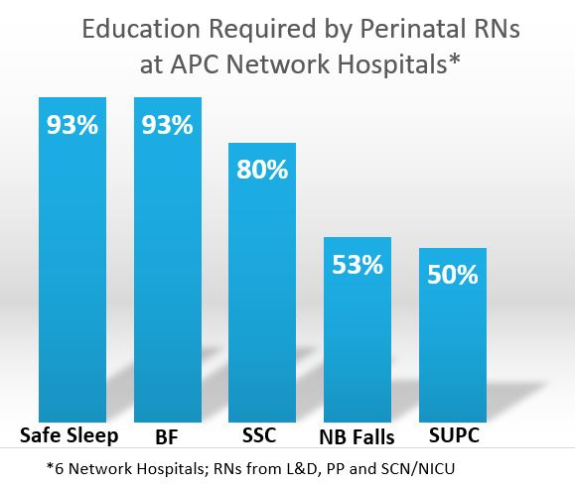
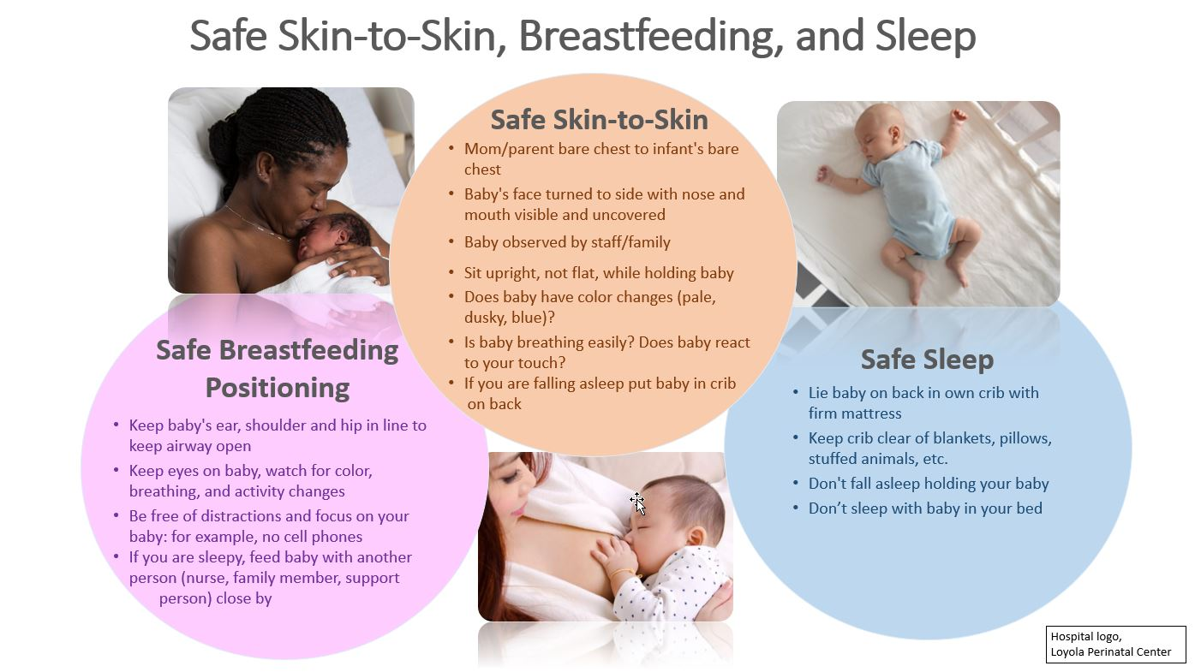
Implementation of a Regional Education Program on Sudden Unexpected Postnatal Collapse (SUPC)
for Perinatal Staff and Their Patients/Families
Lisa Festle, MSN, RNC-NIC, APRN/CNS and Stephanie Loiacono, BSN, MS, RNC-OB, CBC
Administrative Perinatal Center (APC), Loyola University Medical Center (LUMC)
ILPQC 2022
Perinatal Network Storyboard
LUMC Perinatal Network Overview
Project AIM Statements
Barrier & Strategies
The Loyola University Medical Campus is located in Maywood, a western suburb approximately 13 miles from the Chicago loop. LUMC receives consults, referrals, and transports from its network hospitals and throughout Cook, Will and DuPage counties. The LUMC Perinatal Network has more than 10,000 births annually.
By March 31, 2022, the Loyola APC network hospitals will provide SUPC education for its nurses and healthcare workers caring for postpartum women and their newborns, and also for new mothers and their families, as evidenced by completion of required education activities.
On April 1, 2022, standardized parent education will be implemented as demonstrated by quarterly audits starting July, 2022 (for Q2: April, May, June).
Bedside staff nurse perception of “more work”:
APC to provide evidence-based practice education and resources
Staff/educator and leadership shared decision-making
Risk of inadequate/missed parent education:
All patients and families should be given the same education and support -
Benefits of SSC & BF
Components of safe positioning during SSC & BF
Avoiding all distractions during SSC & BF
Not sleeping while holding baby
Supervised SSC/BF
What to look for – signs of SUPC
Safe to Sleep/Back to Sleep instructions when infant placed to sleep/in crib
Lactation consultation/support as needed
Biased attitudes of maternity/newborn care providers:
Promote staff awareness of their own biased attitudes and beliefs (explicit or implicit), and how these can affect actions, behaviors, decisions, & patient care
Treat all patients with neutral compassion, care, and respect
Sustainability:
All new hires complete education module and pre- and post- assessment surveys
Incorporate SUPC education into annual competencies
Complete quarterly audits to track parent education
The LUMC Perinatal Network
Loyola University Medical Center Ascension St. Alexius Ascension Alexian Brothers
Ascension Resurrection Morris Hospital MacNeal Hospital
Non-Birthing Hospitals
Community First Hospital Loretto Hospital Gottlieb Hospital
Methods & Project Timeline
Introduction/Background
Date | Action | Responsible
Dec 2021 – Feb 28, 2022 | Review available SUPC network materials Review literature (1, 10, 14) Develop standardized: - SUPC education module for staff - Staff pre- & post-education assessment tools | All Educators
March 1 – 31, 2022 | Provide/Assign/Complete staff standardized SUPC education: - Online module - Pre- and post-education assessment surveys Create standardized parent education materials | All Educators
April 1, 2022 (Q2: April, May, June) | Standardized SUPC education given to parents/families Develop audit form | Network Educators & Staff; All Educators
July, 2022 | Perform quarterly audit | Network Educators/ Designee
August 1, 2022 | Report audit results; Assess and continue/make changes as needed | Network Educators & APC Outreach Educators
Hospital practices to initiate skin-to-skin care (SSC) and breastfeeding (BF) immediately after delivery may have the unintended consequence of Sudden Unexplained Postnatal Collapse (SUPC) of the newborn, a rare but serious event, with death in half of reported cases and neurologic damage with disabilities in the majority of survivors (1, 2).
The Loyola Administrative Perinatal Center (APC) is designated by The Illinois Department of Public Health (IDPH) to provide education and quality improvement resources, to its network hospitals that improve maternal and newborn outcomes. The APC created an education project with its network hospitals to provide standardized SUPC education for staff and parents/families.
Overview
The incidence of SUPC varies widely from 2.6 - 133/100,000 infants, most likely due to different definitions, inclusion/exclusion criteria, and reporting (1, 3, 4).
SUPC is most commonly defined as:
the sudden collapse of an apparently healthy newborn
typically born at ≥35 wks gestational age
with 5-min Apgar score >8
discovered in a state of cardiorespiratory failure during SSC
Collapses usually occur within the first 7 days of life, with the infant requiring resuscitation with intermittent positive pressure ventilation (1, 5).
Racism and bias may also adversely affect BF and outcomes among Black women. Studies reveal they receive fewer lactation support referrals and limited assistance. Inadequate education, support, and supervision places Black women at increased risk for poor outcomes, and potentially SUPC (6, 7, 8, 9, 10, 11).
Next Steps
Readminister SUPC post-education survey: Measure retention of initial education in one year
Evidence-based practice change considerations:
Policy statements addressing SUPC: Add addendum/incorporate into an existing policy at each hospital
Implementation
Results
SUPC Education Module
All hospitals successfully launched online module, March 1-31
Pre- and post-SUPC Education Assessments
Survey links/QR codes embedded into module
Parent Education Materials for In-Hospital & Discharge Teaching
Poster/handout, April
Quarterly Audits
10 chart audits per month
358 staff completed pre-education assessment survey
313 staff completed post-education assessment survey
Conclusions
Gap in Education
Six delivering hospitals totally over 10,000 deliveries/year worked collaboratively with the APC to implement a standardized SUPC education program. This project will help perinatal nurses recognize at-risk mothers and newborns, prevent SUPC, and report events which would be previously unidentified. As a result of this education, additional practice changes may be considered to further identify/prevent SUPC of the newborn.
SUPC is likely more common than reported. Studies indicate estimates are lower than actual collapses in hospitals, reflecting only severe events (3). Most hospitals do not screen for "at-risk" newborns or mothers, and have no standardized protocols or patient/family teaching materials regarding possible dangers during SSC/BF (4).
Improvement of SUPC knowledge noted in post-education survey.
Opportunity identified to reinforce maternal risk factors:
Primip
Maternal fatigue
Maternal obesity
Medications causing drowsiness/
sedation
Distraction in caregivers
Maternal smoking during pregnancy
Unsafe newborn positioning
SSC/BF
The Loyola APC surveyed its six network hospitals' perinatal educators, asking what staff and patient/family SUPC education and safe infant holding practices they provide.
Results showed all hospitals had some safe sleep, SSC, BF, and falls prevention practices/education in place; only three had SUPC-specific education for nurses and parents/families.
Thank you to Crystal Antos (Ascension Saint Alexius) for co-chairing this project with us and all of the Loyola APC network hospitals’ educators for collaborating on this important education initiative:
Peggy Farrell, Ascension Alexian Brothers
Kara Calhoun, Ascension Resurrection
Tori Hansen, Allison Henke-Schotke, & Kellie Smith, Ascension Saint Alexius
Julie Dervishoski & Lindsey Young, Loyola University Medical Center
Karen Richardson, MacNeal Hospital
Julie Kerr, Morris Hospital
Thank you all of the nurses/staff in the Loyola APC network for their dedication to keeping all patients safe!
References
Based on results of the network surveys collected in November 2021, and literature supporting that SUPC education and prevention bundles make a difference in SUPC rates (10), the Loyola APC outreach educators and its network hospital educators designed an SUPC Quality Improvement project.
Contact Information
lfestle@lumc.edu
Stephanie.Loiacono@luhs.org
Literature cites that the prevention of SUPC should focus on: 1) Safe, early SSC in the delivery
room through day of life 7, 2) Supervised BF, and 3) Safe positioning of the infant during sleep (2, 12, 13, 14, 15).

