Slide 1
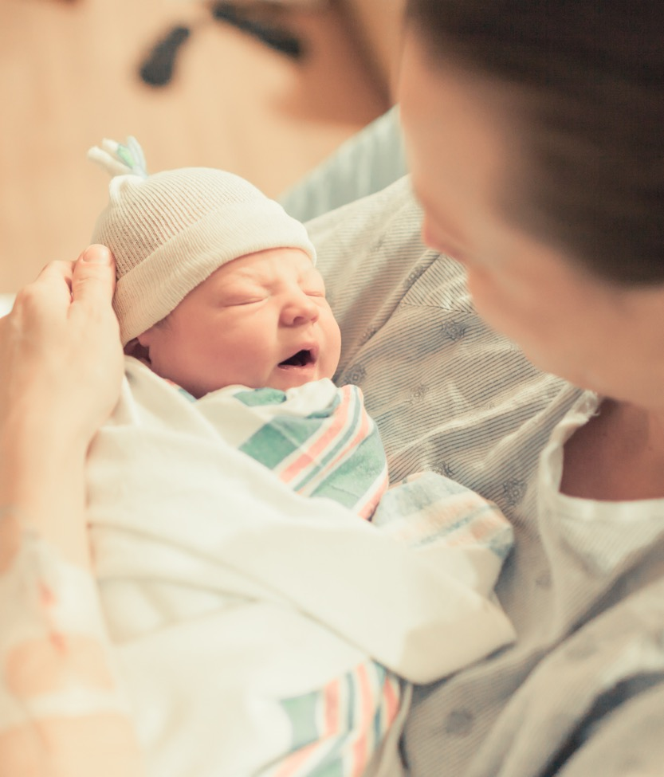
Neonatal Face-to-Face 2022 Storyboards (Perinatal Levels 2/2E)

Slide 2
Perinatal Level 2

Slide 3
Participating hospitals
Perinatal level | Hospital name
2 | Carle BroMenn Medical Center
2 | FHN Hospital
2 | Memorial Hospital Shiloh
2 | NM Huntley
2 | NM Palos Hospital
2 | Riverside Medical Center
2 | Silver Cross Hospital
2 | SSM Health Good Samaritan
2E | Advocate Condell Medical Center
2E | Advocate Sherman Hospital
2E | Ascension Resurrection
2E | Franciscan Alliance, Olympia Fields
2E | OSF Little Company of Mary Medical Center
2E | OSF Saint Anthony Medical Center

Slide 4
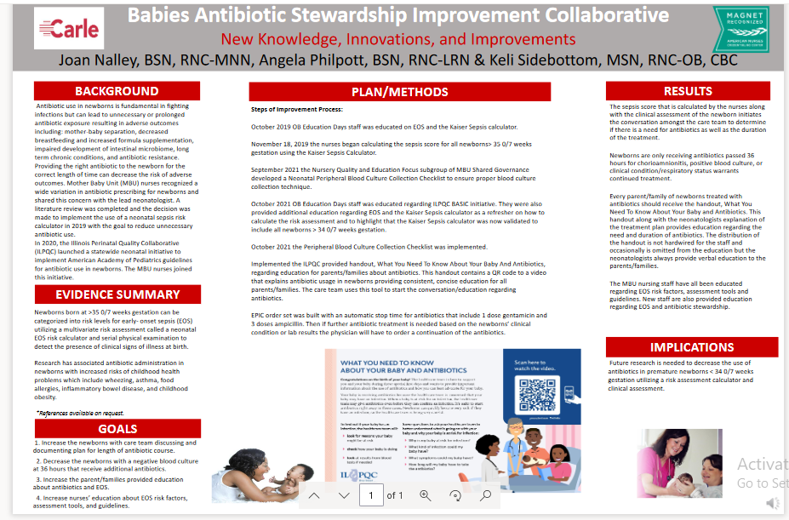
FHN Memorial Hospital
Notes:
Folders, coordinated discharge worksheet,

Slide 5
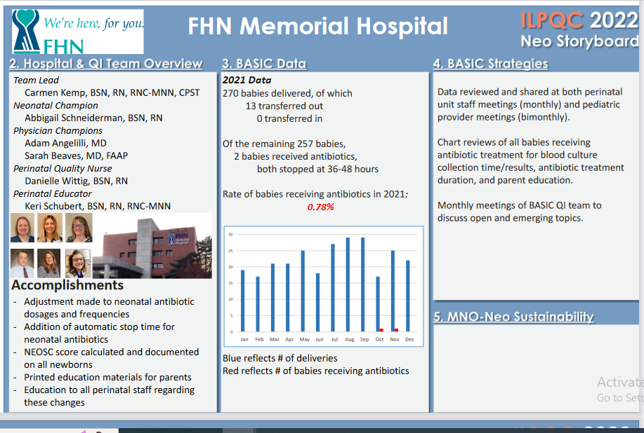
FHN Memorial Hospital
Notes:
Folders, coordinated discharge worksheet,

Slide 6
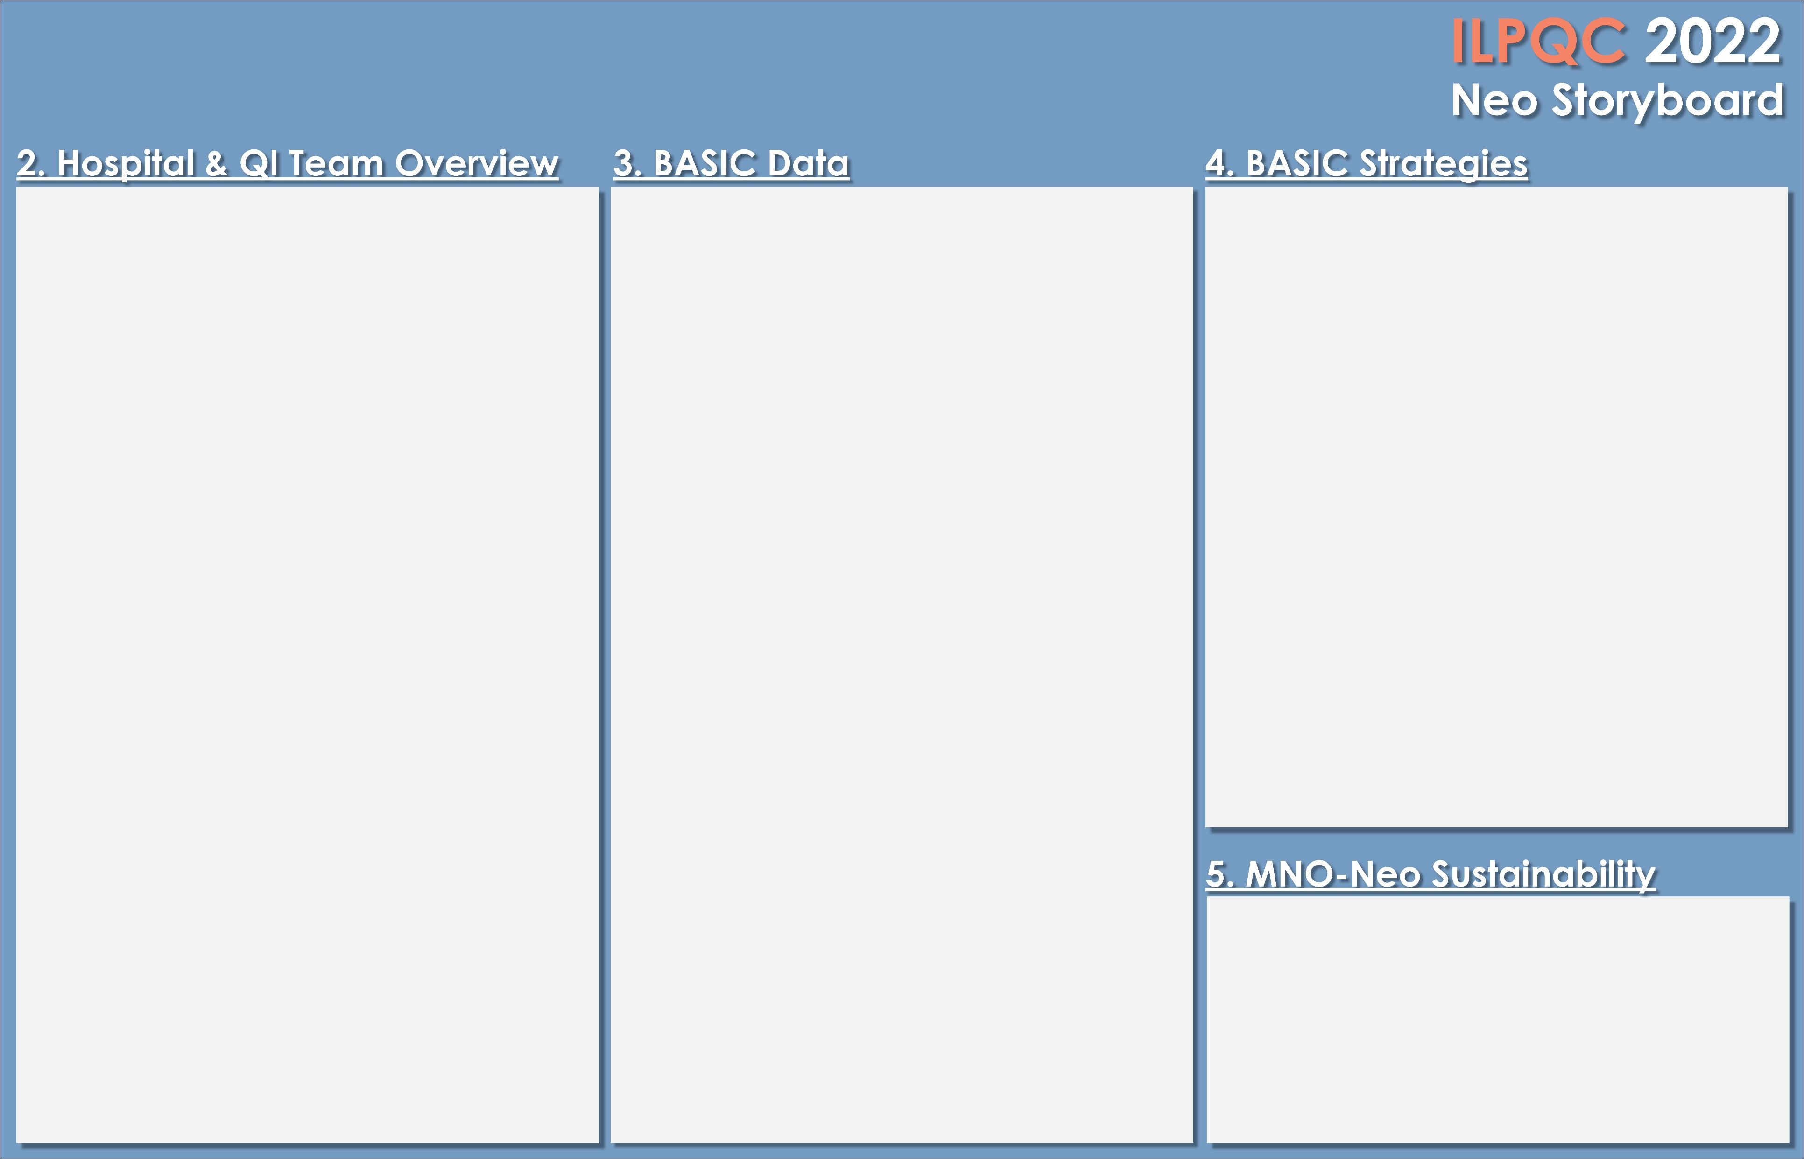

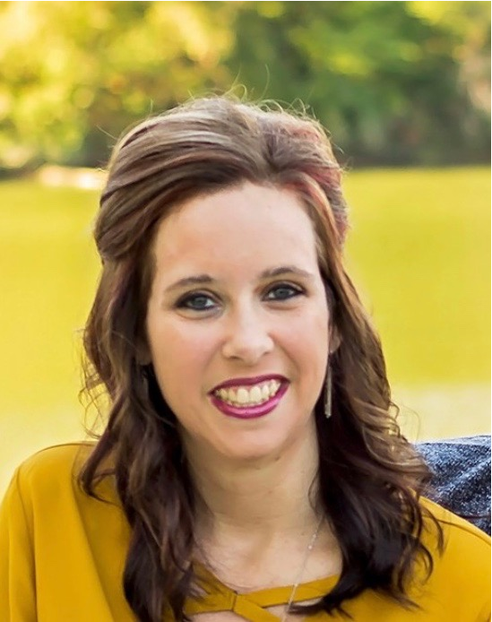
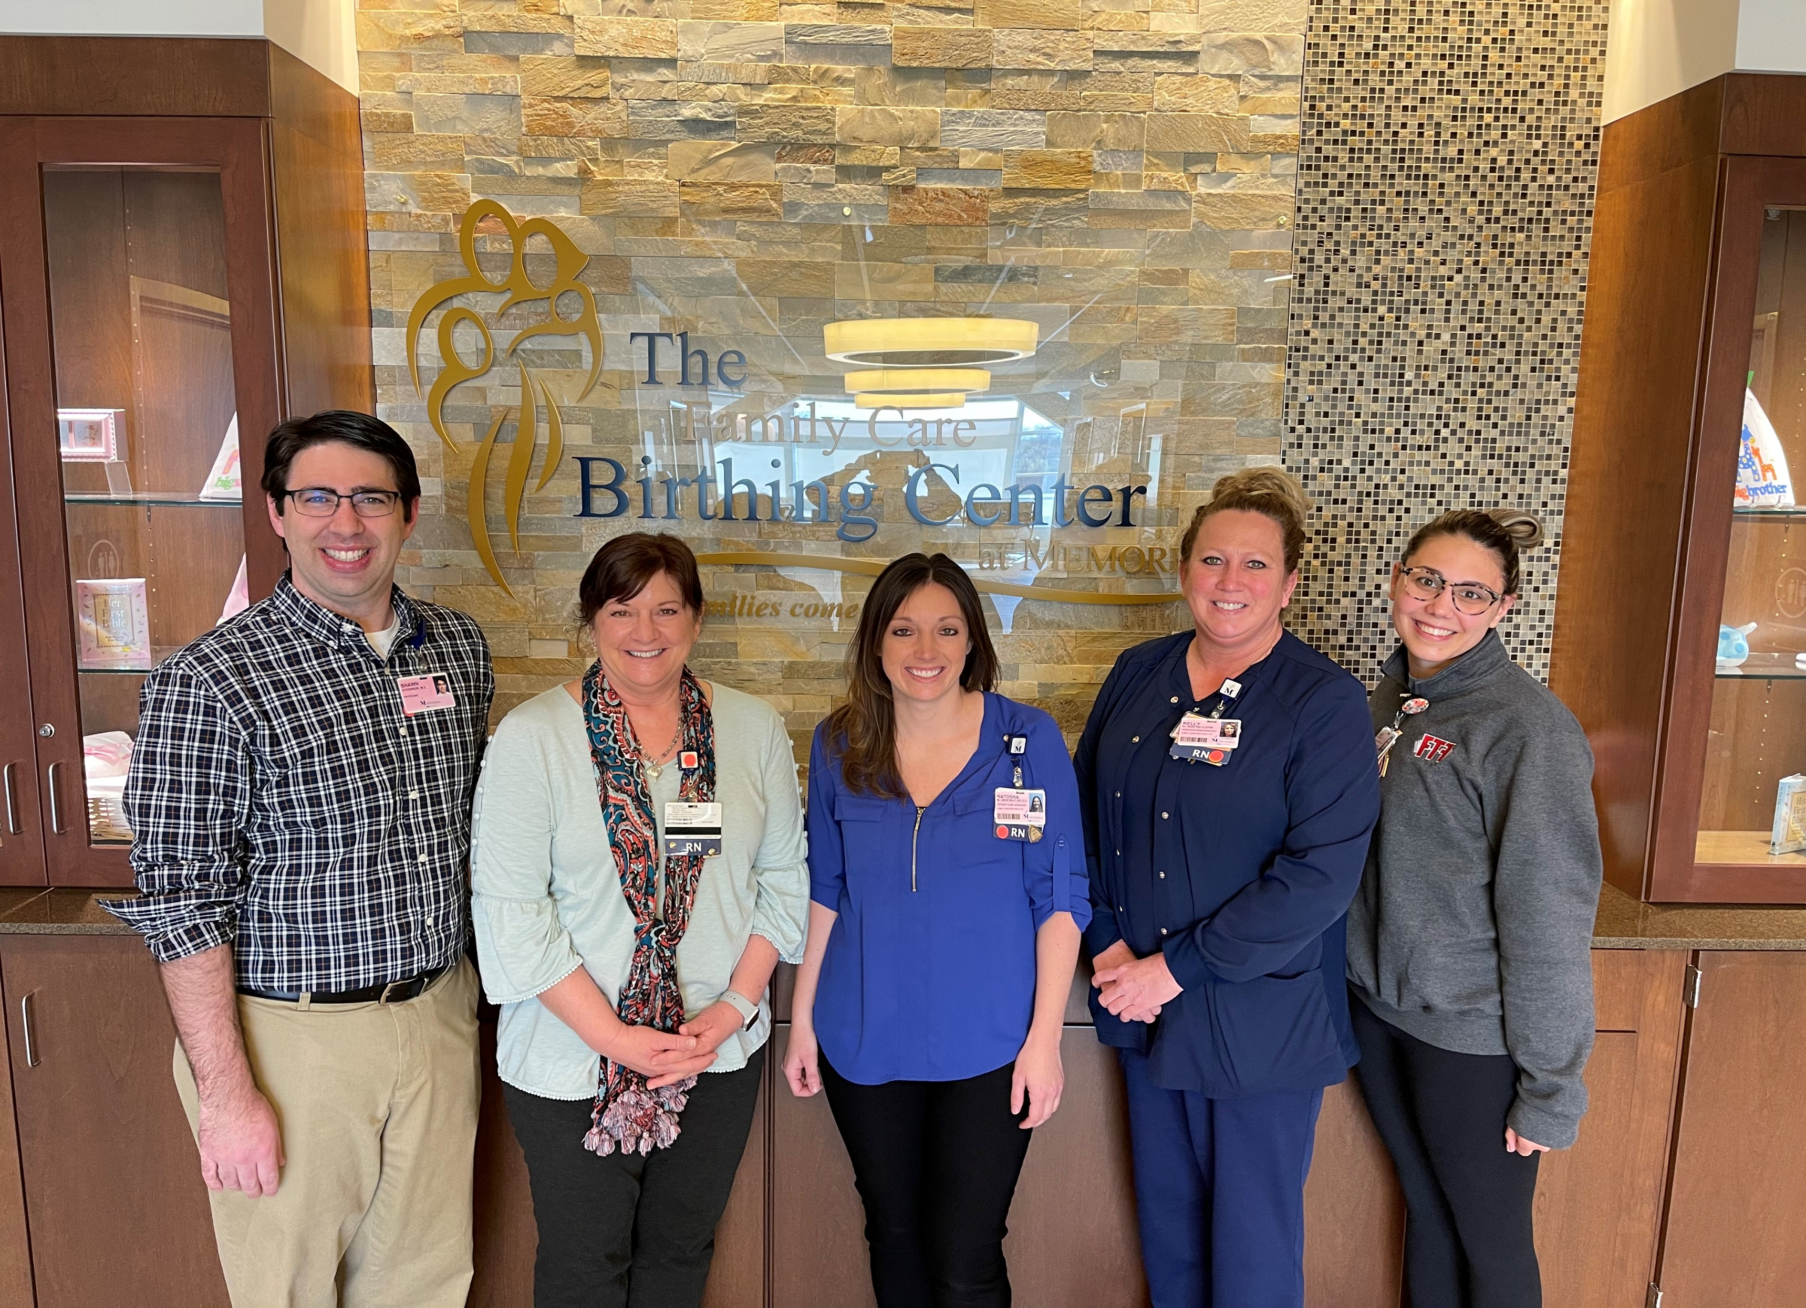
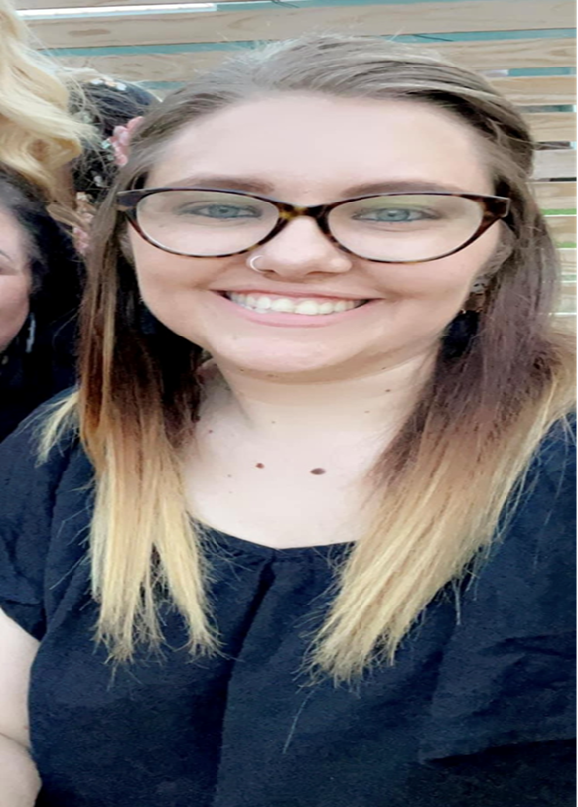
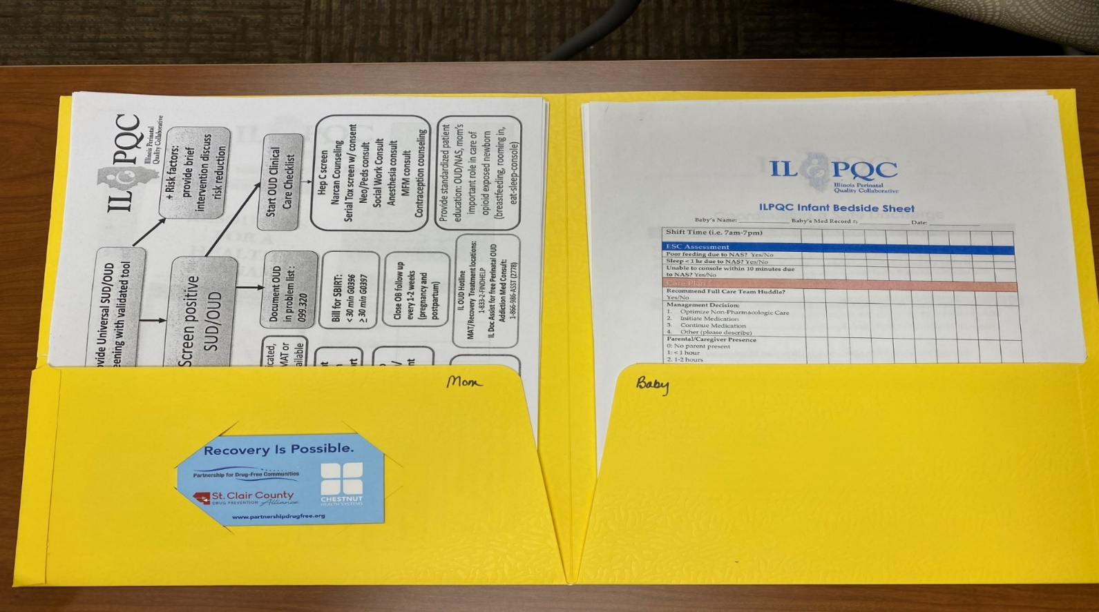
Memorial Hospital Shiloh
Jennifer Sturgeon, MSN
Neonatal Team and Roles:
Neonatology Medical Director: Dr. Shawn O’Connor
Director: Donna Stephens
Manager: Natosha McEvers
ANMs: Kelly Harre & Rebecca Lyons
Educator: Jennifer Sturgeon
QI: Natosha McEvers & Kelly Harre
Describe specific strategies for implementing key BASIC structure measures
Standardized protocol for all BJC hospitals is followed by newborn team including use of sepsis risk calculator.
Rebecca Lyons, BSN
Left to Right: Shawn O’Connor, Neonatology Medical Director. Donna Stephens, DNP , Natosha McEvers, MSN, Kelly Harre,BSN
List your biggest accomplishments this
year / since last Face to Face.
100% of blood cx’s drawn before initiation of antibiotics
Implementation of new EMR (EPIC)
Continued use of folders/checklists
Missed Opportunities Form
Education incorporated in annual training and new hire education.
Notes:
Folders, coordinated discharge worksheet,

Slide 7
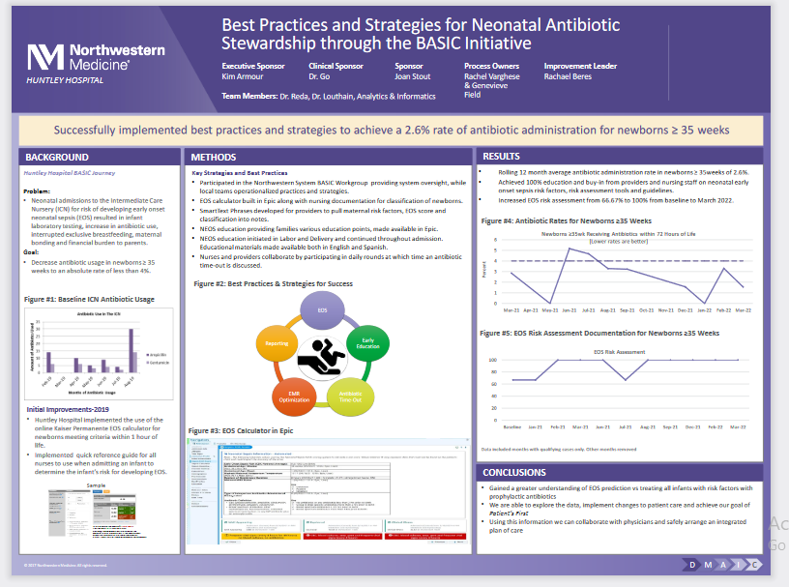
FHN Memorial Hospital
Notes:
Folders, coordinated discharge worksheet,

Slide 8
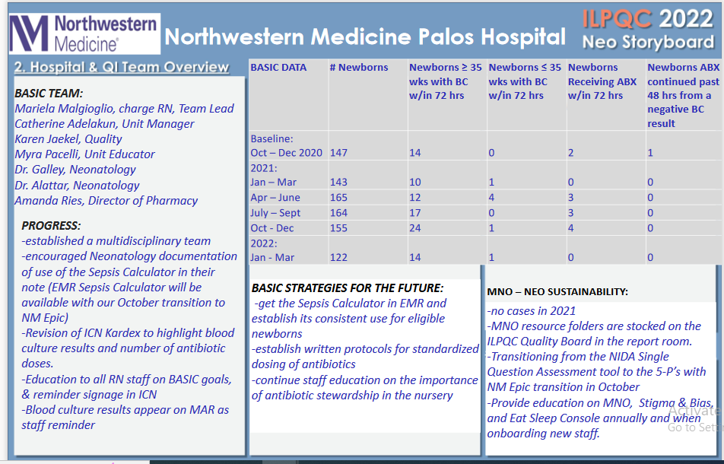
FHN Memorial Hospital
Notes:
Folders, coordinated discharge worksheet,

Slide 9


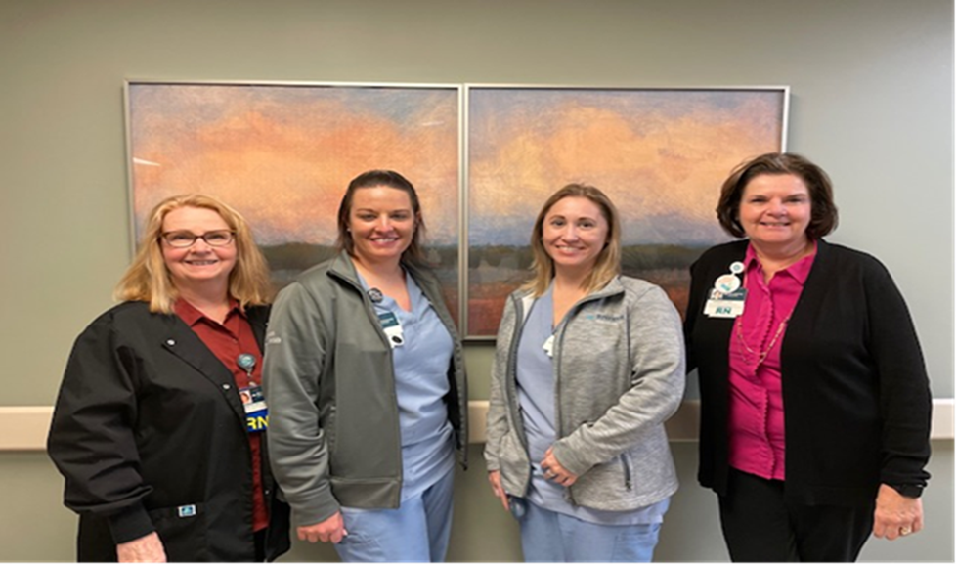
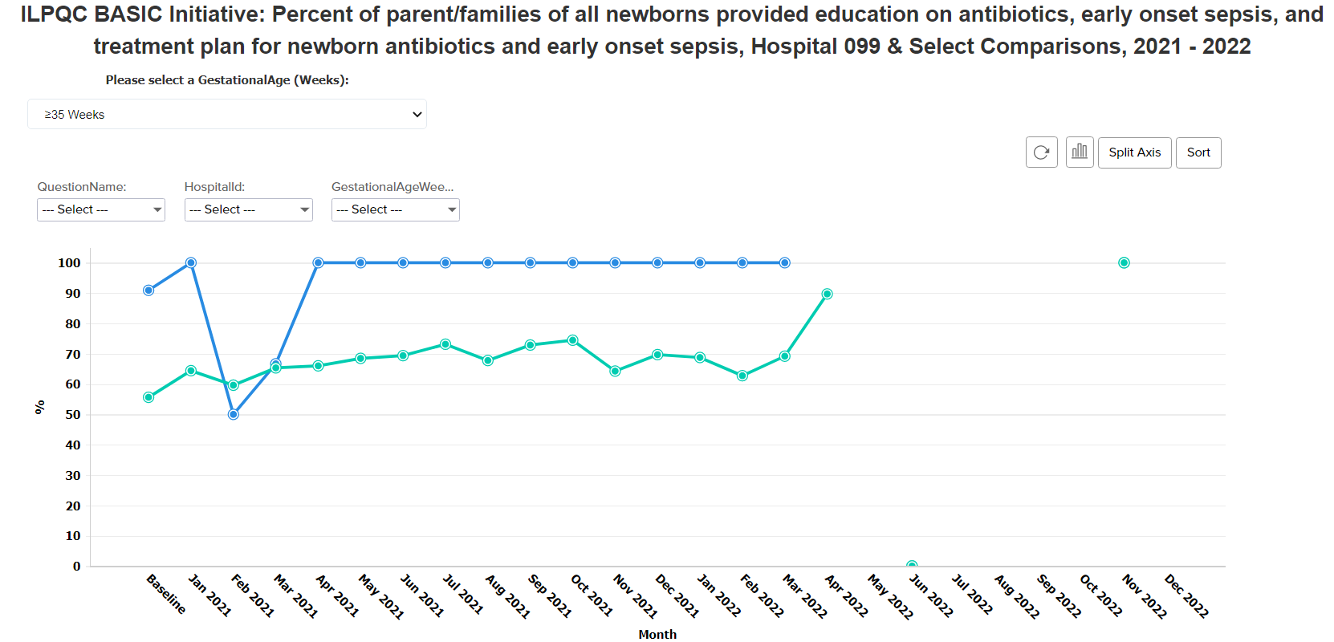
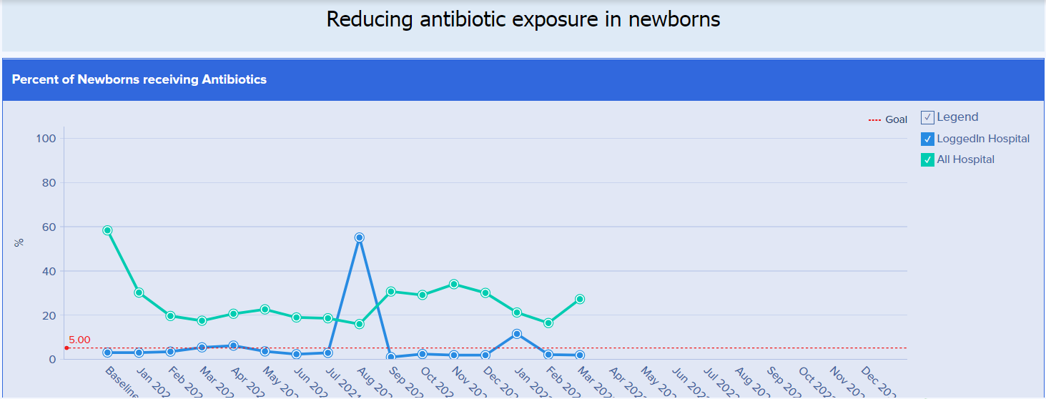
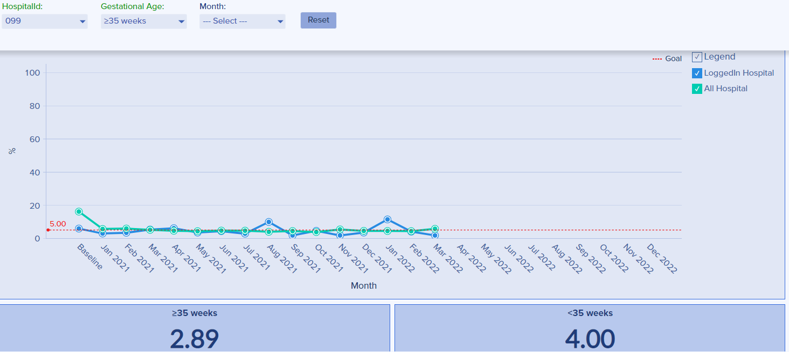
<Hospital Logo>
Riverside Hospital
Hospital Overview
Level II Nursery
18 beds/3 SCN beds
7 bed LDR-1100 del.’s yr.
4 antepartum beds
15 PP beds
Affiliated with University of Chicago Hospital Perinatal Network
Team Overview
Barbara Schuch, Director of Women & Newborn Services & 2Med Ped’s
Heather Davis, Manager FBC & 2Med Ped’s
Kaylee Gray, Team Leader FBC
Laura Brown, Educator FBC
Melissa Emerson, Nursery RN
Mary Ellen Arrington, Perinatal Quality Coordinator
Whitney Pelletier, Pharmacy Clinical Coordinator
Dr. Grazelda Kwakye-Ackah, OB Dept. Chair
Dr. Jean Schied, U of C Pediatric Hospitalist, OB dept. Co-Chair
Biggest Accomplishments
Kaiser Sepsis Calculator built in EPIC
July 2021 BASIC Grand Rounds for Physicians
Staff education placed in the hospitals’ OLIE education system
Parent education created
Antibiotic time out created in EPIC
***Currently working on 36-48 abx auto stop time
Our unit was moving towards the goals of this initiative prior to the ILPQC’S rollout of BASIC. Our low number of infants on antibiotics impact the overall statistics. 2021 unit data…
BASIC Redcap Graphs/Charts
Strategies for implementing key BASIC structure measures
U of C Pediatric Hospitalist participation
RN & Pharmacy champions
Bringing the initiative to the broader Women & Children’s Service line Meeting
Working through concerns with physicians
Persistence
FBC Program Measures | Jan % | Feb % | Mar % | April % | May % | June % | July % | Aug % | Sept % | Oct % | Nov % | Dec % | Bench Mark | Comments
# Infants born > 35 wk | 74 | 63 | 58 | 67 | 63 | 74 | 73 | 64 | 58 | 71 | 60 | 59
# Infants born < 35 wk | 1 | 0 | 0 | 1 | 1 | 1 | 1 | 2 | 4 | 1 | 2 | 1
# Infants w/BC > 35 wk | 5 | 6 | 6 | 6 | 7 | 9 | 4 | 12 | 1 | 6 | 3 | 4
# Infants w/BC < 35 wk | 1 | 0 | 0 | 3 | 1 | 1 | 1 | 2 | 1 | 0 | 2 | 0
# Infants Transfer >35 wk | 3 | 3 | 1 | 1 | 4 | 4 | 1 | 3 | 0 | 3 | 2 | 1
# Infants Transfer <35 wk
Audit of Infants not TR:
# BASIC Infants>35 wk on Antibiotics | 2 | 2 | 3 | 4 | 2 | 3 | 2 | 6 | 1 | 3 | 1 | 2
%Infants > 35 wk on Antibiotics | 2.8 | 3.3 | 5.3 | 6.1 | 3.4 | 4.3 | 2.8 | 9.4 | 1.7 | 4.2 | 1.7 | 3.4 | 4%
Risk Assess.tool Used/Documented | 100 | 50 | 66 | 75 | 100 | 0 | 0 | 100 | 100 | 66 | 0 | 100 | >70%
Docum of maternal Risk factor peds chart | 100 | 50 | 100 | 75 | 100 | 100 | 100 | 100 | 100 | 100 | 0 | 100
Antibiotic auto stop- Time entered in chart | 0 | 0 | 0 | 0 | 50 | 0 | 0 | 17 | 0 | 0 | 0 | 0 | >70%
BC drawn prior to Antibiotic admin | 100 | 100 | 100 | 100 | 100 | 100 | 100 | 100 | 100 | 100 | 100 | 100
Antibiotic continued Past 48 hrs with neg BC result | 50 | n/a | 66 | 25 Dx chorio | 0 | 33 | 0 | 17 | 0 | 0 | 0 | 0 | <30%
Antibiotic stopped >36 and < 48 hrs | 50 | 50 | 33 | 75 | 100 | 66 | 100 | 83 | 100 | 100 | 100 | 100 | >70%
Antibiotic stopped <36 | 0 | 1 | 0 | 0 | 0 | 0 | 0 | 0 | 0 | 0 | 0 | 0 | n/a | Not goal of RMC
**Infants with neg. BC Receiving antibiotics >36 hrs. | 100 2 of 2 | 50 1of 2 | 100 3 of 3 | 100 4 of 4 | 0 | 0 | 100 | 100 | 100 | 100 | 100 | 100 | 20% decrease By 6-2022 | **Riverside goal of 36-48 hours, not 36. Re-eval 2022
Antibiotic time-out Discussed | 0 | 0 | 0 | 0 | 50 | 0 | 0 | 17 | 0 | 66 | 0 | 0 | 80%
Family/Parent Educ Provided EOS, etc | 100 | 50 | 66 | 100 | 100 | 100 | 100 | 100 | 100 | 100 | 100 | 100 | 80%
At Benchmark
Within 5%
> 5% Benchmark
Notes:
Folders, coordinated discharge worksheet,

Slide 10
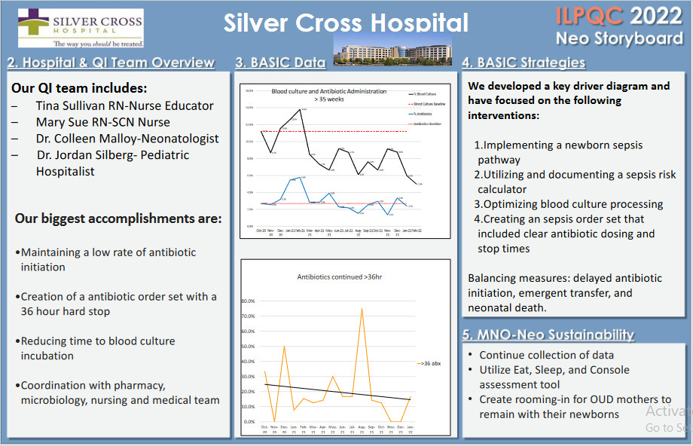
FHN Memorial Hospital
Notes:
Folders, coordinated discharge worksheet,

Slide 11
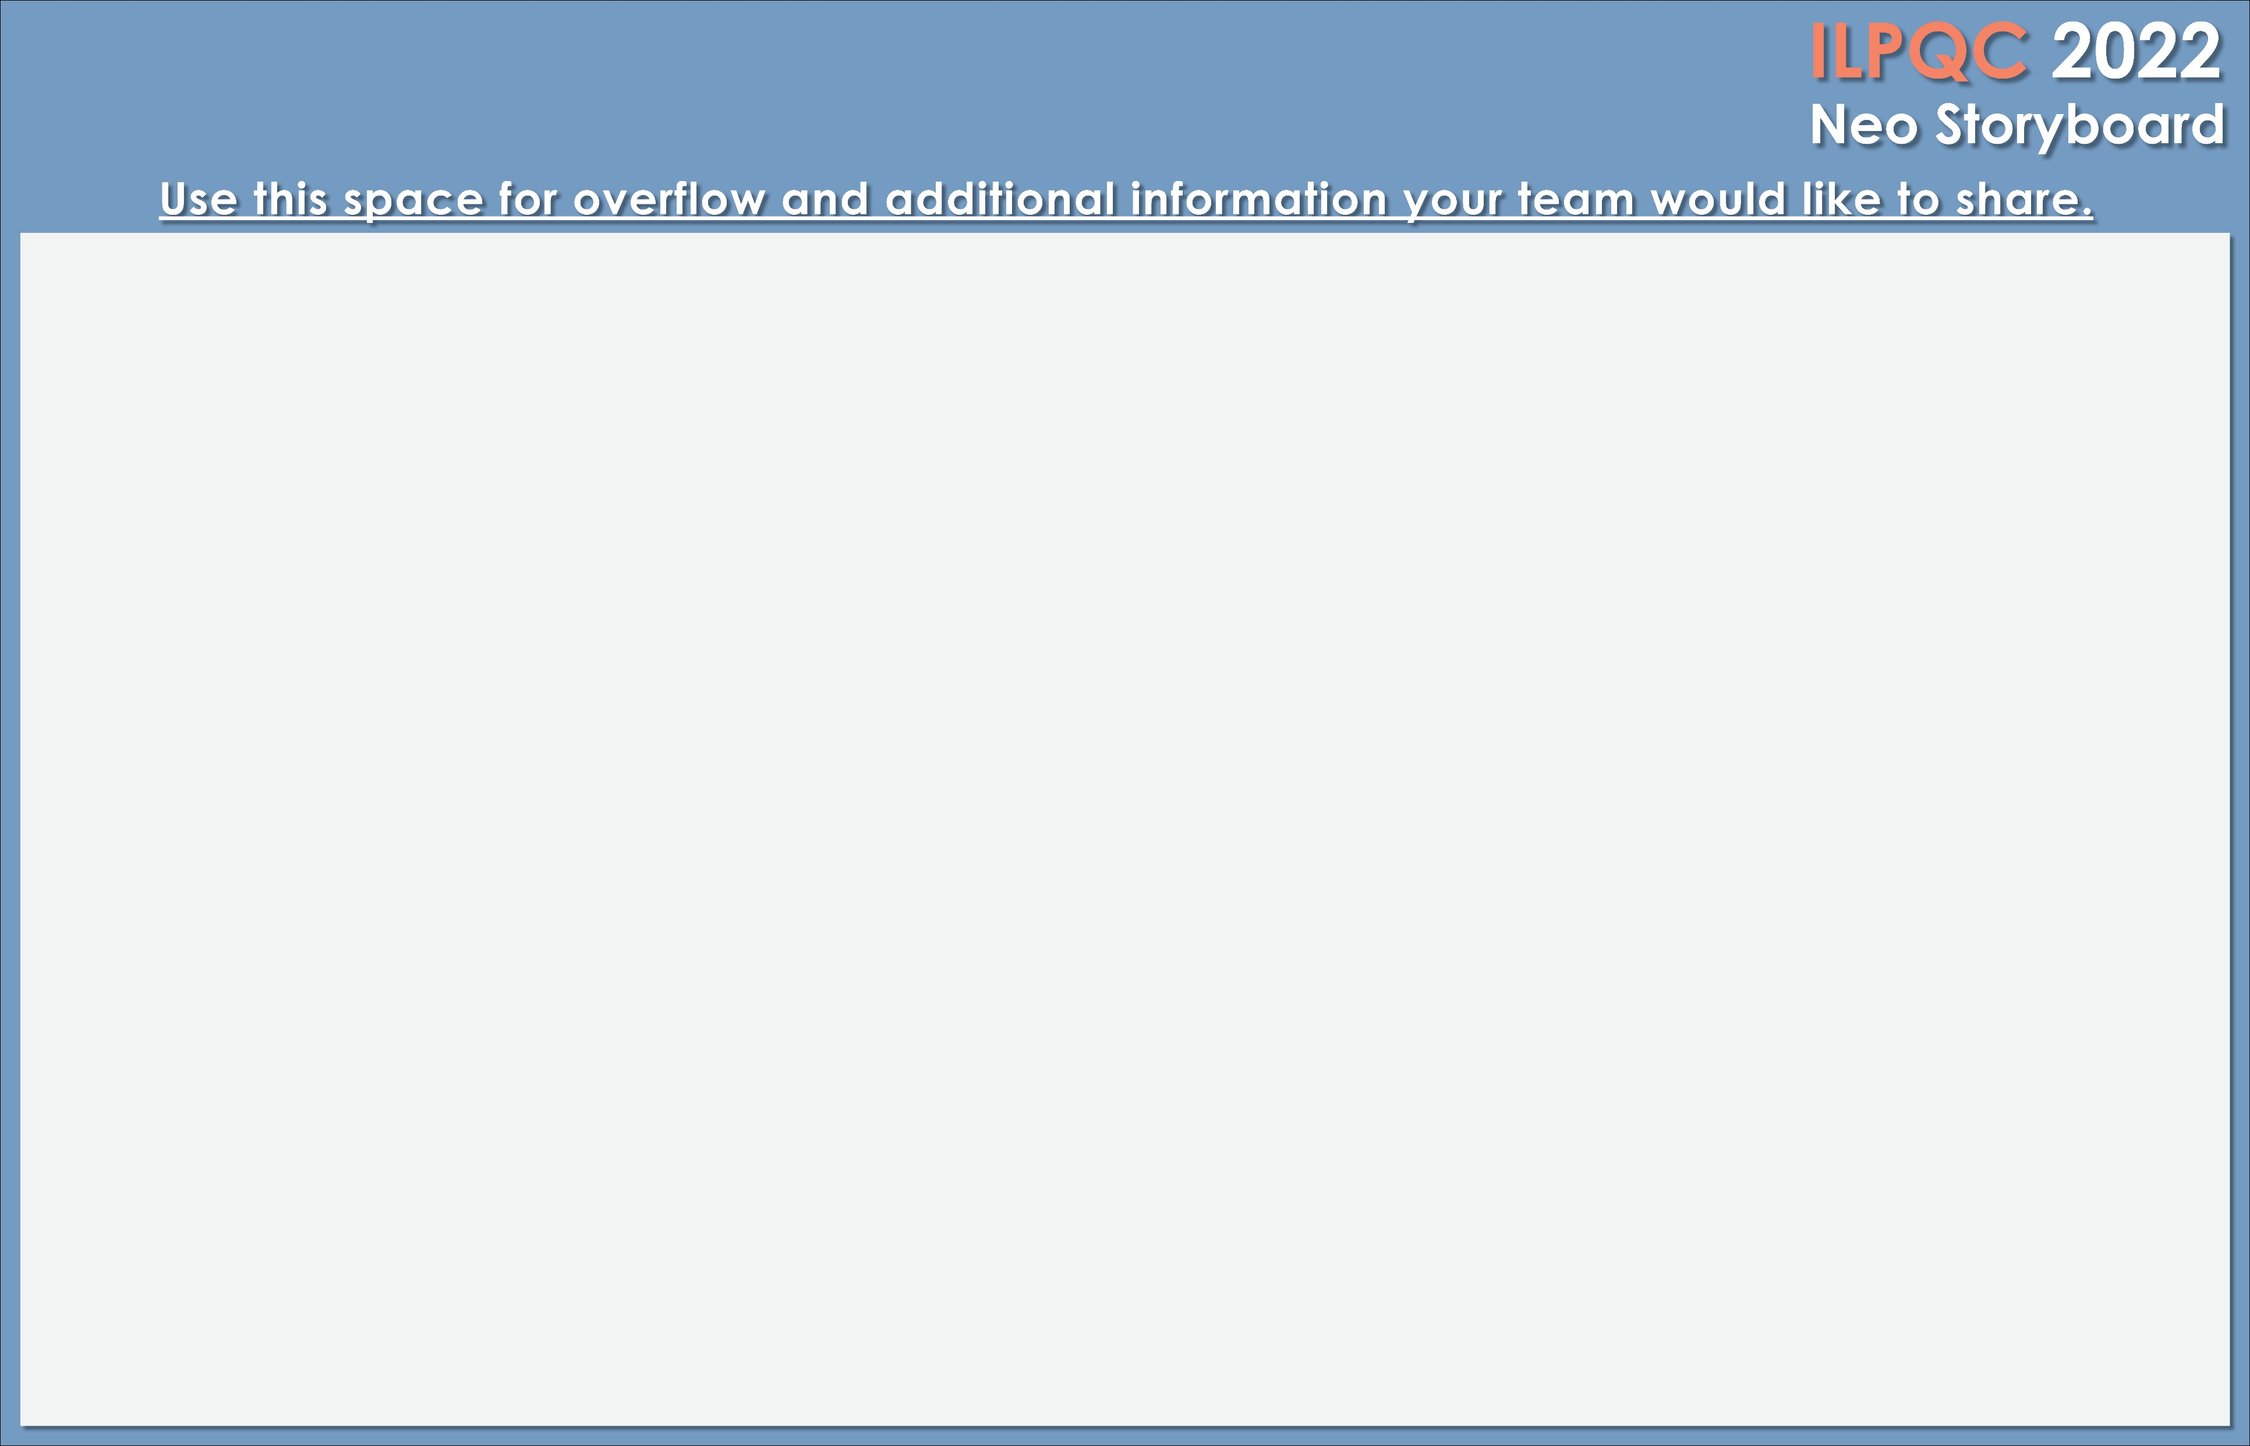


<Hospital Logo>
Silver Cross Hospital
The percentage of newborns with blood cultures drawn is down from 12% to 6%, on average.
The percentage of newborns on antibiotics is down trending, and is more consistently below our goal of <4%.
The percentage of newborns receiving antibiotics >36 hours has improved
No negative outcomes of any of our three balancing measures noted since project initiation
Successes:
  The hospital IT department was receptive to developing a newborn sepsis order set and was able to have a usable order in the EMR within 8 weeks of submitting for approval. Most importantly, the order set included 36hr stop times on antibiotics.
  The hospital laboratory explained the process of blood cultures, from collection to results, and recently hired new technicians to keep up with demand
    Average time from collection to incubation for blood cultures per month ranged from 1.96 to 2.62 hours.
Challenges:
  Although the sepsis calculator is used by most physicians, the documentation of the use of the sepsis calculator is poor. Frequent reminders have not changed the use. A recent intervention is an alert in the sepsis order set to document the calculator score in a physician note. We have considered a way to utilize delivery nurses in score calculation based on feedback from other ILPQC sites
  We initially focused on establishing standardized chorioamnionitis diagnosis criteria, however have not been able to get all OB providers to support one standardized criteria. With the establishment of the calculator to guide decision making, we decided that this was less important to our smart aims in this project, but is important to overall perinatal health at our hospital.

Slide 12

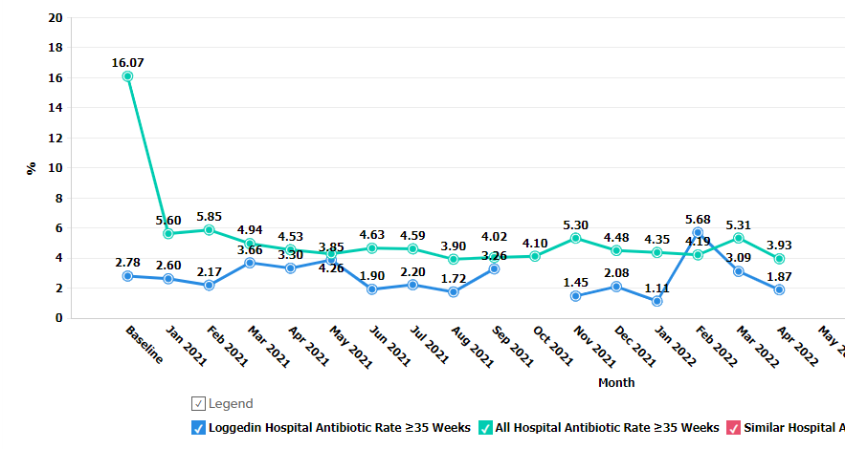

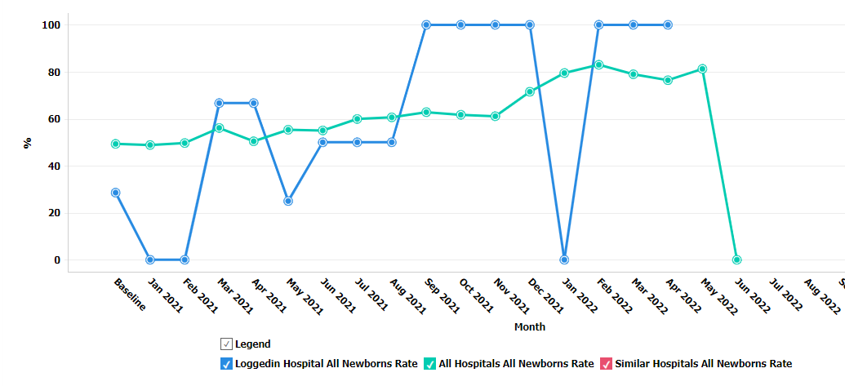
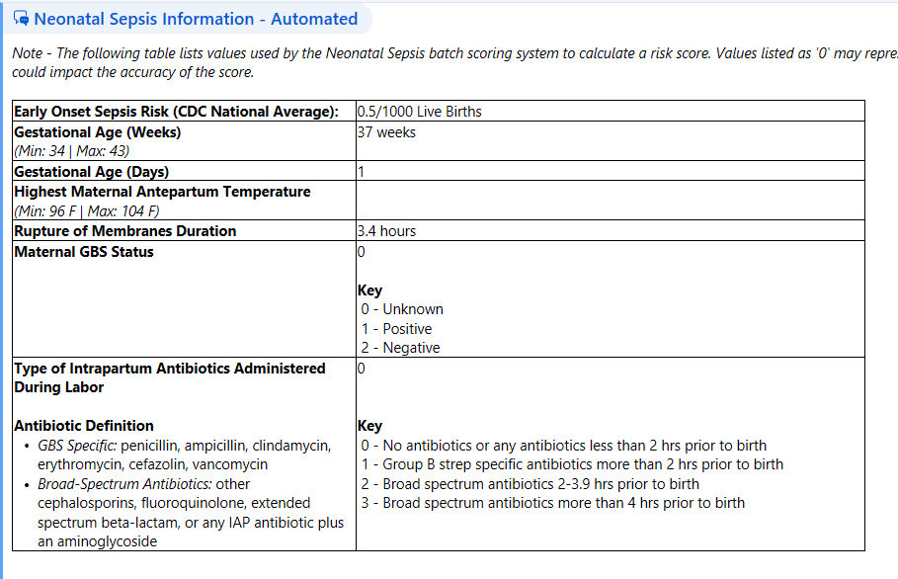
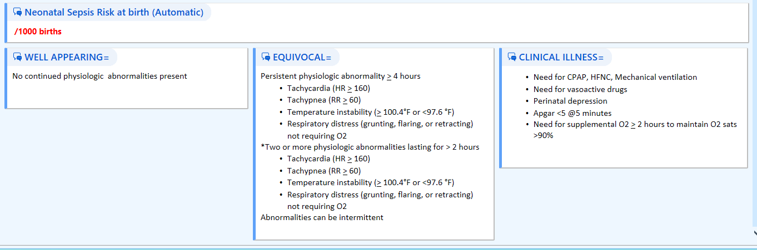
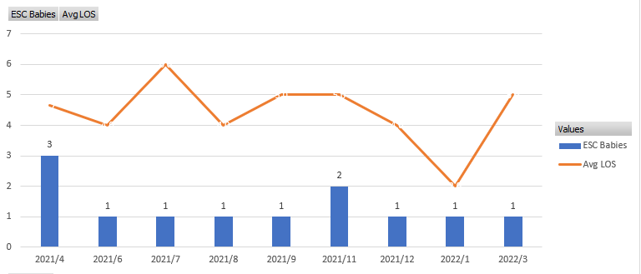

<Hospital Logo>
SSM Health Good Samaritan Mt. Vernon
SSM Health Good Samaritan BASIC Team
Dr. Ronald Chediak-Physician Lead
Pat Baker –BASIC Team Lead
Pam Butts-Level 2 Nursery staff/Charge Nurse
Cindel Polhemus – Women’s Center Educator
Helen Essenpreis – Women’s Center Director
Cressie Halberg – Data Entry
% of newborns> 35 weeks who received antibiotics within 72 hours of life
Our opportunities for the next 6 months include: documentation of standardized assessment tool used and antibiotic huddle/time out, consistent education of parents.
100% of nurses and providers have received education.
Patient education is readily available in the nursery for parents-laminated page with QR code. We have an IPAD if they have no phone.
We have worked with lab to improve blood culture specimens- correct technique and volumes. Coming soon-RNs to draw blood cultures!
Accomplishments: We have been successful with our overall antibiotic prescribing rate < 4% every month except 1 (> 35 weeks). We have implemented our standardized algorithms for < and > 35 weeks. We are close to using the Kaiser calculator in EPIC flowsheets.
Automatic Stop time for antibiotics > 35 wks.
SSM Health Good Samaritan Hospital Women’s Center is a Level 2 facility with 1000 births per year. We have 6 LDRs and 18 postpartum/GYN rooms along with a 2 bed Level 2 nursery. Our staff consists of RNs, unit secretaries, scrub techs, and IBCLCs. We serve a 11 county area in southern Illinois.
Notes:
Folders, coordinated discharge worksheet,

Slide 13
Perinatal Level 2E

Slide 14

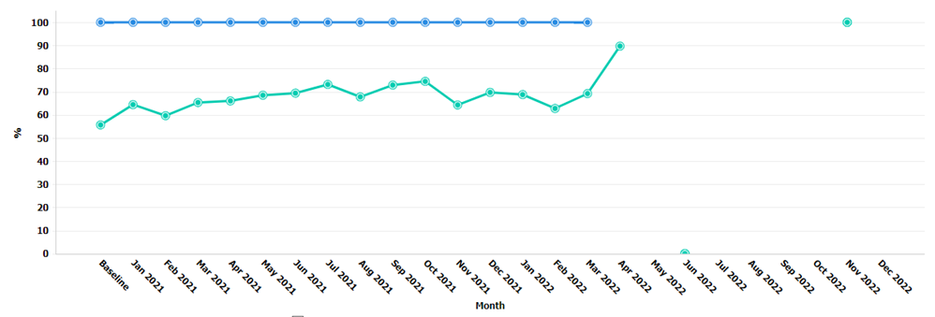
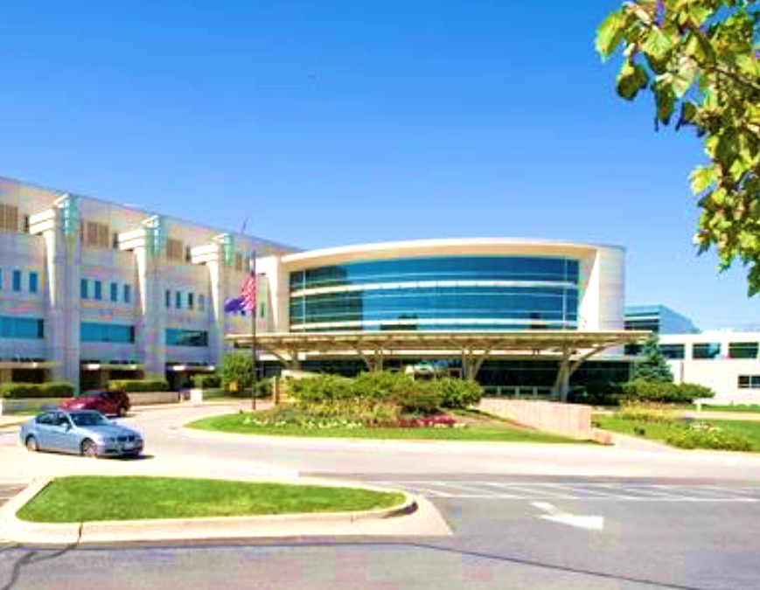
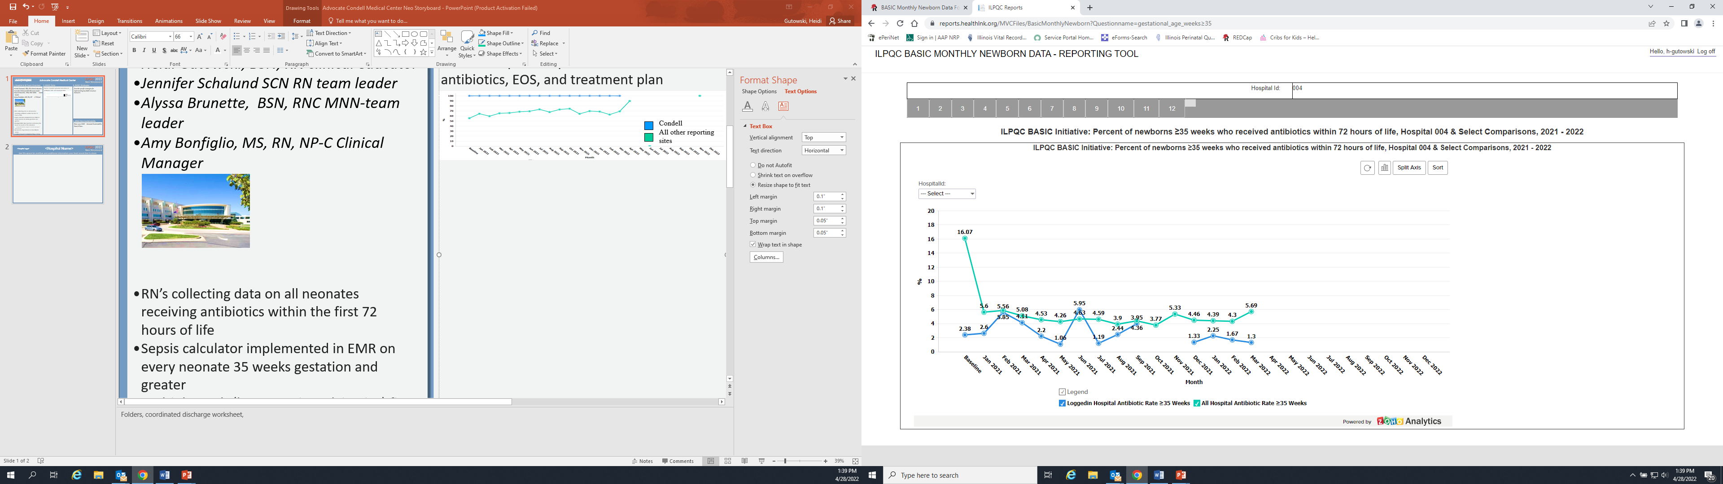


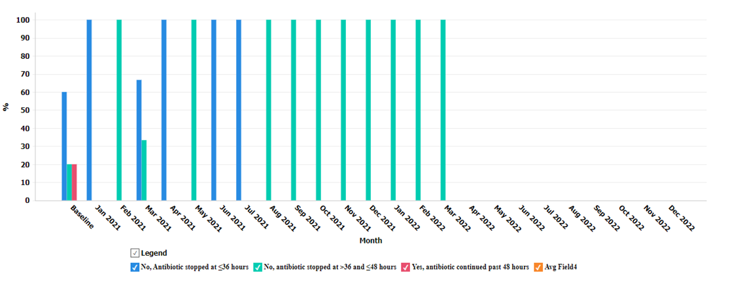
<Hospital Logo>
Advocate Condell Medical Center
Alyssa Brunette, BSN, RNC MNN: team leader
Heidi Gutowski, BSN, RN: clinical educator
Jennifer Schalund SCN RN: team leader
Amy Bonfiglio, MS, RN, NP-C: Clinical Manager
Percent of parents provided education on antibiotics, EOS, and treatment plan
Sepsis calculation on all infants > 35 weeks began on 1/4/21
Education and re-education of all nursing staff
Automatic stop times
Standardized and automatic best practice advisory (BPA) built into EMR and will fire based on results of sepsis calculator or clinical findings
      Includes next steps for the nurse to take
      BPA will also fire if the sepsis calculator is not run or is incomplete
Opportunities:
Optimize processing of lab specimens
Standardize patient education
Condell
All other reporting sites
Percent of neonates > 35 weeks who received antibiotics within 72 hours of life
Condell
All other reporting sites
RN’s collecting data on all neonates receiving antibiotics within the first 72 hours of life
Biggest accomplishment is all clinicians are taking a multi disciplinary approach in making assessments and looking at each patient’s clinical picture before making decisions about antibiotic usage
Looking forward to implementing a strong parent education strategy within the next 6 months
Condell 12 month average: 1.79
Percent of neonates > 35 weeks with antibiotics stopped < 36 hours to >48 hours with a negative blood culture
Provided staff education on ESC and reviewed toolkit
New hire education revamped
New Advocate system policy in place
Anticipate continuing to collect data
In 2021 71% babies assessed with ESC, improvement from 15% when initiative started

Slide 15

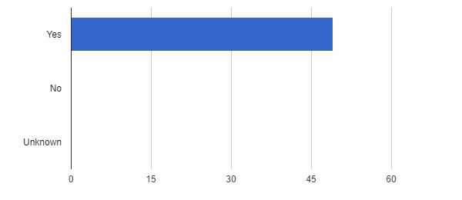
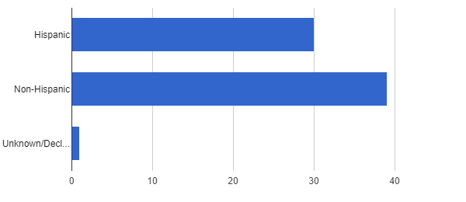
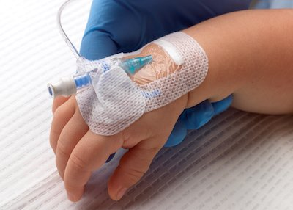
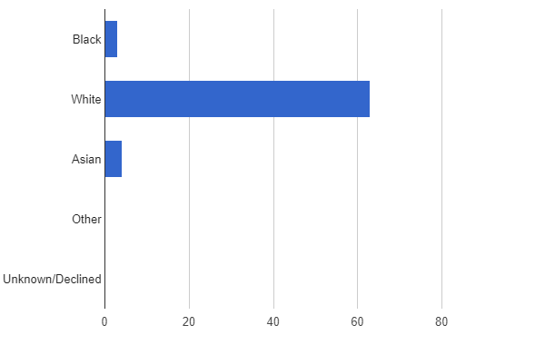
<Hospital Logo>
Advocate Sherman Hospital
Fill in BASIC QI Team & Roles.
Fran Teti-Teal- Director Family Birth Center
Jude Duval -Maternal Fetal Medicine
Julie VanNoord –Perinatal Quality Coordinator
Amina Habib MD- Neonatologist
Marilee Ellis RN, Crisanta Csonka RN- BASIC Team Leaders
Dana Jones RN- MNO Team Leader
Risk Assessment Tool Use:
Ethnicity:
Race:
Strategies for BASIC implementation:
Reviewing in daily staff huddles which infants are receiving antibiotics.
Verifying BASIC data sheet initiated.
3. Collaborate with Neonatology, Pediatric Hospitalists and L/D staff to ensure sepsis calculator compliance.
Biggest Accomplishment:
Making entire SCN nursing staff aware of the importance of filling out BASIC Newborn Data forms for every infant started on antibiotics, and completing prior to maternal discharge.
Decrease in number of infants maintained on longer courses of IV antibiotic therapy.
Looking Forward:
Work towards implementing a standardized process of data stratification by race/ethnicity and insurance status.
Continued support and Education to families on ESC support and goals toward non-pharmacological care.
Team involvement through management of each MNO case via team and parent huddle.
Quarterly review with MNO team to report cases and any need for improvement on care or patient outcomes.
100% of infants discharged with Coordinated Discharge Plan.
Notes:
Folders, coordinated discharge worksheet,

Slide 16


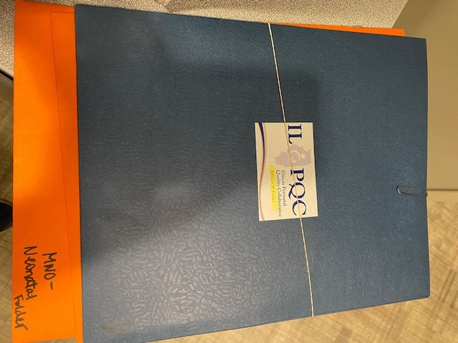
<Hospital Logo>
Franciscan Health
Olympia Fields
---Shift Change Huddles
Shift huddles on infants receiving antibiotics and indications for continuation
---Pharmacy/Family Birth Collaboration
Pharmacy collaboration to establish stop times in EPIC charting system and promote safe practices
---Parent/Family Education
The next step is a rollout of education for the parents and families, so they are ACTIVE participants in the infant’s care and understand the indication for antibiotics and stop time criteria
2022 Antibiotics stopped at under 36 hours once negative blood culture achieved:
January: 36%
February: 33%
March: 67%
April: 78%
Implementation of STOP times in EPIC in FEB 2022!
About 70-80 deliveries per month.
Raquel Lewis, RNC-OB,
Interim Nurse Manager
Trish Kovacs, MSN, RNC-OB, C-EFM
Nursing Education/BASIC Champion
Jennifer Shutts, BSN, RN
BASIC Champion
Samir Wassef, MD
Kirsten Sorum, MD
Neonatalogists
&
St. James Olympia Fields Awesome
Pharmacy Team!!!!!!!!!!
BIG WIN !
Successful reduction in antibiotics past 48 hours from 57% to 22% over the course of 4 months once antibiotic stop time implemented in EPIC!
-Screening tools utilized upon admission
in EPIC and during prenatal care
-Reviewed plan of care for OUD patients in staff shift huddles.
-Folder bundles to guide nursing and physicians physicians.
Notes:
Folders, coordinated discharge worksheet,

Slide 17
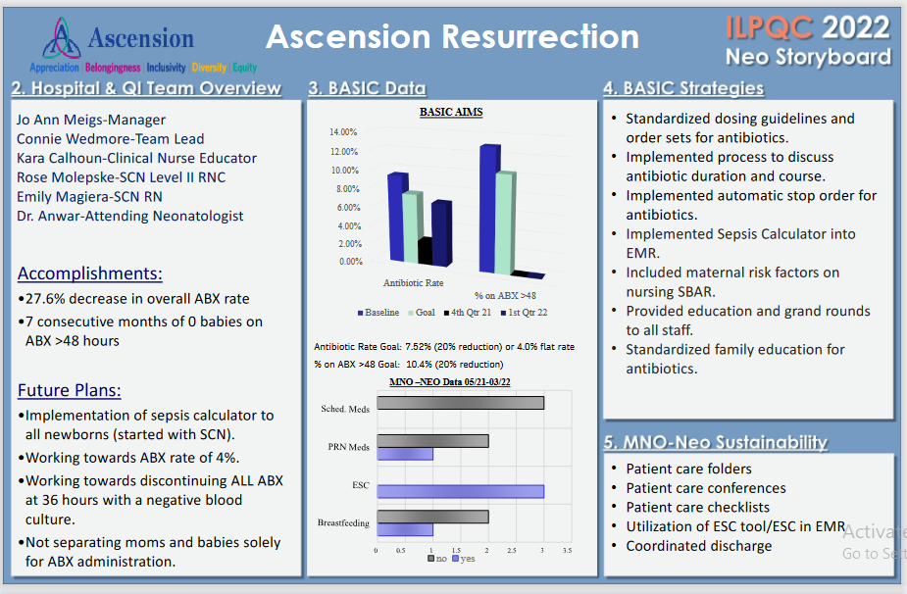
FHN Memorial Hospital
Notes:
Folders, coordinated discharge worksheet,

Slide 18
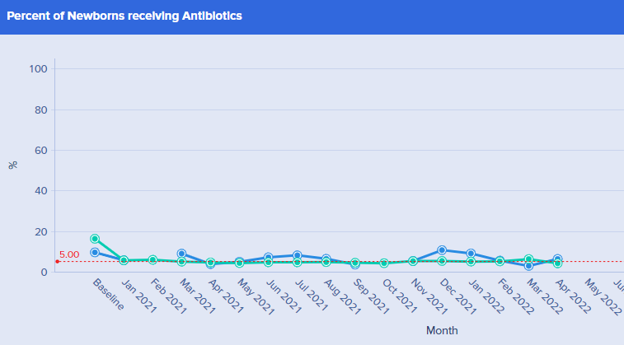
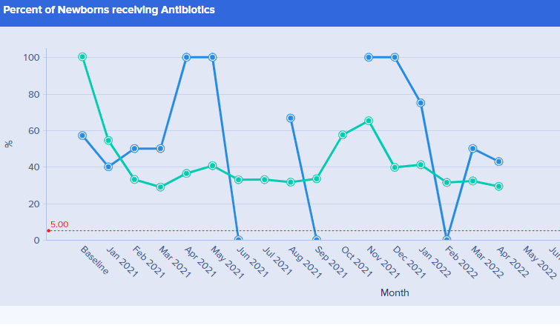
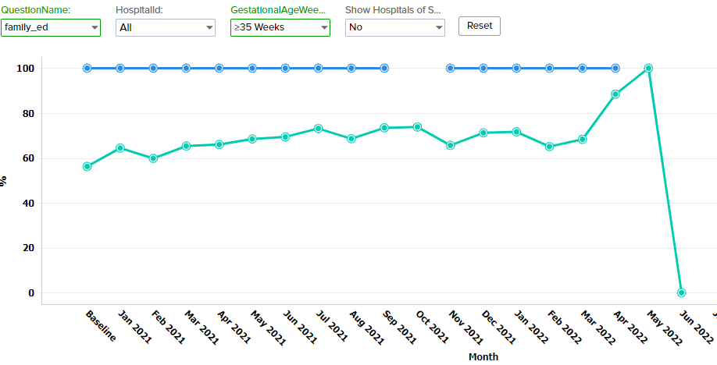
<Hospital Logo>
OSF Little Company of Mary Medical Center
Fill in BASIC QI Team & Roles.
Dr. O. Itani Physician Lead
Cheryl Chemers RN-Lead
Mary Grimm RN Mgr.
Mary Ward-Mayster RN
Camille Di Costanzo NNP
Patricia Gelezauskas RN M/B
Share data on progress towards achieving BASIC measures. Please use graphs when possible.
Infant >35 week:
Infant < 35 week:
Parental Education:
We need to implement a standardized EOS tool built into our EMR.
List your biggest accomplishments this
year / since last Face to Face and what you are looking forward to working on in the last 6 months of year.
Education for Parents regarding antibiotics.
Nurse/provider daily review of antibiotic use.
Share your MNO-Neonatal Sustainability Data & Plans.
Continue with our yellow folders for mom and families and monitor ESC, coordinated D/C planning, non-pharm treatment,
Notes:
Folders, coordinated discharge worksheet,

Slide 19

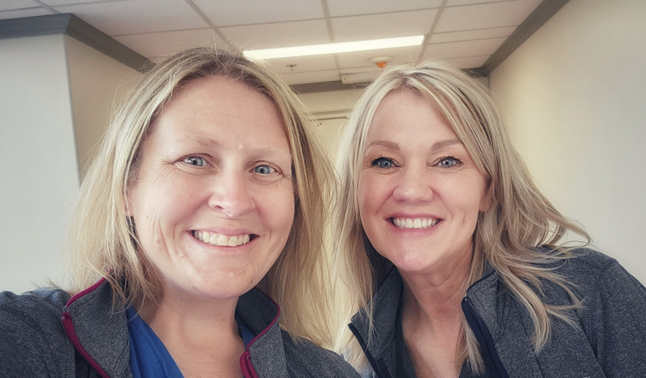

OSF Saint Anthony Medical Center
Hospital QI Team
Lacie Driscol RNC-OB, C-EFM Charge Nurse
Courtenai Smith RNC-OB, C-EFM OB Clinical Educator
Biggest Accomplishments:
All key BASIC structure measures are in place
Education provided to our staff and providers on EOS, assessment tools and guidelines
MNO sustainability achieved
Looking Forward:
Implementing all BASIC structure measures that are now in place ☺
All BASIC key measures are in place
No data is available as all infants started on antibiotics to date have been transferred to a higher level of care
All measures were implemented prior to transfer
Understanding Chorioamnionitis & What You Need to Know about Your Baby and Antibiotics handouts in place for family education
Physicians and nurses educated about early onset sepsis risk factors, assessment tools and guidelines
Education provided on having blood culture drawn prior to initiation of antibiotics
Antibiotic tools in place to increase percentage of newborns with care team discussing and documenting plan for length of antibiotic course
Automatic stop times for antibiotics at 36 hours
Binder with required forms, screening tools and resources available
Patient education folders
All cases reviewed/debriefed
MNO education provided to staff at skills days
Narcan education, counseling and medication provided at discharge
Notes:
Folders, coordinated discharge worksheet,

Slide 20





Thank you
Questions?
info@ilpqc.org
I-PROMOTE IL

