Slide 1
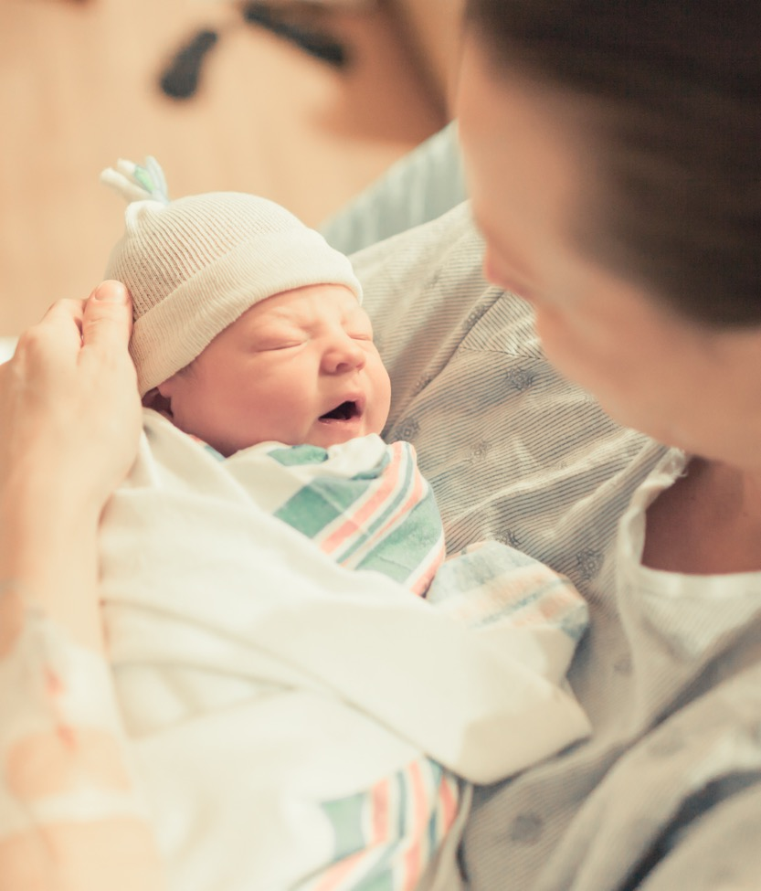
ILPQC: Wrap-up, evaluation, raffle and next steps for 2022
2022 Virtual OB Face to Face Meeting

Slide 2
PVB – helping ALL teams cross the finish line!
Monthly Team Webinars
When: the 4th Monday every month at 12:30pm
Next call: June ^{27th}
Grand Rounds
OB Provider Meetings
Provider and Nurse Education
What: Personalized and FREE service to available to all participating teams
How: Email Ellie Suse to schedule today info@ilpqc.org
Topic: Dystocia Management Strategies
NEW! ILPQC Virtual Labor Management Support E-Modules
1-1 QI Support Calls
We are providig 1-1 QI support calls for all teams with C-section rates over 23.6%
Live class recorded and created into 10-20 minute e-modules available for free to all hospitals!
Email Ellie Suse and Alana Rivera at info@ilpqc.org to schedule
Work to achieve all initiative aims
Complete a sustainability plan
Confirm standardized education
Utilize MNO folders for every OEN
Attend MNO-Neonatal sustainability calls
Notes:
Ellie, can you update this?

Slide 3

Thinking ahead… What is next for BE teams?
Find the right path for your team on your Birth Equity journey
Ok to focus on 1 strategy at a time
Plan a 30/60/90 plan that works for you
Remainder of 2022 we will focus on:
  SDOH screening/linkage
  Implicit Bias trainings
  Respectful care strategies
  PREM implementation
  Community Engagement meetings to facilitate patient/community feedback on QI initiatives

Slide 4

What’s Next for MNO: OB Sustainability?
Continue compliance monitoring for MNO goals and review all OUD cases to achieve optimal OUD Care
Work with your team to review your sustainability plan and make any updates on protocol changes since 2020
Take notes from the MNO-OB Breakout Session and Storyboard review to bring strategies back to your team to implement!

Slide 5
What Can I Do Tomorrow?
Take a minute to reflect on today's general sessions, panel, storyboards, and breakout session
Write down one thing that you are going to do to work towards MNO-OB Sustainability, BE, and PVB improvement tomorrow/next week

Slide 6

Thank You to our Speakers & Panelists!
Amelia Lund, BSN, RN
Amy Mehl, BSN, RN
Ann Walsh, BS, BSN, RN, RNC-OB
Christa Sakwoski, MSN, RN, C-ONQS, C-EFM, CLE
Danielle Felty, MSN, RN, NEA-BC, RNC-OB, C-EFM
Dr. Nakeitra Burse, DrPH, CHES
Dr. Weronika Armstrong, MD
Elena Jenkins, BSN, RN, BA
Julie Dervishoski, MSN, RN, C-EFM
Kimberly Harper, MSN, RN, MHA
LaToshia Rouse, CD(DONA)
Tomeka Isaac, MBA, MHRM, CAMS

Slide 7

Thank You Breakout Facilitators & Discussants!
Abbe Kordick
Andrew Fisher
Anna Marzano
Anna McCormick
Barrett Robinson
Becky Boedeker
Beth Plunkett
Catherine Adelakun
Chariya Christmon
Courtney Pemberton
Crystal Antos
Daniell Ashford
Danielle Wittig
Deb Marunde
Deb Miller
Diane Beck
Dina Kapogiannis
Elena Jenkins
Emily White VanGompel
Emmett Hirsch
Jamie Kane
Jana Richards
Jaqueline Lowry
Jason Lowe
Jodie Skirmont
John Holden
Joy Ungaretti
Julie Dervishoski
Kate Austman
Katie Doty
Kellie Smith
Keri Schubert
Kieya King
Kristina Salcedo
Laura DiGiovanni
Lena Callan
Lori Stevenson
Mary Jarvis
Michele Jahn Sager
Migdalia Cortina
Molly Cardwell
Omar Lablanc
Paloma Toledo
Pam Chay
Sandee Hayes
Sara Polonsky
Shamim Y. Patel
Shawn O'Conner
Shawn Smith
Sherry Jones
Sogi Sakari
Soti Markuly
Tanner Colegrove
Terah Holland
Theresa Bainbridge
Tiana Dunlap
Valerie Swiatkowski

Slide 8

Thank You Planning Committee!!!
Andrea Cross MSHA RN
Cecilia Lopez MSN, RN
Christina Stupek MSN, RNC-OB, C-EFM, C-ONQS
Deborah Miller MPH, BSN, RN, CPHQ
Donna Lemmenes MSN, CPNP, RNC-NIC
Dr. Joseph Hageman, MD
Dr. Shawn O’Connor, MD
Dr. Sherry Jones, MD
Joanne Sorce MSN, RNC-OB, C-EFM
Mary Jarvis MSN, RN, CLC
Sogi Skariah RN

Slide 9

AND THE WINNER OF THE STORYBOARDS STEAL SHAMELESSLY RAFFLE IS?
Notes:
For gift card, random steal shamelessly?

Slide 10

Team Photo Pizza Party Raffle $100 gift card for team celebration
THANKS to all the teams who submitted a photo or slide to display during the Face to Face!

Slide 11
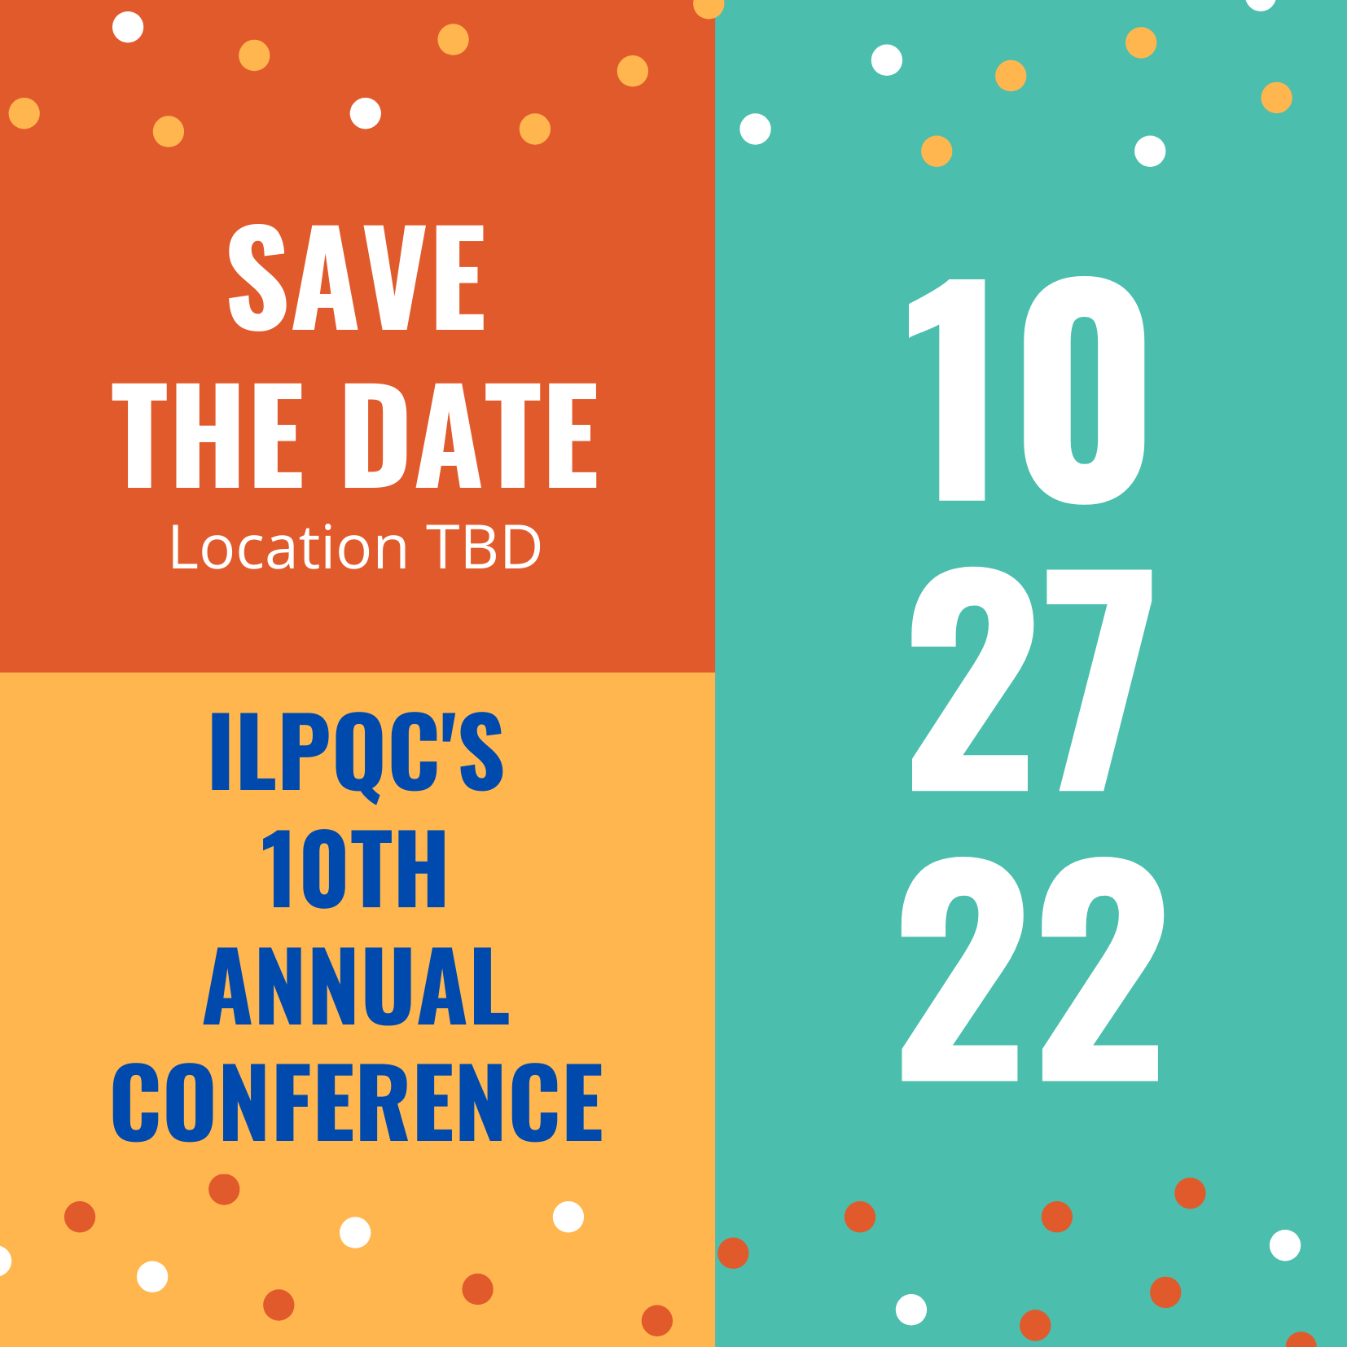
Save the Dates:
Calling all perinatal health care providers, nurses, allied health professionals, and public health/community partners!
ILPQC OB and Neonatal Face to Face Meetings:
  May 24 and 25, 2023 TBD

Slide 12



Opportunity to attend the
LAST PQI SPEAK-UP Training
WHAT: The Institute for Perinatal Quality Improvement’s (PQI) SPEAK UP Against Racism Action Pathway is a train-the-trainer education program
WHO: ILPQC is sponsoring two additional team members per hospital to attend
WHEN: June 15th & 16th, 8:30 AM-12:30 PM CT (both days required)
  Agenda Flyer here
  Registration link here register 2 team members today!
Illinois Perinatal Quality Collaborative

Slide 13
Upcoming ILPQC Events
Event | Day/Time
OB Advisory | June 13th at 12:00pm
PQI Speak-Up Training | June 15th & 16th at 8:30am
PVB Dystocia Management Strategies | June 27th at 12:30pm
BE Review of Key Strategies & Team Sharing | July 18th at 12:00pm

Slide 14

Most important thank you to all
ILPQC teams: We are ILPQC

Slide 15
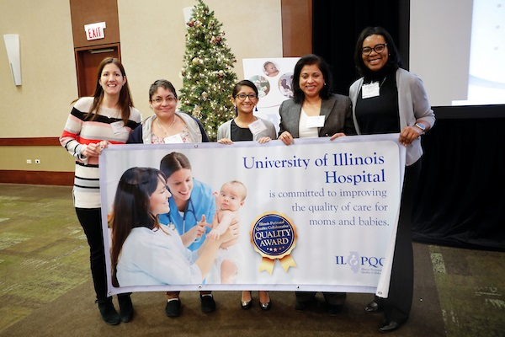
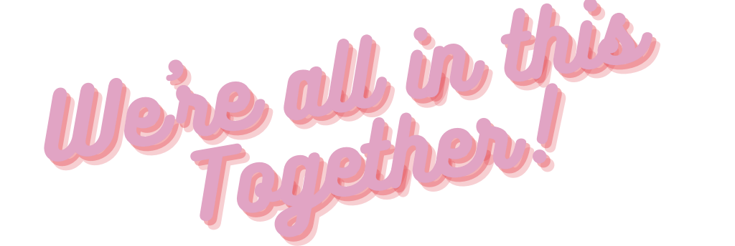
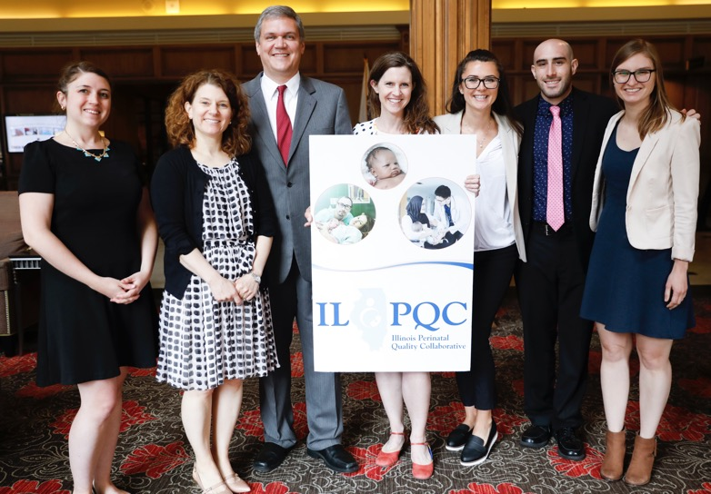
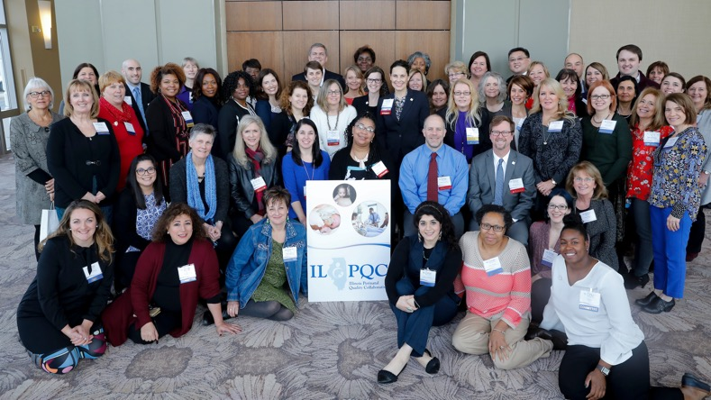

Slide 16
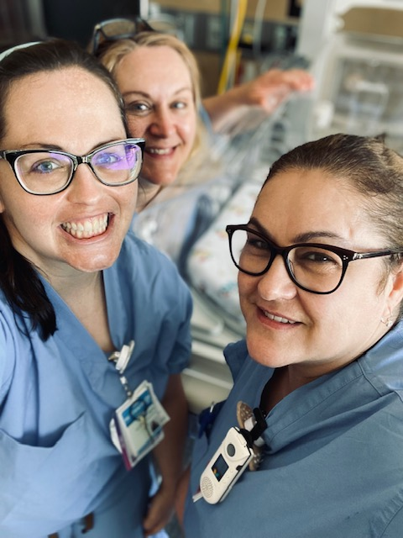
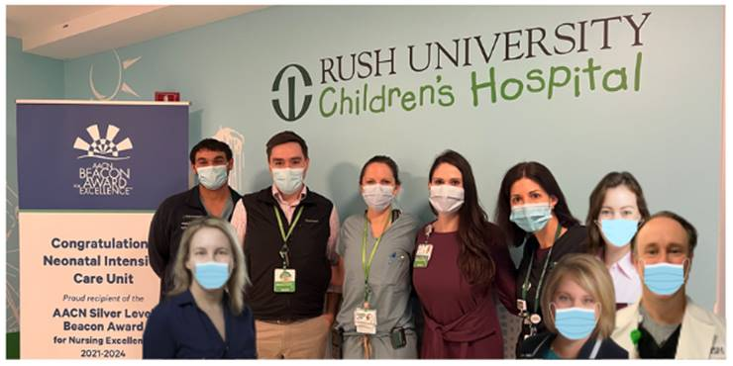
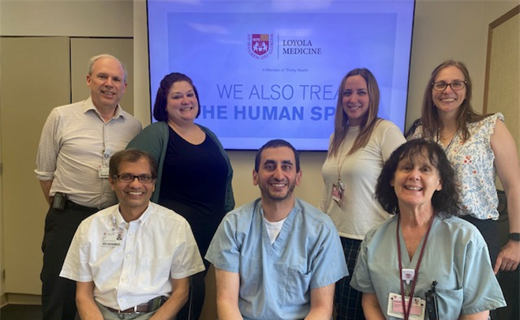
Join Us Tomorrow for the ILPQC
Neonatal Face-to-Face Meeting
Make sure to tune in tomorrow for our ILPQC Neonatal Face-to-Face Meeting!
We have some amazing speakers and a packed agenda including...
  Recovering from the Pandemic
  Continuing our MNO-Neonatal Work
  Partnering with Parents on our QI Journey
  BASIC: Going for Gold in 2022 and Teams Panel
  Breakout Sessions
We hope to see you there!

Slide 17










Thanks to our Funders
In kind support:

