Slide 1
Creating Change through Patient and Community Engagement
LaToshia Rouse, CD(DONA)
Kimberly D. Harper, MSN, RN, MHA
Tomeka James Isaac, MBA, MHRM, CAMS

Slide 2
Creating Change through Patient and Community Engagement
LaToshia Rouse, CD(DONA)
Kimberly D. Harper, MSN, RN, MHA
Tomeka James Isaac, MBA, MHRM, CAMS

Slide 3
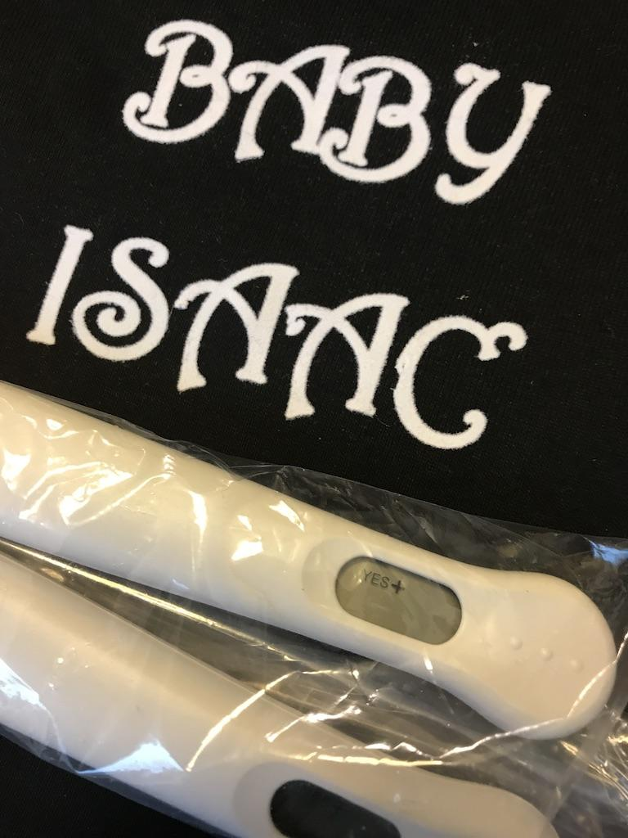
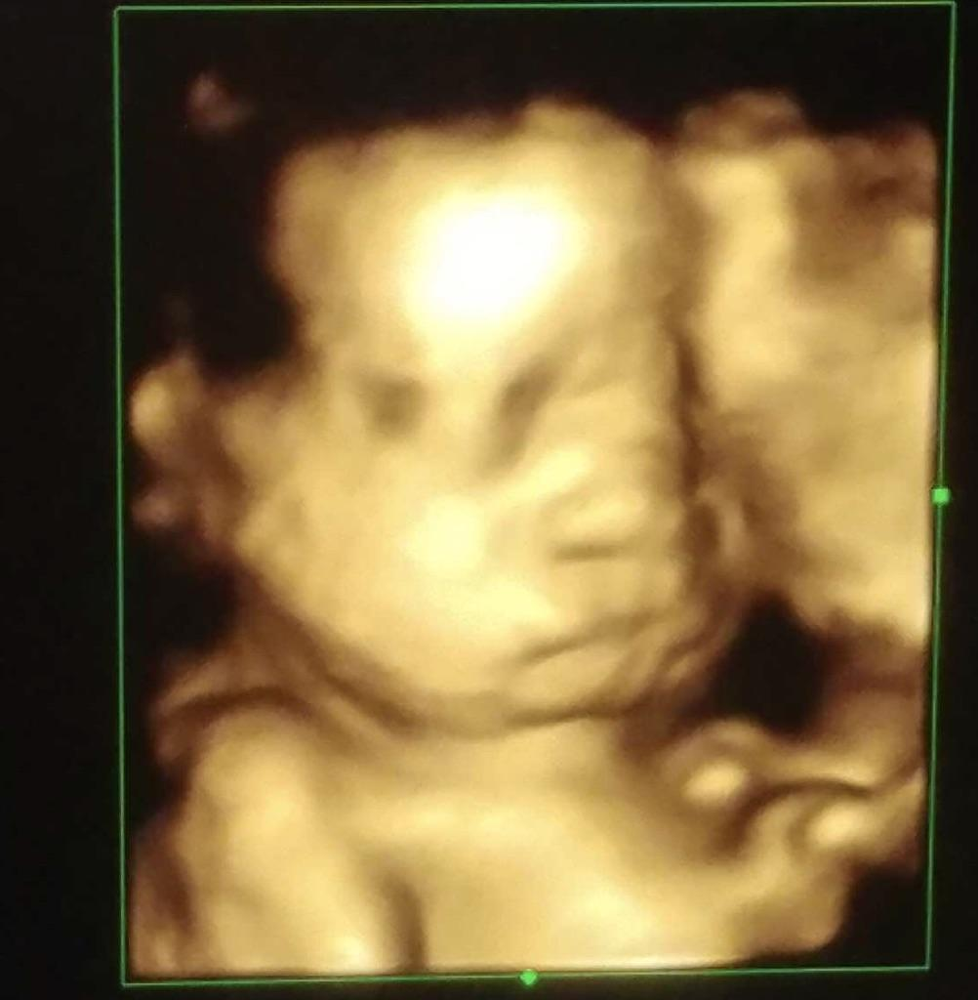
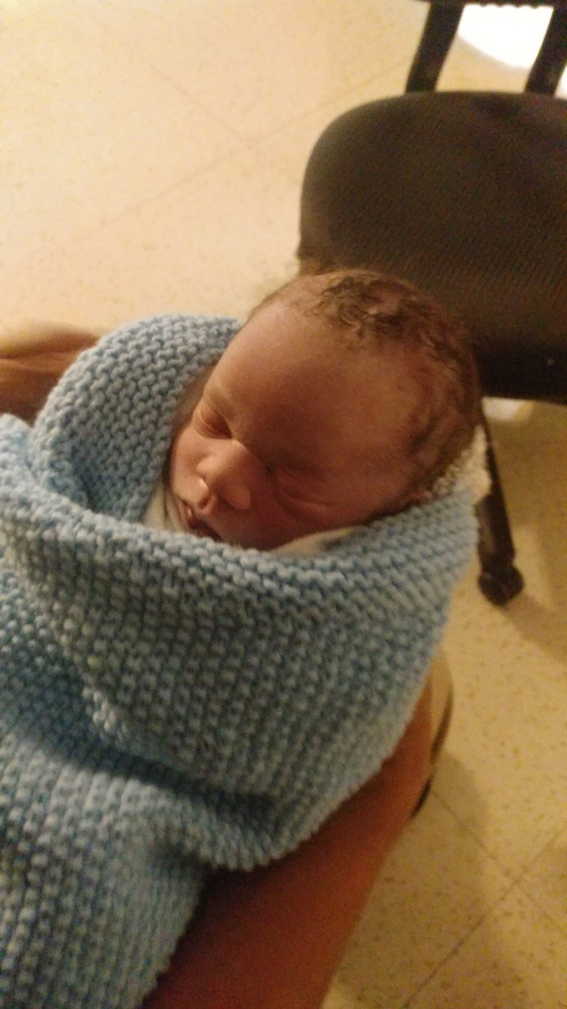
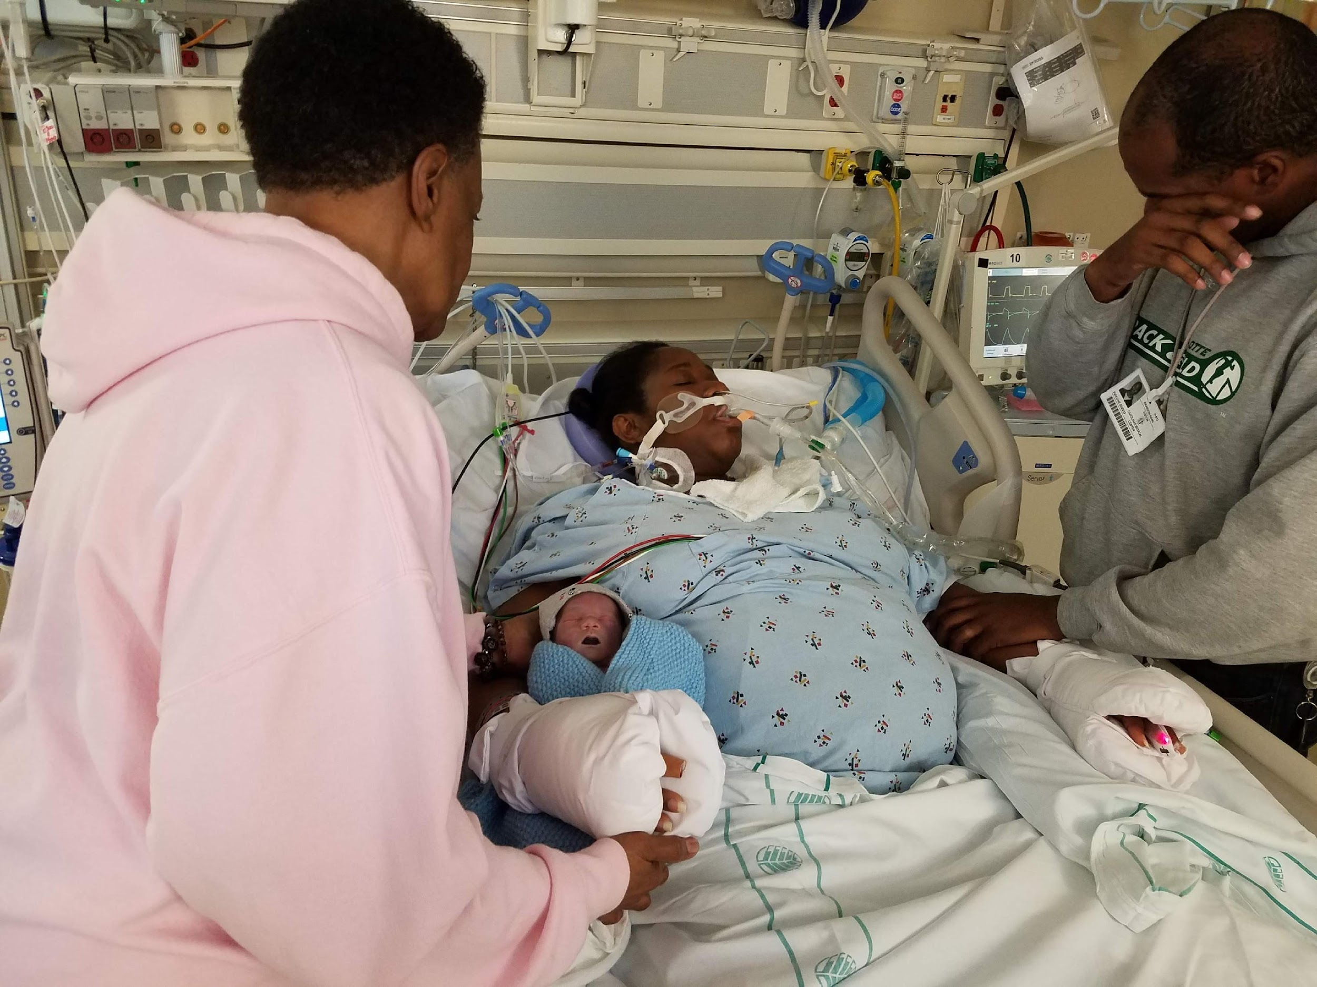
Jace Alexander Isaac
May 15, 2018

Slide 4
Data
Improvement Opportunities
Story

Slide 5
Presenter Disclosures
Notes:
Presenter intro and discussion:
PNOC with UNC Collaborative for Maternal and Infant Health. I serve on several state and national projects to impact and improve maternal health. As LaToshia mentioned, my background is as a Labor and Delivery nurse and nurse leader. I have had the opportunity to collaborate and support organization locally and across the nation implement various projects and initiatives that integrate the voice of those with lived experiences into the health care system. Here you can see my amazing and wonderful little humans that I have the pleasure to help guide through the world that we live in. I think that it is important to highlight all components of life that we bring together into initiative and projects. My experiences as a nurse and health care team member influence how I interact within the health care team. But more importantly my role as a mother, wife and research also contribute to the lens that has shaped my view of services.

Slide 6
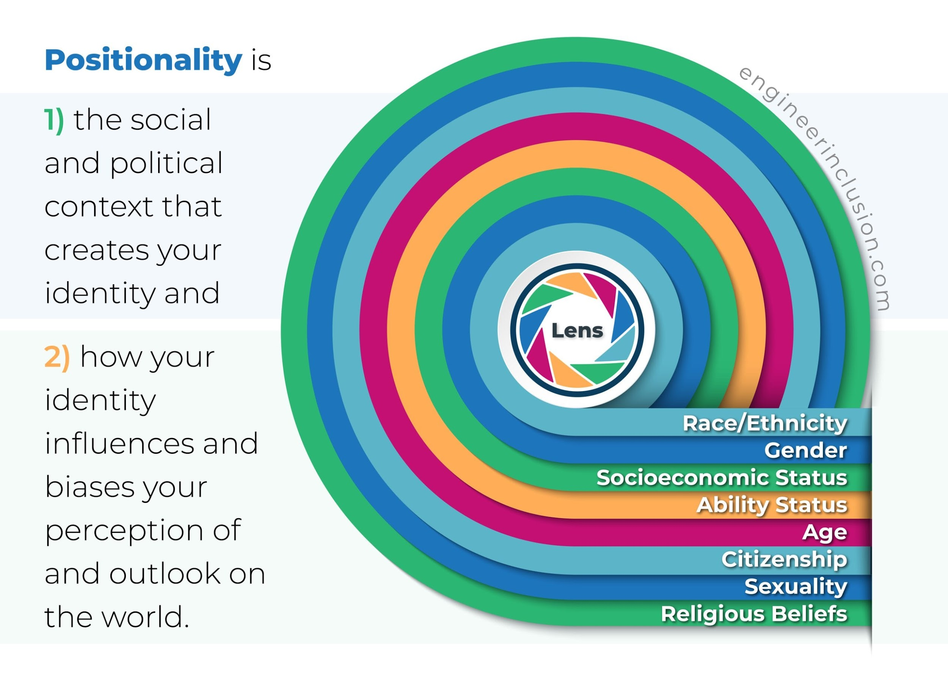

Slide 7
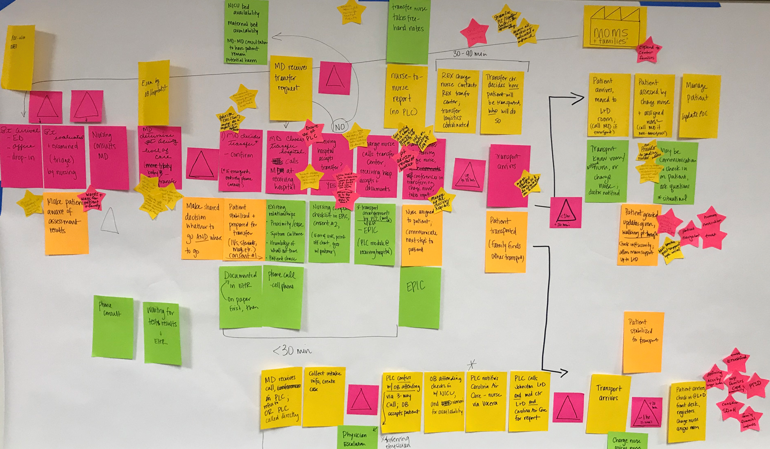
Collaborating to Improve Care
Participate in transfer review process
Co-designing patient education materials
Participating in Simulation Scenarios
Building Community
Notes:
What you see before you is a picture from one hospital system that I had opportunity to collaborate with after complete the LOCATe assessment. This hospital systems had several hospitals ranging from level 1 to level 4. The facilities met to review their transfer protocols and policies currently in place. They invited representatives from nursing, medical providers, emergency services and patient advisors. Having voices with lived experience at the table to co-design policies can help to identify strategies that produce effective, efficient and comprehensive workflows for process improvements.
Another recommendation that was presented from another group was the development of a NICU transfer guide. The guide provided useful tips for families that were transferred from outside facilities. Some of the tips were places to eat, where to park, visiting hours and what to expect during your stay. These helpful guides were available at the transferring hospital with information about the unit they were going to and directions for their loved ones. This was helpful because many times families were separated in the transfer process

Slide 8
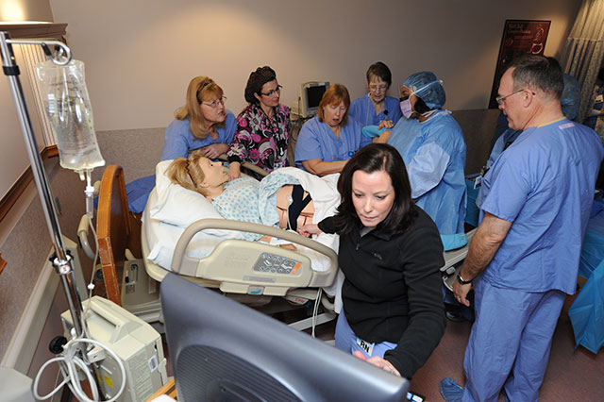
Simulations
Notes:
.
You can support and guide the transfer process by engaging in educating the healthcare team thru simulations. The LOCATe tool assess if certain drills and protocols take place. In some institutions, drills of the transfer process may take place. Collaborating with unit educators to serve in the role of the patient during the drill, allows you to share perceptions and patient experiences.
A simulation is a practice run thru for the intuition…….

Slide 9
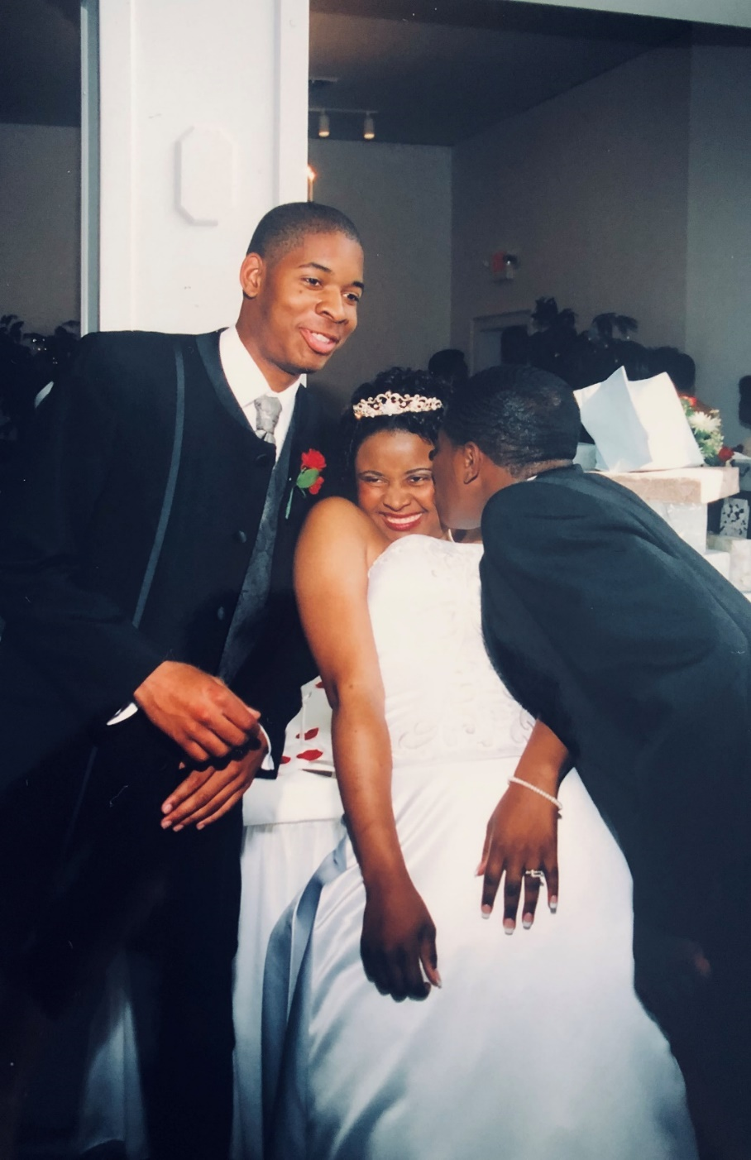
Building Community
Notes:
The last way that thing that I’d like for you to consider is how you can identify innovative and unique ways to help create and build community. The two little guys in this picture are my brothers. They are not this little any more but this picture reminds me of our time overseas. My mom gave birth to my youngest brother in Germany. He decided to make his grand entrances a several months early. I think that my mom went to the hospital in the middle of night or early one morning. The next day, I found myself with the ability to choose whatever I wanted to wear to school and a rather interesting hairstyle crafted by my dad. Afterschool, I was greeted by neighbors and friends. One gave me a new hairstyle, another entertained my brother and I for the night. We also had the opportunity to have dinner together. As children, we saw this as an opportunity to have fun with friends. But as I look back on that time as a mom, I realized how blessed my family has been. The ability to not worry as much about what is happening with other children or responsibilities is an amazing gift.
The birthing experience is different for everyone. So may not have a support system or community currently in place and may have additional needs.

Slide 10
It’s all about the connection and moving forward to the next step…

Slide 11
Reflection/ Evaluation
Awareness
You don’t have to be perfect.
Problem Solving Wheel
Action
Information / Gathering
Visioning/ Planning
Analysis
©dRworks

Slide 12
Methods to Engage Patients in QI
1. Interviews
2. Focus/ workgroups
3. Questionnaires/ Surveys
4. Townhall meetings/ Listening Session
5. Conferences/ Workshops
6. Co-Design on QI Teams
7. Patient/Family Advisory Councils

Slide 13
Strategies for Integrating Patient Partners on Committees/Projects
Step 1
Onboarding
Provide information to provide to Partners. (Time commitment, date, what to expect in meeting, etc.)
Step 2
Match Interests
Make every effort to match the interests of the Partners to the topic of the committee or project.
Step 3
Preparation
Connect the Partner with team liaison to provide more information on the meeting topic. Plan a 30 minute meeting for 1:1 time with Partners and allow time for questions.
Step 4
Follow Up
Follow up soon after the first encounter with a new team. Provide additional resources and answer questions. Did they have everything they needed to participate effectively?
Notes:
Make every effort to match interests
Provide additional Preparation
Identify low hanging fruit first
Send PFA teams of 2
If not possible, Point Person should be available to accompany to first meetings/encounters
Follow up soon after encounter
Additional resources needed
Increased understanding of concepts

