Slide 1

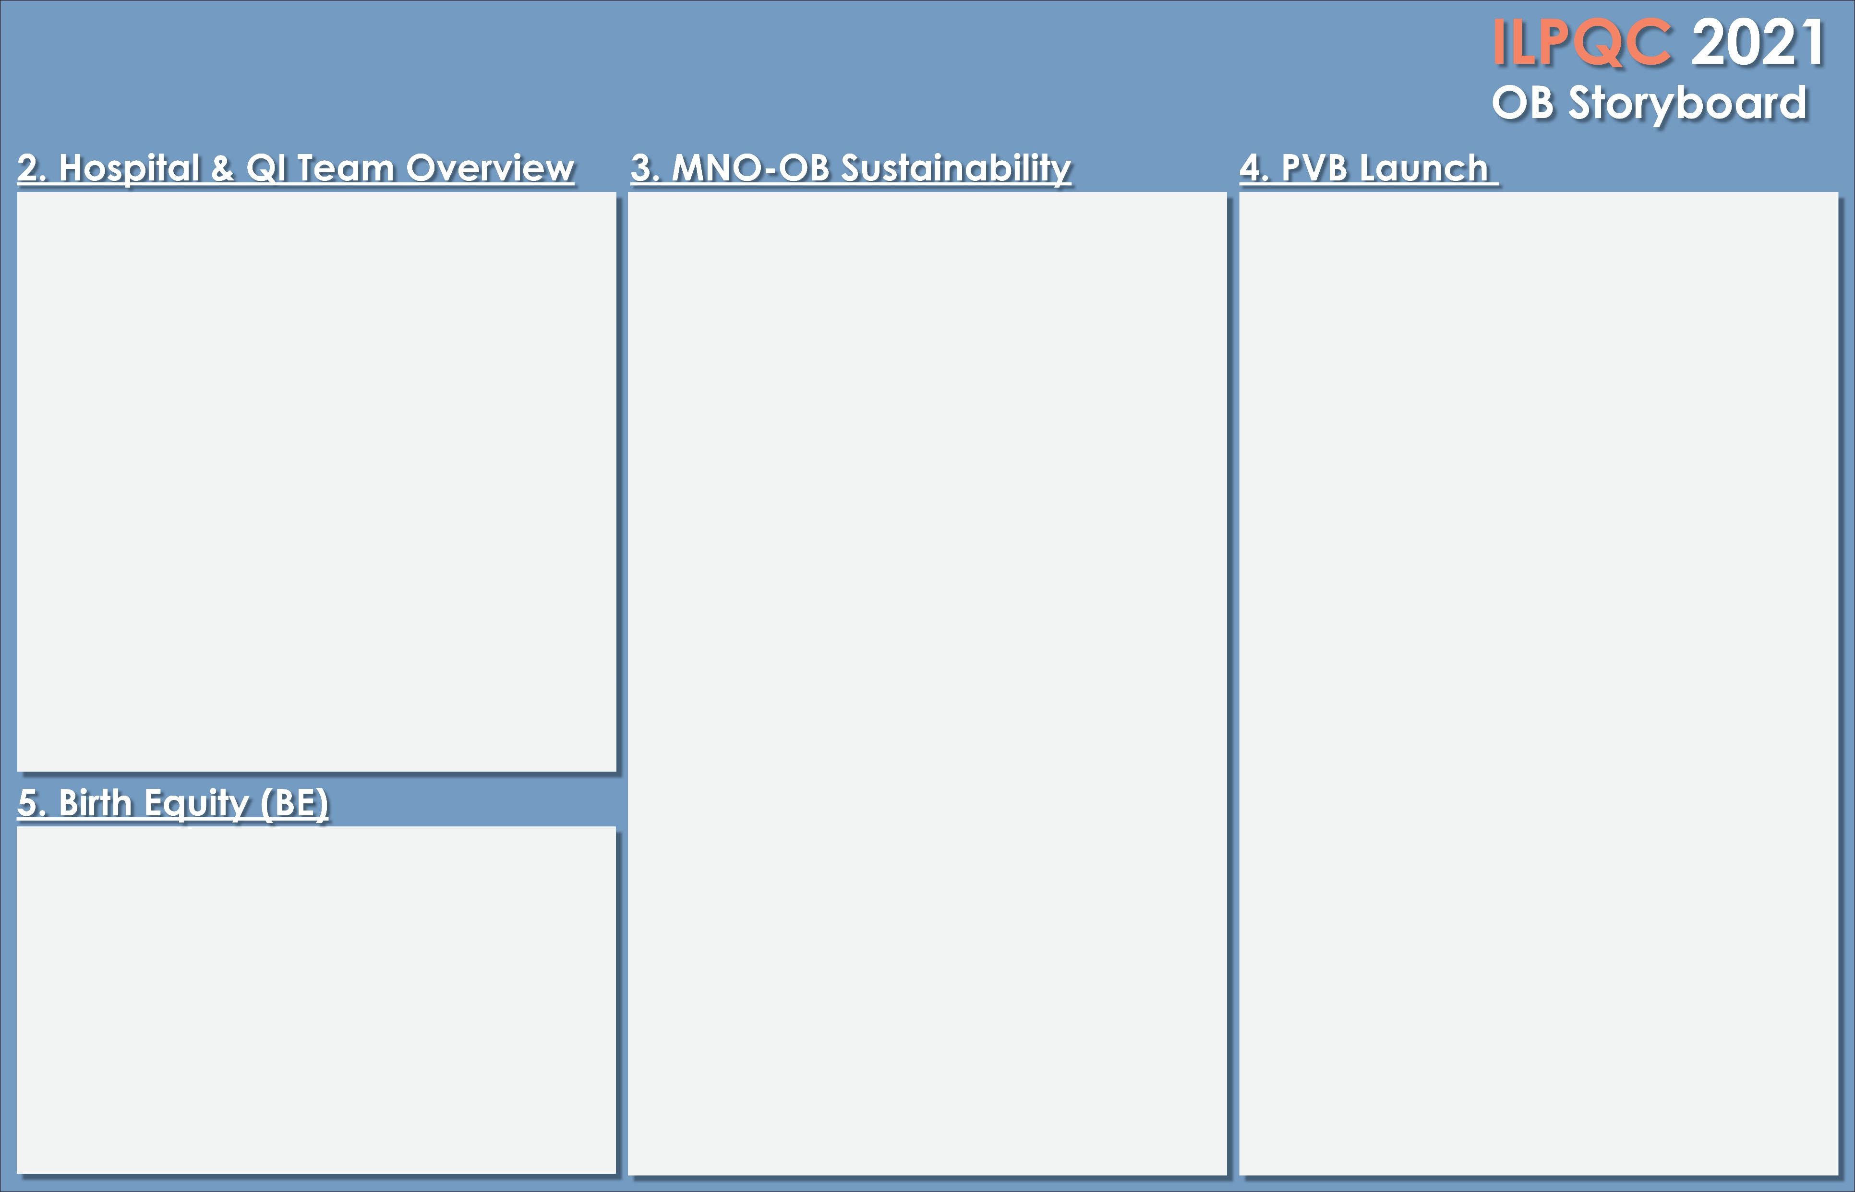
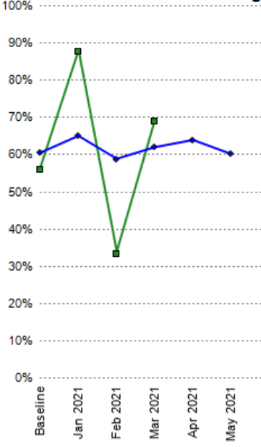

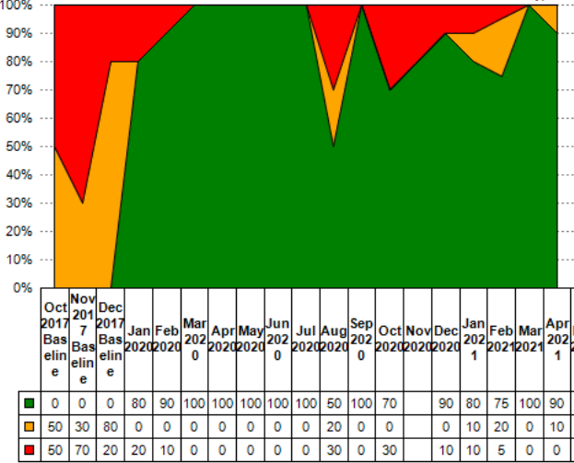
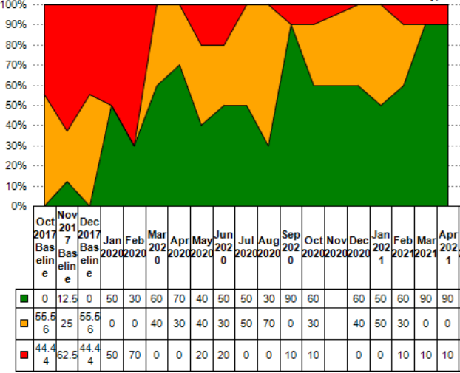
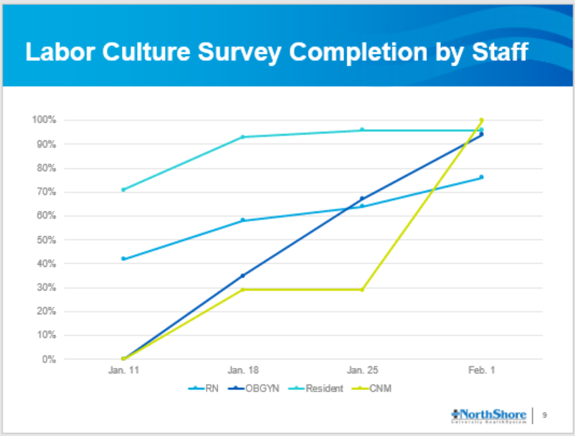
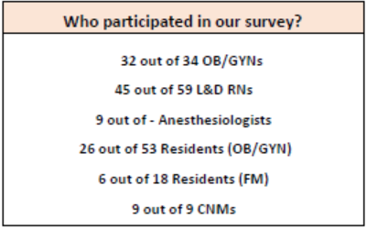
NorthShore University HealthSystem, Evanston Hospital
MNO-OB Team
PVB Team
Birth Equity Team
Total % of NTSV C/S that
meet ACOG/SMFM
guidelines is not consistent
or at goal.
We have our work cut
out for us!
Sustainability Plan
Monthly audit to check validated screening tool documentation (prenatally and on L&D)
When OUD case is identified, checklist is implemented in EMR and patient is added to a shared patient list in EMR
OB/Neo/Behavioral health teams actively monitor the list
L&D admission huddle when OUD patient arrives on L&D
Quarterly QI team meetings to review hospital data reports
Annual and new hire education of nurses and providers
Insure MNO folders are available outpatient an inpatient
Display SAVE A LIFE posters in L&D and post partum floors
Screening on L&D
Prenatal Screening
Consistent prenatal screening with
a validated screening tool continues
to be a challenge even though it has improved dramatically from the start of the initiative. We will continue to work on this until we have 100% compliance.
Physician Leads: Beth Plunkett, MD, MPH, David Ouyang, MD Nursing Lead: Jackie Mortillaro, RN Suzanne Guy, RN Peggy Healy, LCSW Marin Arnolds, MD Jennifer Balster, Lactation Counselor Janet Winslow, LCSW | Lydia Muhlbach, RN Melissa Raedle, RN Myra Sabini, RNC-OB, C-EFM Dan Weiss, MPH Amanda Abrams Amy Angarita- Rodriguez Kelly Jacobs, LCSW
30/60/90 day plan as of 4/16/21
Assess next steps based on Labor Culture Survey Results
Choose and Implement C/S checklist
Investigate Doula/Centering pregnancy options for
NorthShore
Physician Leads: Emmet Hirsch, MD, Beth Plunkett, MD, MPH, Mark Neerhof, DO Project Team Lead: Sara Polonsky, RN, MPH OB Nurse Champions: Blake Thoren, RN, Diana Campbell, RN Family Practice Champion: Emily White VanGomple, MD Community Member/Doula: Malik Turley | Midwife: Gaye Koconis, APN-CNM QI: Marci Adams Other Team Members: Janice Hopson,RN Suzanne Guy, RN, Cheryl Bauer, RN, Jennifer Kim, MD, Mariah Plawer, MD, Emma Clear, MD, Caroline McGowan, Nicole Tanna, Myra Sabini, Lauren Keenan-Devlin, Josie Nowak, RN
30
MNO-OB Data
60
Physician Leads: Barrett Robinson MD, Emily White VanGompel MD Nursing Lead: Janice Hopson RN Team Lead: Lauren Keenan-Devlin PHD Dana Merk RN (L&D Nurse) Stephanie Mills RN (Postpartum Clinical Coordinator) | Renne Stone RN (outpatient MFM Nurse) Janel Hughes-Jones (Breastfeeding Peer Counselor) Jane Turbov (Research) Kathy Kearns RN (Research) Britney Smart MPH (Research)
90
Our excellent response to the Labor Culture Survey was due to:
Getting clinical leadership buy-in
Using a variety of modalities to advertise and
Using ongoing data from survey completion to help us determine who still needed to be engaged
Our Birth Equity Team is focusing on:
increasing the diversity of experiences among our team members
scheduling initial meetings
reading shared materials
reviewing ILPQC toolkit
having honest conversations about the importance of this work
Strategies for improving Narcan counseling
Narcan prescription simplified in EMR
SAVE A LIFE Posters on L&D and post partum floors
Prescribing information available in MNO folders in outpatient offices, L&D and post partum floors

Slide 2
<Hospital Logo>
<Hospital Name>

