Slide 1
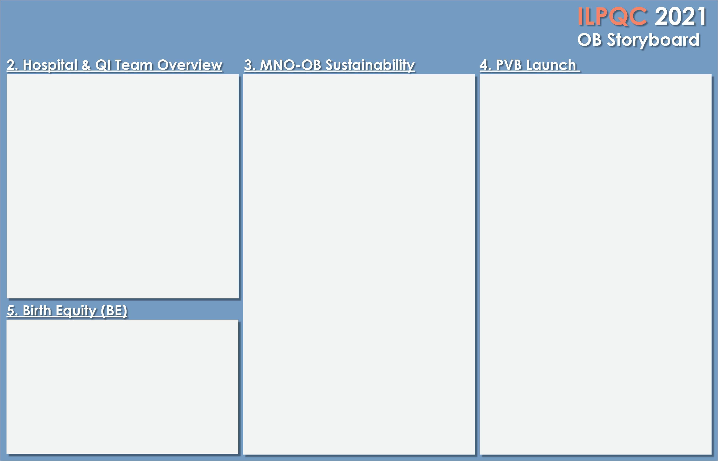

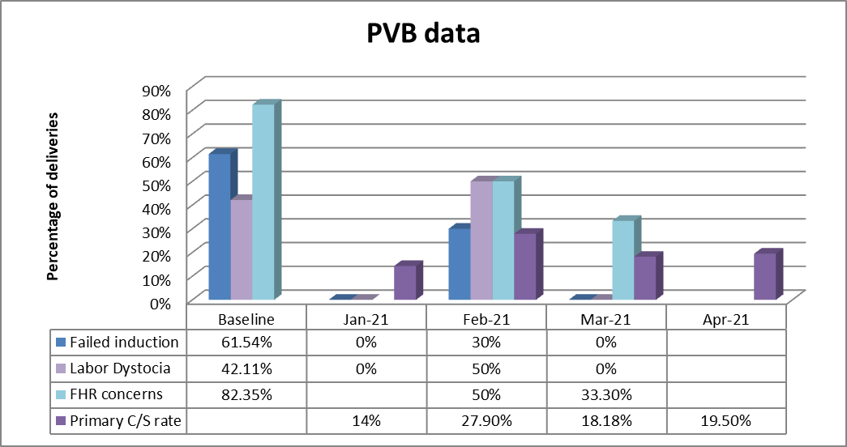
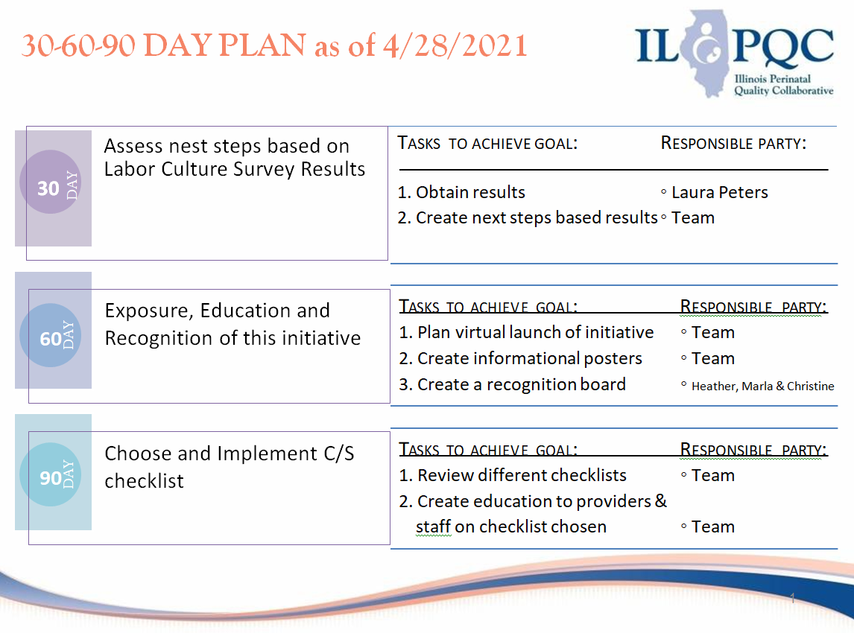
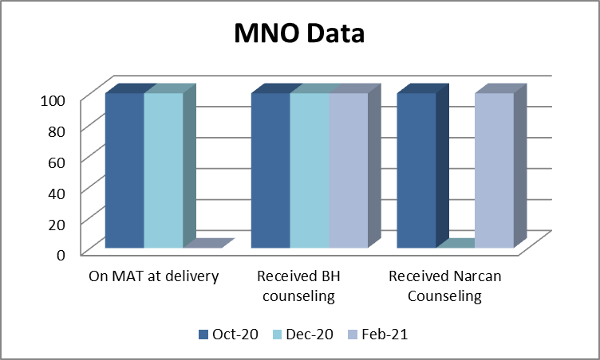
Northwest Community Healthcare
MNO-OB Team
Team Lead: Jaime Kelly, RN
OB Provider Lead: Dr. Markuly
Nurse Champion: Kathryn Beam, RN
Neo/Peds Rep: Dr. Fisher
Additional team members:
Addiction Specialist, Outpatient representative- Pediatric PT, Lactation consultant, Social Worker, Patient Safety Officer
PVB Team
Team Leads: Laura Peters, RN & Jaime Kelly, RN
Physician Lead: Dr. Henry Dominicis
QI representative: Elizabeth Schuett, CPHQ
Nurse Champions: Heather Alpert, RN, Marla Blatt, RN & Christine Vitzthum, RN
Sustainability Plan
NCH will continue tracking SUD/OUD screenings prenatally and on admission to L&D, MAT at delivery, linking patients to behavioral health/recovery treatment, Narcan counseling and providing a Narcan prescription, and Hepatitis C screening prior to delivery.
We will continue to educate new nurses/providers with the eModules and the Missed Opportunity Review form.
Data
30/60/90 day plans
MNO-OB Data
We are excited for the launch of Birth Equity. Our team will be formed after the ILPQC face to face when we receive more information regarding this initiative. NCH has already formed the Diversity, Equity and Inclusion Council to address equity concerns of its patients and community.
Strategies for improving Narcan counseling & prenatal screening.
Narcan education included in our new OUD order set will improve Narcan counseling.
New obstetrician are educated on the initiatives at NCH including MNO prenatal screening
Progress of labor culture survey
As of 5/4/2021:
50% of nurses have completed the survey
50% of providers have completed the survey
We were having difficulty with by-in for the survey due to confidentiality concerns. We created a new flyer and sent out a reminder email addressing those concerns. We hope to have more responses by the end of the survey.

Slide 2

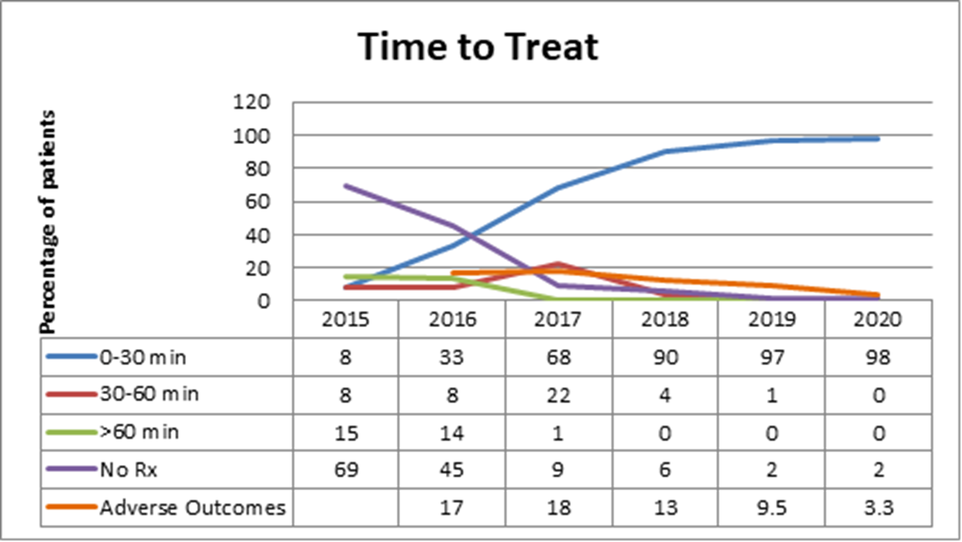
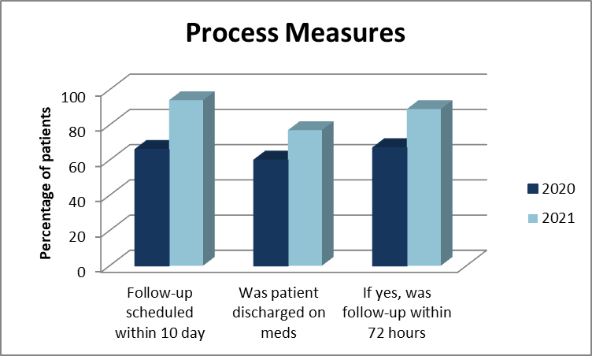
Northwest Community Healthcare
SEVERE HTN
In 2020 the Severe HTN team recognized a need to improve discharge follow up for patients given antihypertensives in the hospital and prescribed antihypertensives upon discharge. To remind providers to schedule the patient for a follow-up appointment, we created a Best Practice Advisory in our EMR. This reminds the provider the patient received or is on antihypertensive medication and needs a follow-up visit. From January 1, 2021 to April 19, 2021 our numbers have improved from the 2020 data.
Sustainability
We continue to track severe HTN data. Our adverse outcomes have drastically improved since the start of the initiative.

