Slide 1
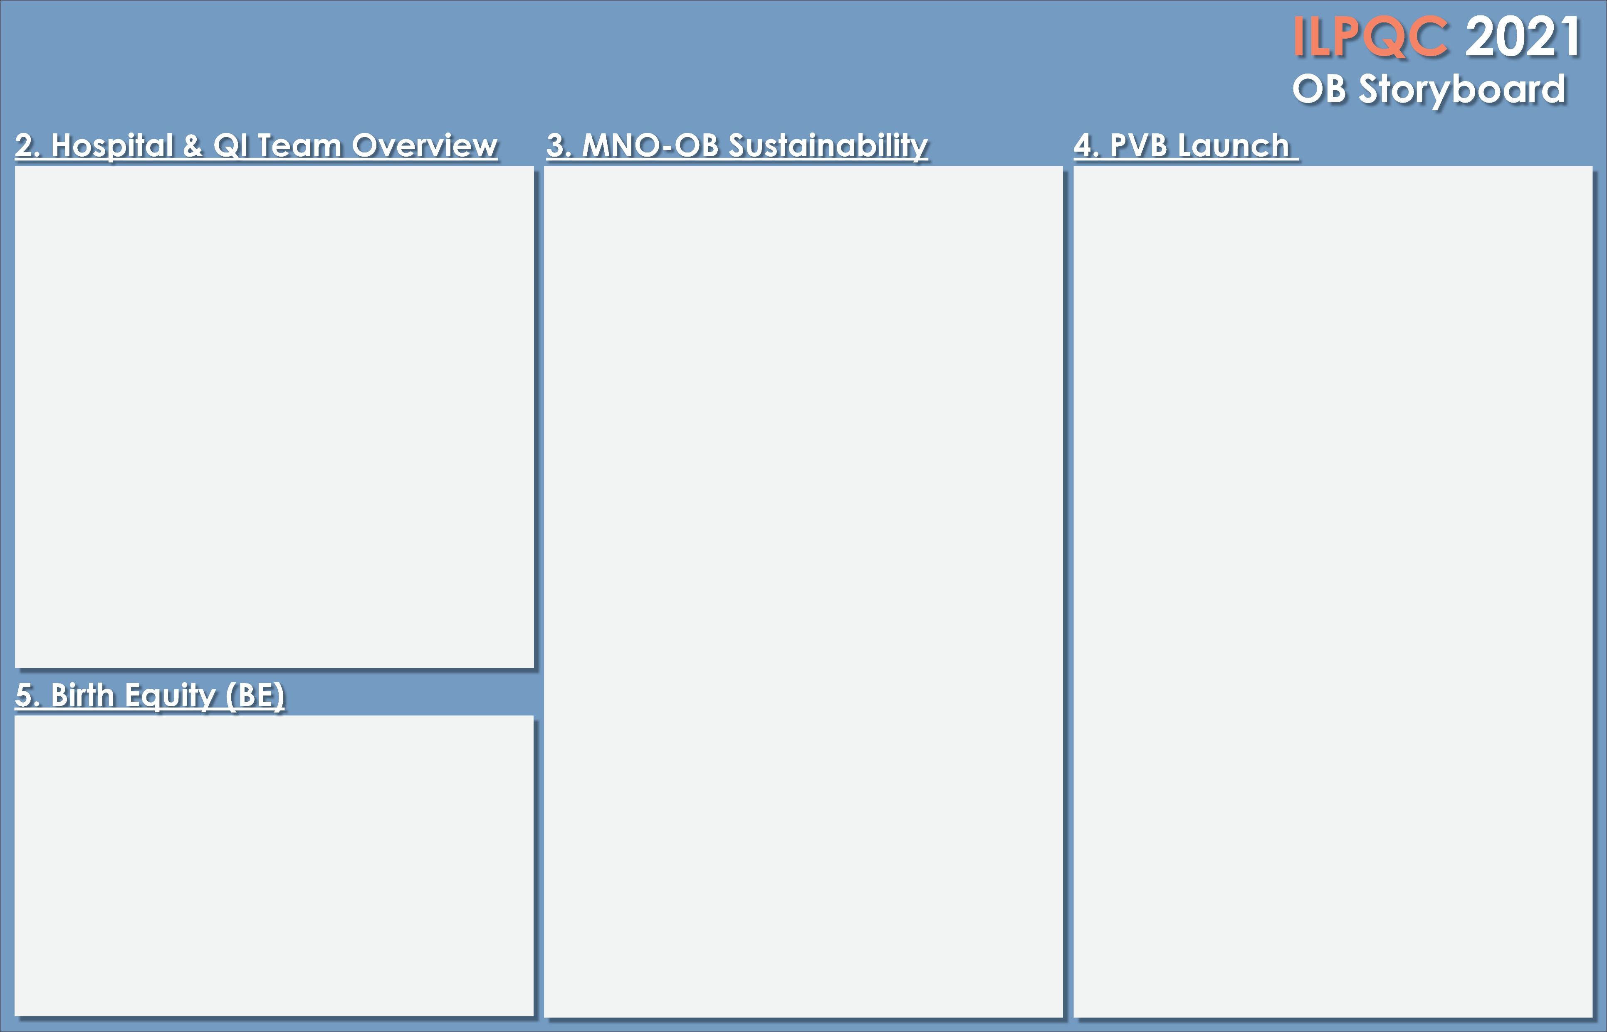


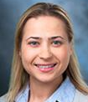

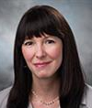
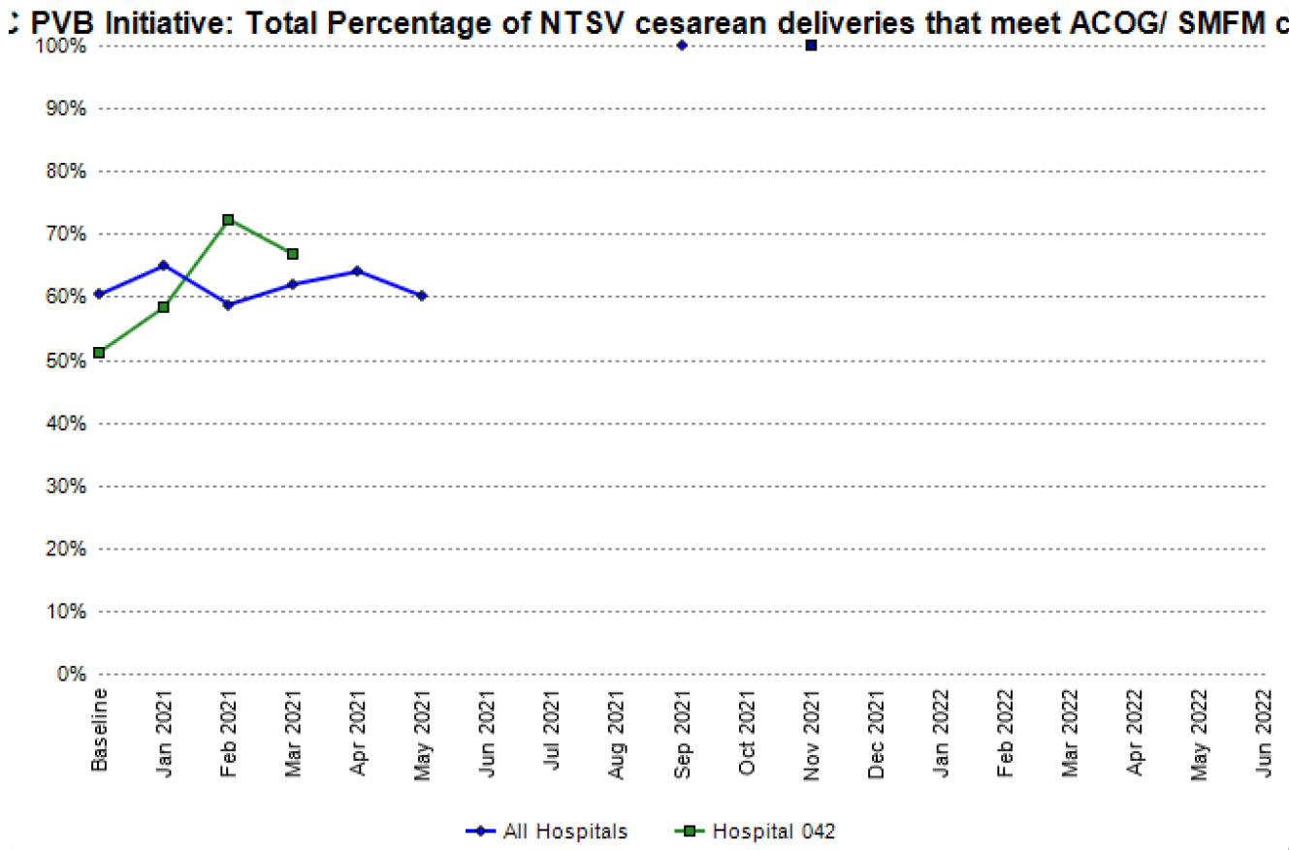
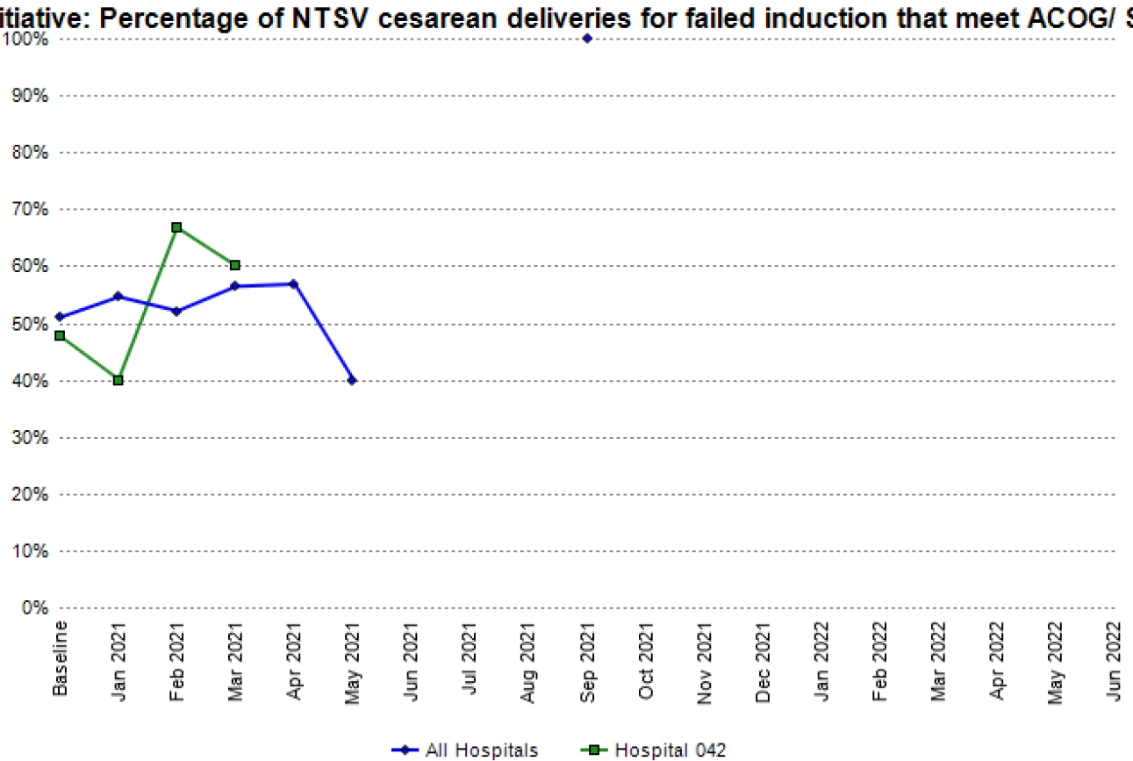
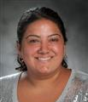

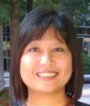
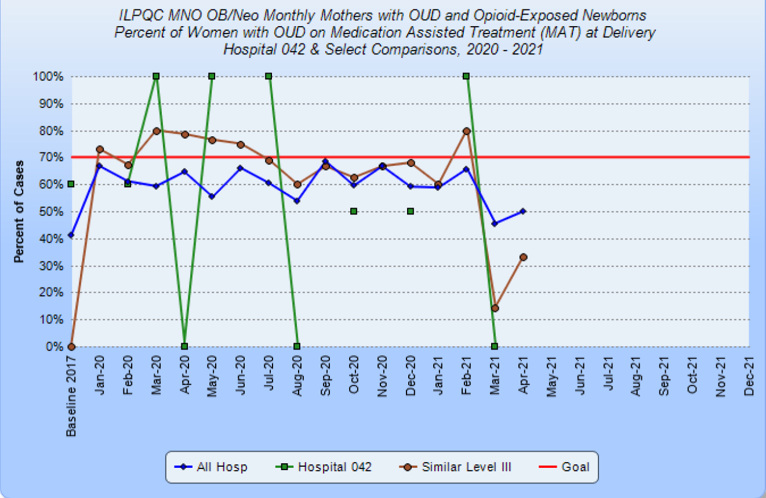
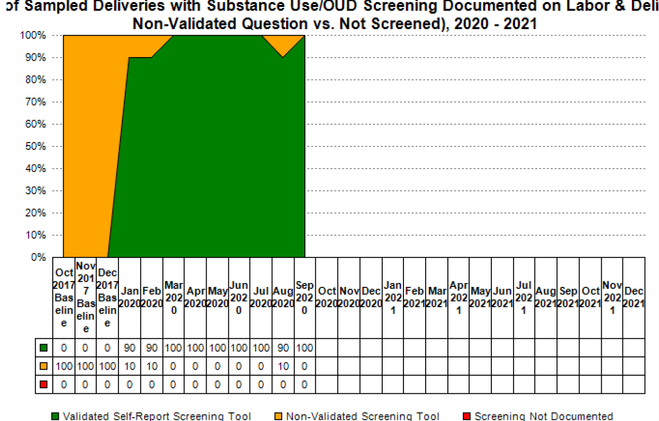
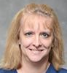

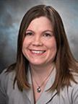

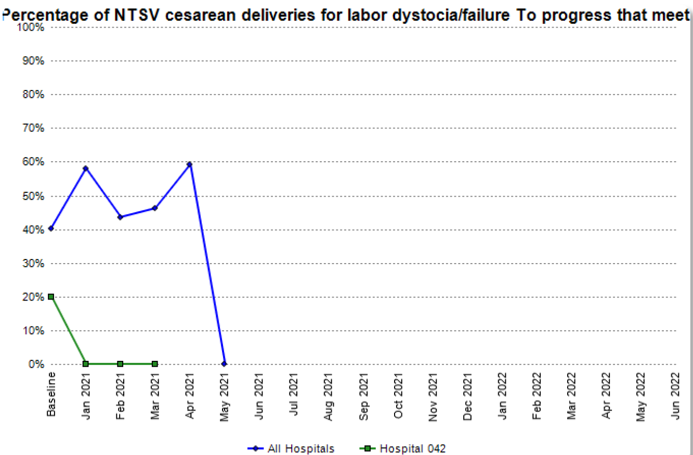
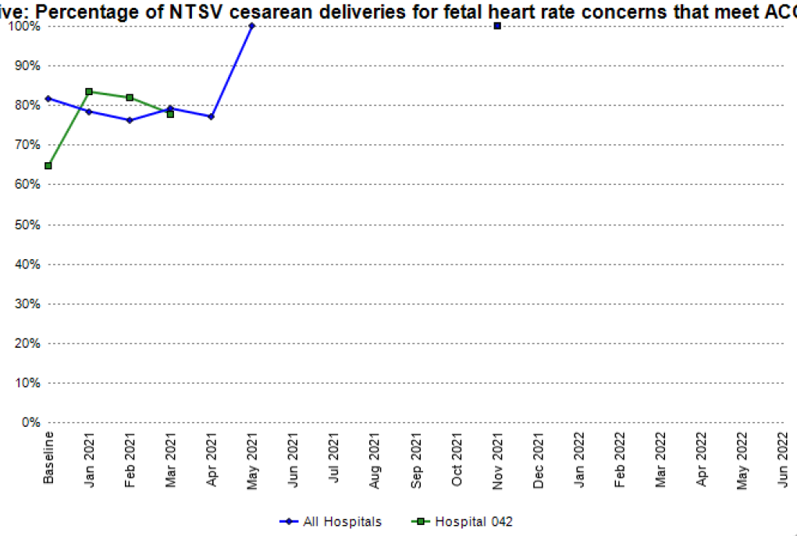
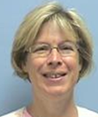
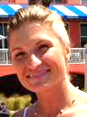
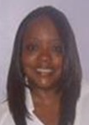

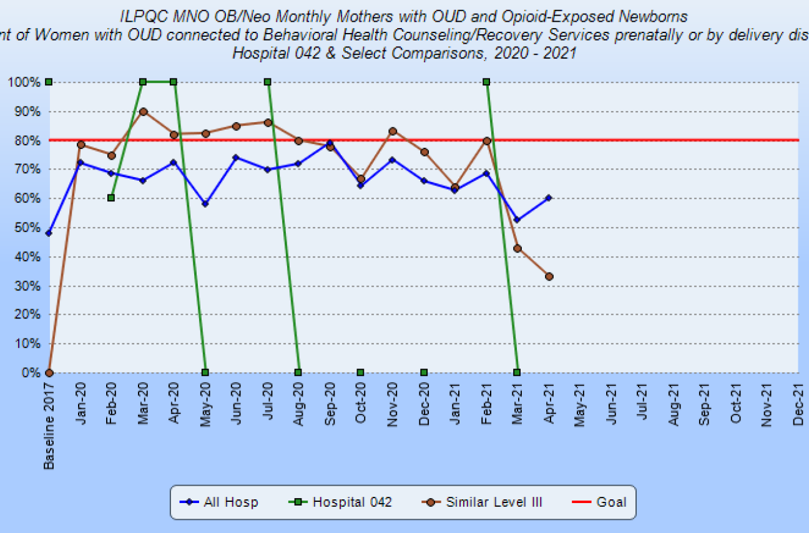
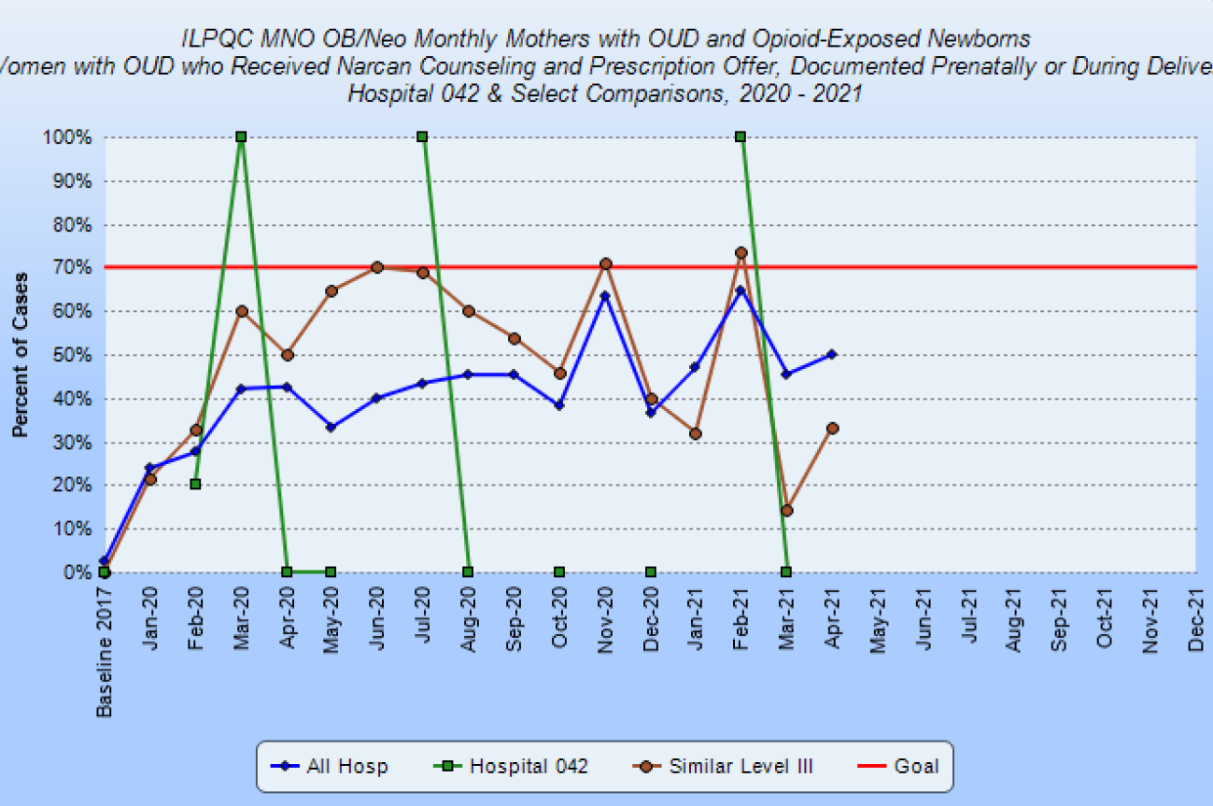



Advocate Christ Medical Center
MNO-OB Team
Sustainability Plan
SUD/OUD screenings documented
MAT by discharge
Linkage to BH counseling by discharge
Narcan counseling/prescription
Hep-C screening prenatally or by discharge
Baseline Data
Kim Kocur, RNC-OB, MSN, APN
Nurse Lead
Perinatal Outreach Coordinator
Alexandra Golobof, MD
Physician Lead for LARC
AMG OB Gyn
Therese Kirsch, MD
Physician Lead for MNO
AMG OB Gyn
Melissa Sheeran, RNC-MNN, MSN
Manager, Postpartum
Jennifer Doerr, MSN, RN, CPN, RNC-OB
Manager, Labor and Delivery
Laura Jester MSN, APN, ACNS-BC, RN-BC
Clinical Practice Specialist, Postpartum
Janet Finlon, MA, BSN, RN, NEA-BC
Director, Institutes Clinical Operations Women and Infants’ Services
Joseph Pavese, MD
Department Chairman
Tina Davis-Larkin, APN, MSN, RNC-OB
Clinical Practice Specialist
Labor and Delivery
Rusmea Rosie Salah, RNC
Assistant Clinical Manager
Labor and Delivery
Hazel Canavan, RNC
Assistant Clinical Manager
Labor and Delivery
Liz Roberson, RN
Postpartum
The data presented is current through March. We have not implemented any MD or nursing education up to this point. We expect improvement in all areas as the initiative progresses. Our initial focus will be on labor dystocia and failed induction as they are the areas that have the most opportunity for improvement. We plan to concentrate on one area at a time, beginning with labor dystocia.
MNO-OB Data
PVB Team
Valerie Swiatkowski MD
Physician Lead AMG OB Gyn
Kim Kocur, RNC-OB, MSN, APN
Project Team Lead
Perinatal Outreach Coordinator
Tina Davis-Larkin, APN, MSN, RNC-OB
Nurse Lead
CPS L&D
Jennifer Doerr, MSN, RN, CPN, RNC-OB
Manager, Labor and Delivery
Emily Welps RN
Team Member L&D
Barbara Lubovich, APRN
Certified Nurse Midwife Perinatology
Dawn Doran RN
Team Member L&D
Cathy Crivelone RN
Team Member L&D
Hazel Canavan, RNC
ACM L&D
Lindsay Brauneis RN
Team Member L&D
30/60/90 day plans
30-Day | 60-Day | 90-Day
Plan for culture survey Subcommittee created Poster created for L&D nursing skills day Labor positions QR code for labor Culture survey ACOG/SMFM Guidelines Participation in system wide committees for PVB: MD Education-V.Swiatkowski, MD Patient Education-K.Kocur, RN & Tina Davis Larkin, APN Education for committee on chart audits | Kick-off Presentation of data and education regarding purpose and plan for PVB initiative at OB MD meeting, including use of C-section checklist and huddle 5/3/2021 Individual NTSV rates sent to all MD’s and displayed with range within the department. Algorithm regarding decision tree for proceeding to C-section for labor dystocia, failed induction and FHR issues sent to all OB MD’s Initiation of C-section checklist-customized for Christ Medical Center 5/10/2021 Signage, e-mails, and verbal reminders to complete culture survey Development of class content on methods/positioning to promote vaginal birth for L&D RN’s | Development of further education on ACOG and SMFM guidelines for MD’s Implementation of educational content for RN’s in L&D Continued analysis of PVB targeting specific issues to focus education Working with system on revising induction policy and development of intermittent auscultation policy
BE Goals:
Perform baseline equity needs assessment to identify areas of change and improvement.
Educate health care providers about inequities in maternal and infant outcomes.
Strategies for improving Narcan counseling & prenatal screening.
Engage OB providers to screen all patients at prenatal visits
Ensure all MNO patients have consult to BH specialist
MNO patients reviewed at staff huddles every shift to assure protocol adherence including Narcan counseling
Currently recruiting a provider champion

